Slide 1
Best Practices for Treating Nicotine Use in Populations Dually Diagnosed with Nicotine Use Disorder & One or More Psychotic Disorders with an Emphasis on Schizophrenia
Laura Culpepper & Darby Leinbach

Slide 2
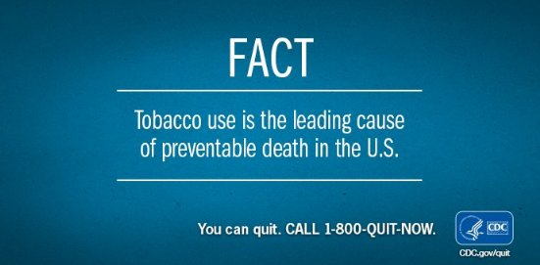
Importance of Addressing Nicotine Use of Individuals Diagnosed with Schizophrenia
Extremely prevalent amongst this population
Increased risk of tobacco-related morbidity = major contributor to health inequities
2 - 3x increased mortality rate compared to general population
10-20-year reduction in average lifespan
https://twitter.com/cdctobaccofree/status/950450666086060032?lang=ga
Quigley & MacCabe (2019), Heiberg et al. (2018), CDC (2021)
Notes:
Script:
Addressing nicotine use with individuals who are diagnosed with schizophrenia is crucial. Behavioral healthcare providers should care about this issue for the following reasons: Firstly, nicotine use is extremely prevalent amongst individuals diagnosed with schizophrenia. Evidence reveals that these individuals are at an increased risk of tobacco-related morbidity, which is a major contributor to health inequities. According to Heiberg et al. (2018), individuals diagnosed with schizophrenia have a 2-3x increased mortality rate compared to the general population, and a 10-20 year reduction in average lifespan. Therefore, these individuals are particularly vulnerable to adverse health outcomes caused by nicotine use. The CDC notes that amongst the entire U.S. population, tobacco use is the leading cause of preventable disease, disability, and death.
References:
Heiberg, I. H., Jacobsen, B. K., Nesvag, R., Bramness, J. G., Reichborn-Kjennerud, T., Naess, O., Ystrom, E., Hultman, C. M., & Hoye, A. (2018). Total and cause-specific standardized mortality ratios in patients with schizophrenia and/or substance use disorder. PLoS ONE, 13(8), 1-17, https://doi.org/10.1371/journal.pone.0202028
Quigley, H. & MacCabe, J. H. (2019). The relationship between nicotine and psychosis. Therapeutic Advances in Psychopharmacology, 9, 1-12. https://doi.org/10.1177/2045125319859969

Slide 3
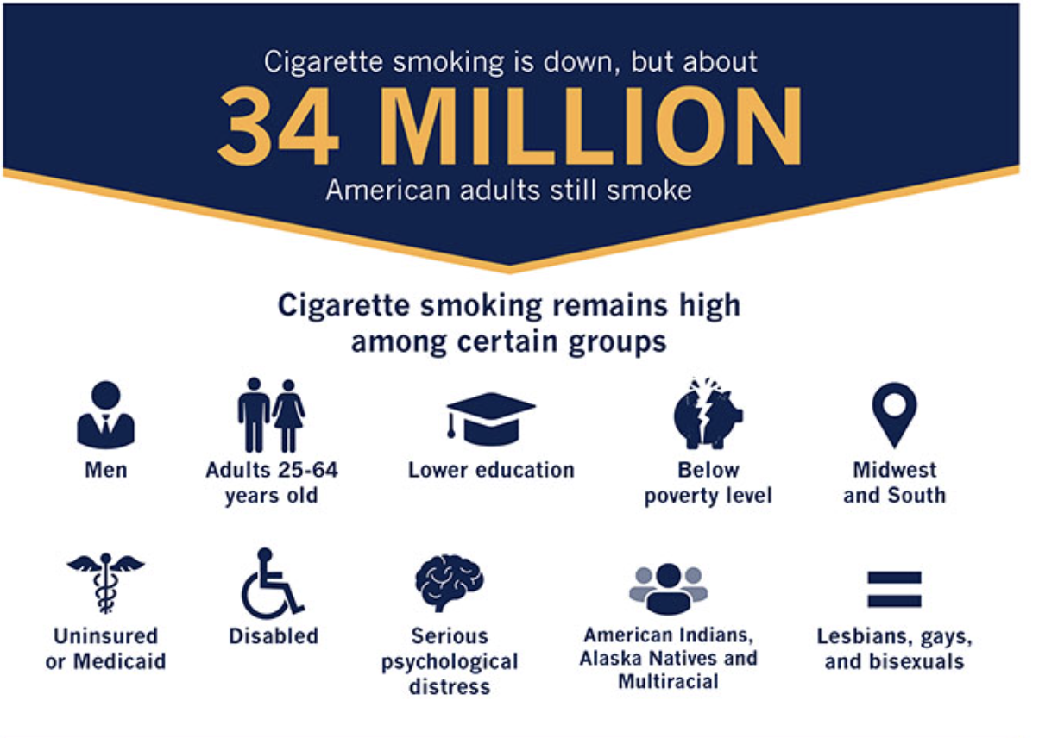
Prevalence
2-3x higher for those diagnosed with SPMI
Up to 75% of people with SPMI smoke
*SPMI = severe persistent mental illness
https://www.cdc.gov/tobacco/infographics/adult/index.htm
Quigley & MacCabe (2019), Pratt et al. (2016)
Notes:
Script:
Cigarette smoking is highly prevalent amongst individuals diagnosed with severe persistent mental illness, SPMI for short. Further, cigarette smoking is particularly prevalent amongst individuals diagnosed with schizophrenia. According to Quigley & MacCabe (2019), Cigarette smoking rates are 2-3 x higher for those diagnosed with SPMI. Further, individuals diagnosed with SPMI who smoke cigarettes are more likely to display patterns of heavy smoking, severe nicotine dependence, and are less likely to quit. Pratt et al. (2016) note that up to 75% of people with SPMI smoke, and most are highly dependent on nicotine and consume more cigarettes per day than smokers without SPMI. The authors also note that although rates of smoking in the general population have steadily declined over the past several decades, rates of smoking have remained high for people with SPMI. The infographic on this slide is from the CDC’s 2021 tobacco use fact sheet, and reflects the most current prevalence of cigarette smoking in the United States. The graphic further breaks down prevalence by age, gender, race/ethnicity, sexual orientation, and other considerations.
Citations:
Quigley, H. & MacCabe, J. H. (2019). The relationship between nicotine and psychosis. Therapeutic Advances in Psychopharmacology, 9, 1-12. https://doi.org/10.1177/2045125319859969
Pratt, S. L., Sargent, J., Daniels, L., Santos, M. M., & Brunette, M. (2016). Appeal of electronic cigarettes in smokers with serious mental illness. Addictive Behaviors, 59, 30-34, http://dx.doi.org/10.1016/j.addbeh.2016.03.009
Centers for Disease Control and Prevention. (2021). Adult Tobacco Use Infographics [Infographic]. CDC.gov. https://www.cdc.gov/tobacco/infographics/adult/index.htm

Slide 4
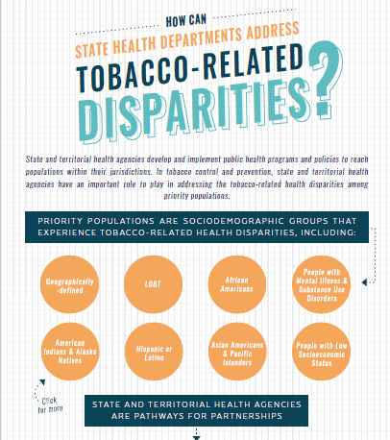
Disparities
Smoking is highest amongst adults who are uninsured or insured by Medicaid, lowest amongst those with private insurance
Higher risk of tobacco-related morbidity & excess mortality for SPMI population = major contributor to health inequities
Tobacco industry targeted SPMI population:
product promotions & giveaways at psychiatric facilities
supporting misconceptions about tobacco & its positive impact on mental health
https://www.bhthechange.org/resources/can-state-health-departments-address-tobacco-related-disparities/
Notes:
Script:
When nicotine use is broken down by race/ethnicity, class, SES, gender, and other factors, many disparities become apparent. Some of these disparities include worse health outcomes, inadequate access to treatment and resources that promote better health outcomes, potentially less access to harm reduction resources (vapes, medication, patches). According to the CDC, cigarette smoking is highest amongst uninsured adults & adults insured by Medicaid, and lowest amongst adults with private insurance. This is concerning as it reflects that the population with the highest risk for nicotine/tobacco related health concerns is least likely to be able to access quality healthcare services. In fact, according to Quigley & MacCabe (2019), those with SMI have increased risk of tobacco-related morbidity & excess mortality, which is a major contributor to health inequities. Further, the authors note that, historically the tobacco industry has targeted this population by targeting psychiatric facilities with product promotions & giveaways in the 1980’s & 1990’s as well as supporting misconceptions about tobacco and its positive impact on mental health.
Quigley & MacCabe (2019)
CDC - Centers for Disease Control and Prevention. (2021). Adult Tobacco Use Infographics [Infographic]. CDC.gov. https://www.cdc.gov/tobacco/infographics/adult/index.htm
https://www.bhthechange.org/resources/can-state-health-departments-address-tobacco-related-disparities/

Slide 5
Complications
Schizophrenia - 2 - 3x increased mortality rate compared to general population & 10-20-year reduction in average lifespan
U.S. spends $225 billion per year to treat smoking related diseases
Smoking can cause damage to the entire body
Cancers, chronic diseases (e.g. heart disease), strokes
Nicotine withdrawal symptoms may interact with & compound symptoms of SPMI
Irritability, anger, depressed mood, anxiety
difficulty concentrating, insomnia, increased appetite/weight gain
Notes:
Script:
The excess mortality in patients with severe mental illness (SMI) has been ascribed to several factors at the individual, health system, and societal level. These factors include lifestyle factors (smoking, substance use, physical inactivity, poor diet), poorer SES conditions, sub-optimal use of or access to medical care, metabolic side effects of high dosages of antipsychotic medication, higher levels of suicides, poisoning, violent behavior, and victimization. The CDC estimates that each year the United States spends around $225 billion to treat smoking related diseases. Smoking has been associated with many adverse health effects, and can cause damage to the entire body, cancers, chronic diseases such as heart disease, and strokes. Smoking can cause damage to the entire body, including cancers and many chronic diseases, such as heart disease, strokes. Withdrawal from Nicotine causes following symptoms, which may interact with and compound the effects of serious mental health conditions such as psychosis, major depression, and schizophrenia- irritability/ frustration /anger, Anxiety, difficulty concentrating, restlessness/impatience. depressed mood, insomnia, impaired performance, increased appetite/weight gain, and cravings & urges to use (Ruebush, 2019).
CDC - https://www.cdc.gov/chronicdisease/resources/publications/factsheets/tobacco.htm
Ruebush, E. (2019, October). Tobacco use & treatment. [PowerPoint]. UNC-Chapel Hill PrimeCare Sakai site.

Slide 6
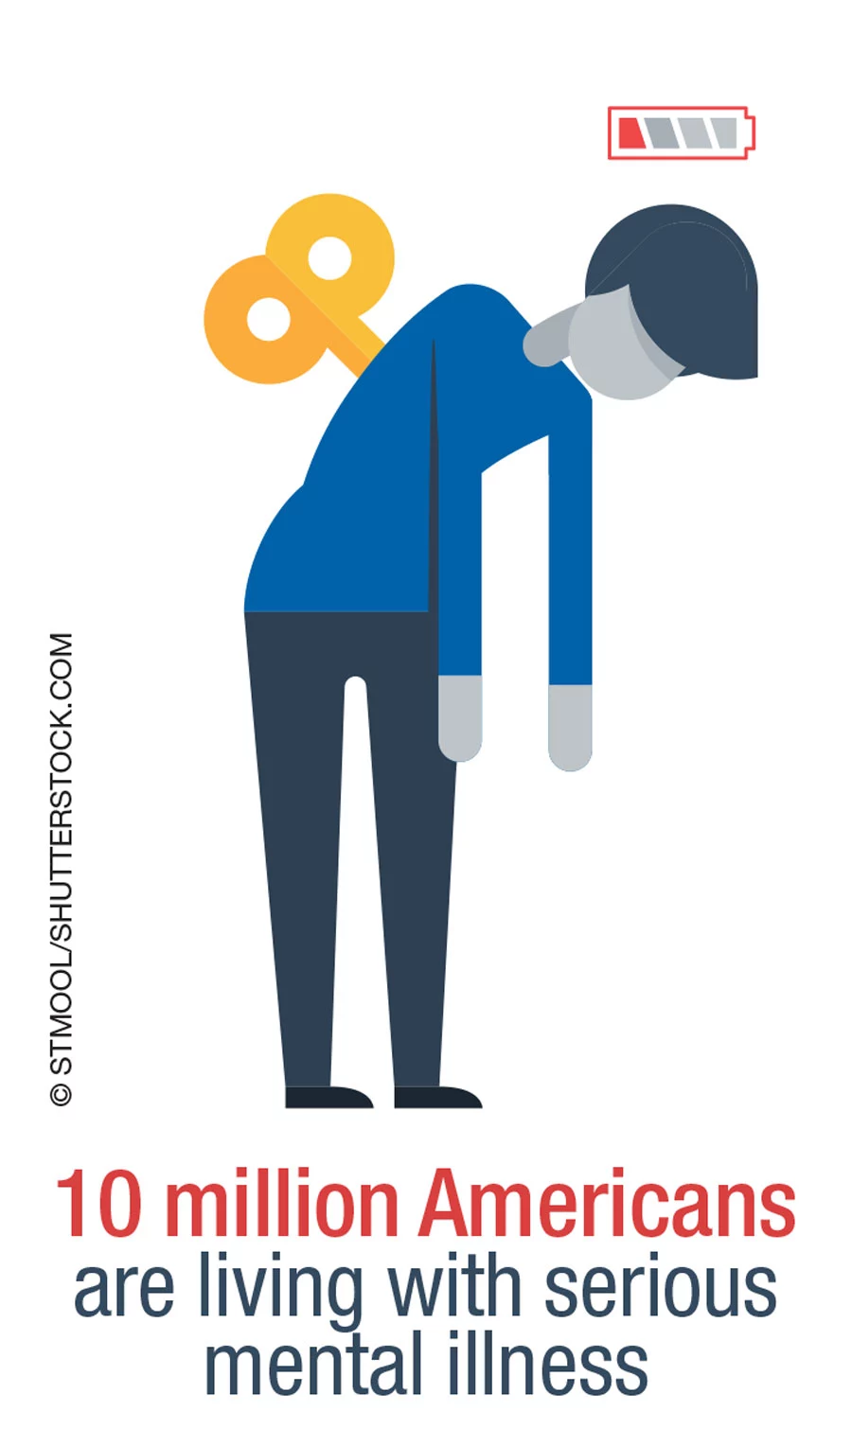
Special Considerations
Nicotine Use & Serious Mental Illness
People diagnosed with schizophrenia & bipolar disorder are more likely to start smoking & less likely to permanently quit
E-cigarettes may reduce overall toxin exposure for those who do not wish to quit
Nicotine use may exacerbate certain psychotic symptoms & interfere with medication & follow-up adherence
Stewart et al. (2010), Pratt et al. (2016)
https://www.psychiatrictimes.com/view/federal-government-ignores-treatment-needs-americans-serious-mental-illness
Notes:
Script:
According to Pratt et al. (2016), people diagnosed with schizophrenia and bipolar disorder are more likely to start smoking and less likely to permanently quit. For those who are unable or do not wish to quit using nicotine via smoking, using E-cigarettes may help reduce overall toxin exposure. The authors also note that e-cigarettes may be appealing for smokers with serious mental illness, as evidenced by high self-report ratings of satisfaction amongst study participants with serious mental illness. Additionally, most of the participants significantly reduced the number of cigarettes they smoked when given access to e-cigarettes. Qualitative data from the study suggested participants liked E-cigarettes because they represent a healthier, cleaner alternative to combustible cigarettes. Stewart et al. (2010) highlights the importance of health risks of certain types of e-cigarettes and vapes, noting that some vapes may contain volatile organic compounds, nicotine, ultrafine particles, cancer-causing chemicals, heavy metals (nickel, tin, lead), flavoring with a chemical linked to serious lung disease, lung injury and burns, & E-liquid poisoning.
References:
Stewart et al. (2010)
Pratt et al. (2016)

Slide 7
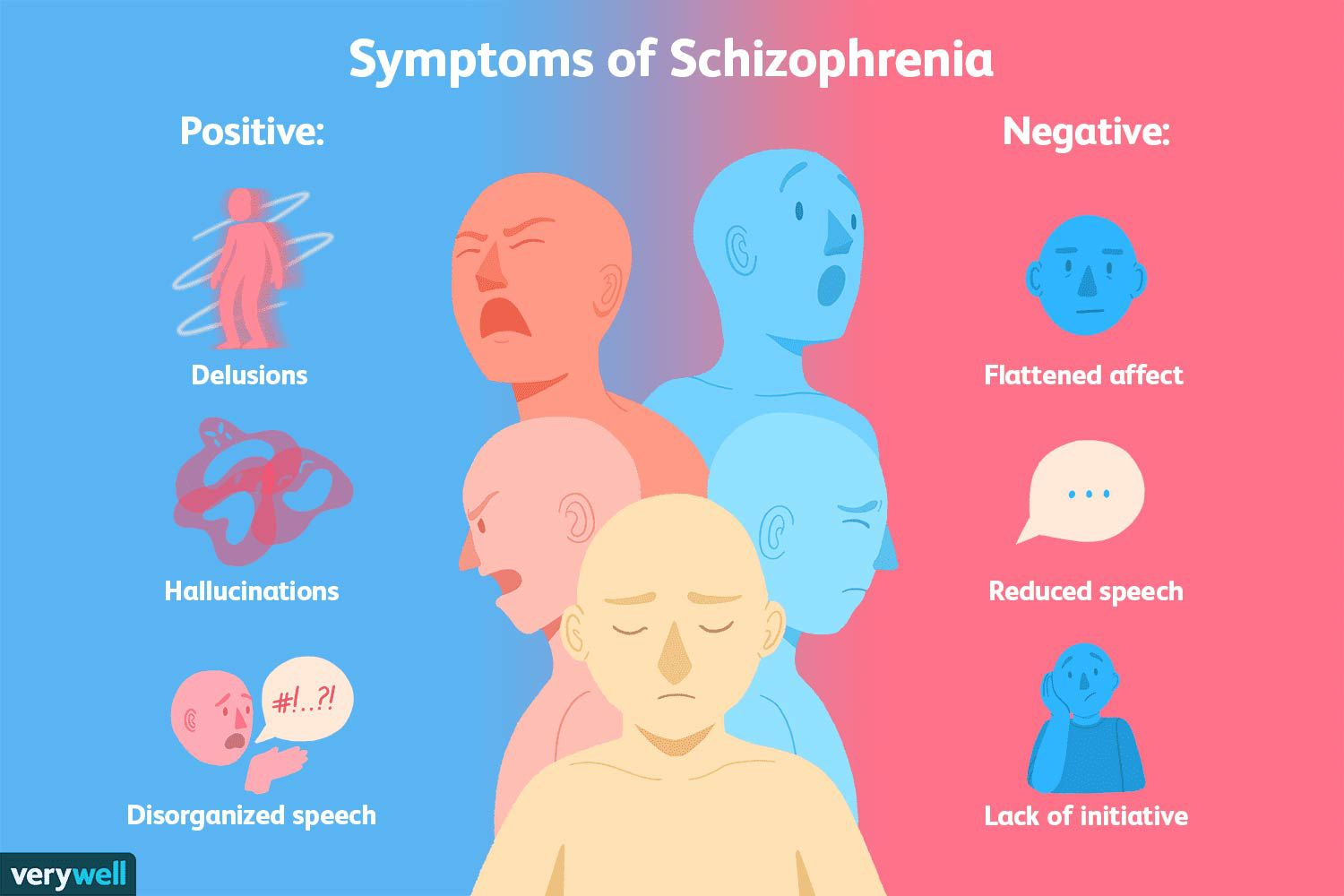
Special Considerations
Nicotine’s Impact on Schizophrenia Symptoms
Negative symptoms of schizophrenia are associated with reduced dopaminergic neurotransmission. Acute administration of nicotine can increase dopaminergic neurotransmission, improving negative symptoms in the short term
Startle response
https://www.verywellmind.com/what-are-the-symptoms-of-schizophrenia-2953120
Sabe et al. (2020)
Notes:
Script:
Sabe et al. (2020) state that negative symptoms of schizophrenia are associated with reduced dopaminergic neurotransmission in the mesolimbic and mesocortical systems. Negative symptoms of schizophrenia include blunted affect, alogia (or “poverty of speech”), asociality, and avolition, meaning a lack of motivation. For those with reduced dopaminergic neurotransmission, the acute administration of nicotine can increase dopaminergic neurotransmission and could thus improve negative symptoms in the short term. Additionally, some studies have found that nicotine use can dull the heightened startle response that those with schizophrenia experience. The encyclopedia Britannica defines startle response as extremely rapid psychophysiological response of an organism to a sudden and unexpected stimulus such as a loud sound or a blinding flash of light. In the general population, startle response will decrease over time and exposure to repeated stimuli. For those diagnosed with schizophrenia, this startle response does not diminish over time or repeated exposure, leading to increased stress and other negative outcomes. Some studies have found that nicotine use can dull startle responses for folks with schizophrenia, which may explain why nicotine use is appealing for this population, especially those who are frequently in situations in which their startle response is activated.
References:
Image source: https://www.verywellmind.com/what-are-the-symptoms-of-schizophrenia-2953120
Encyclopedia Britannica (2019), Startle reaction. Encyclopedia Britannica. https://www.britannica.com/science/startle-reaction

Slide 8
Cultural Considerations
Determine if nicotine use is part of clients culture/cultural practice.
If so, how connected are they to those cultural practices?
Culture should be considered in treatment planning, goal setting, & selecting EBP’s to use with client
Examples:
Cultures that smoke hookah/shisha
Native American/First Nation pipe smoking & ceremonial use
Service Industry, Incarceration, Drinking/Party Culture, Psychiatric Facilities
https://vosh.org/cultural-competence/
Ruebush et al. (2019)
Notes:
Script:
When working with clients who experience psychosis and use nicotine, it is very important to consider the client’s culture in all aspects of engagement, assessment, treatment, and referral. If a client discloses that they use nicotine, it is important to determine if nicotine use is part of their culture/cultural practices, and if so, how connected is their nicotine use to those cultural practices? For example, in middle eastern cultures it is common to smoke hookah and shisha, which involves heating up and smoking flavored tobacco. Smoking hookah has a much higher concentration of nicotine for one smoking session compared to smoking one cigarette. Another culture that incorporates nicotine into their cultural practice is Native American/Indigenous/First Nation Peoples, who frequently engage in tobacco pipe smoking and ceremonial use of nicotine. Finally, there are many subcultures in the United States that have high rates of smoking. These cultures include, but are not limited to: working in the food service industry, prison/jail culture, and psychiatric facilities/hospitals. Additionally, drinking/party culture can be associated with nicotine use, for example, many people say they only smoke when they drink, or only when drinking and at a bar. Culture should always be considered in treatment planning, goal setting, and selection of evidence-based-practices to use with a client. Ruebush et al. (2019)

Slide 9
Pandemic Related Concerns and Telehealth
Pandemic (Kopelovich et al., 2020)
Health
Withdrawal symptoms
Harm reduction
Emotion regulation & distress tolerance
Natural supports
Telehealth (American Professional Agency, 2020)
Privacy
Confidentiality
Safety
Informed consent
https://rightpathpainandspine.com/what-is-the-difference-between-telehealth-and-telemedicine/
Notes:
Script:
The COVID-19 pandemic has impacted many aspects of life and should be taken into consideration regarding nicotine use disorder treatment for those with schizophrenia. It is important to be aware of how substance use might impact clients’ health and might increase their vulnerability to COVID-19. Monitor for signs of withdrawal symptoms if there is a change in clients’ access to substances or interruptions in pharmacological treatment for mental health or nicotine use disorder, including nicotine replacement therapy. Care should be taken to engage in harm reduction strategies such as being in more frequent contact, assisting clients in understanding and accessing community resources, and providing psychoeducation about safer substance use. Teaching emotion regulation and distress tolerance skills can help clients through the uncertainty and changes the pandemic has brought. Encouraging clients to connect with natural supports can help increase clients’ quality of life and aid them in their recovery journey during the pandemic and its aftermath. There are several telehealth principals that should be considered to uphold client care. Observe HIPAA regulations and ensure both the client and clinician can access spaces where therapeutic work can be done over telehealth without outside interruptions. Maintain client confidentiality and the secure transfer of information when applicable concerning telehealth work. Ensure client safety by assessing if telehealth is a good fit for each client and have emergency plans in place should a client experience a behavioral or physical emergency during or between sessions. Provide clients information about telehealth delivery and obtain informed consent before initiating telehealth services.

Slide 10
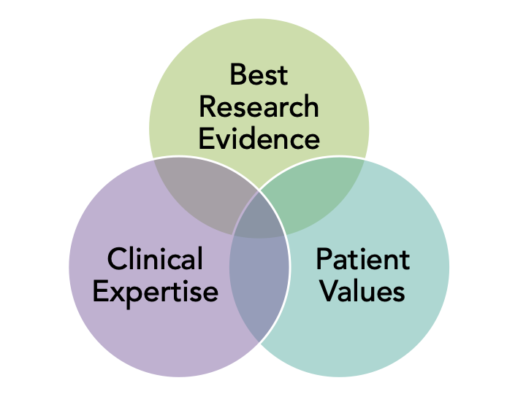
Evidence-based Practices (EBPs)
Harm reduction (Das & Prochaska, 2017)
E-cigarettes/vaporized nicotine products (VNPs)
Considerations for VNPs (Lum et al., 2022)
Very low nicotine content cigarettes
Combined Nicotine Replacement Therapy (NRT) & Pharmacotherapy
Transdermal nicotine patch (TNP), nicotine inhaler, gum, nasal spray, lozenges (Mackowick et al., 2012)
Bupropion & varenicline (Manseau & Bogenschutz, 2016)
Maintenance varenicline (Cather et al., 2017)
https://library.tulsa.ou.edu/ebp
Notes:
Script:
The goal of harm reduction is to decrease the harm caused by substance use to the person using rather than taking an abstinence-only approach which would require the person using substances to abstain from substance use entirely. Harm reduction regarding nicotine is an especially important approach with this population because the prevalence of tobacco use among those with schizophrenia is much higher than those without the diagnosis (Das Prochaska et al, 2017). Studies have concluded that it is safe to continue using cigarettes while utilizing nicotine replacement therapies; the introduction of nicotine replacement therapies with concurrent cigarette use encourages decreased cigarette use over time (Fagerström & Hughes, 2002). Nicotine replacement therapy has been shown to be effective with this population, especially when combined with medications such as bupropion and varenicline (Manseau & Bogenschutz, 2016). Many forms of nicotine replacement products are available, and the type of product used can be tailored to the individual’s preference and to mitigate possible side effects, if any, of a particular nicotine replacement product with an individual’s biology. Maintenance therapy of at least twelve weeks of varenicline after an initial twelve-week course of varenicline reduced return to tobacco use at higher rates than the initial twelve-week course of varenicline alone; this effect was particularly notable for participants with schizophrenia (Cather et al., 2017).

Slide 11
EBPs
Staging/Stages of Change (Kortrijk et al., 2013)
Difference in progress between precontemplation & other stages
Motivational interviewing (MI)
With the addition of personalized feedback (Steinberg et al., 2004)
CBT (Ziedonis, 2015)
CBT combined with pharmacotherapy (Vinci, 2020)
https://leverageedu.com/blog/importance-of-books-in-our-life/
Notes:
Script:
It is effective to stage the treatment of nicotine use disorder among those with schizophrenia to tailor treatment to client motivation and readiness to change. Clients who were in precontemplation tend to have lower rates of reducing or abstaining from nicotine use than clients in the contemplation, preparation, action, or maintenance phase (Kortrijk et al., 2013). Therefore, it is important to enhance client motivation to reduce or eliminate nicotine use. Motivational interviewing can be paired with staging to increase clients’ motivation to reduce or eliminate nicotine use (Steinberg et al., 2004). The addition of personalized feedback with motivational interviewing makes motivational interviewing all the more effective, increasing engagement in treatment (Steinberg et al., 2004). Motivational interviewing is especially effective for reducing or eliminating nicotine use for those with schizophrenia as compared to traditional psychoeducational brief treatment models as motivation to reduce or eliminate nicotine use is often a barrier for this population (Steinberg et al., 2004). Motivational interviewing may be incorporated into other modalities to augment their effectiveness (Steinberg et al., 2004). CBT helps clients change their thoughts, beliefs, and the resulting behaviors related to nicotine use. Research suggests combining CBT with pharmacotherapy, specifically varenicline, to further increase CBT’s effectiveness in reducing or eliminating nicotine use (Vinci, 2020).

Slide 12
EBPs
Psychosocial approaches (Das & Prochaska, 2017)
5 As framework: Ask, Advise, Assess, Assist, Arrange
Smoke free treatment settings
Contingency management
Quitlines
Digital health
https://commons.wikimedia.org/wiki/File:Search_ballonicon2.svg
Notes:
Script:
Psychosocial approaches that utilize technology and community resources can be integrated into nicotine reduction and cessation work with this population (Das & Prochaska, 2017) . The 5 As framework consists of asking clients about their substance use, advising them to quit, assessing their use, assisting them in developing goals and a quit plan, and arranging for follow up care. Smoke free treatment settings, both outpatient and inpatient, can contribute to rates of smoking reduction or cessation. It is recommended to combine smoke free treatment settings with nicotine replacement therapy and pharmacotherapy. Das & Prochaska (2017) describe contingency management as the “pairing positive reinforcement (the possibility of acquiring material or financial incentives) to a desired behavior (participation in cessation treatment) or outcome (confirmed not smoking with carbon monoxide breath sample)” (p. 7). Contingency management can increase rates of smoking reduction or cessation for those with schizophrenia, particularly for those with schizophrenia who are Medicaid beneficiaries with limited income (Brunette et al., 2018). It is important to note that return to use is more likely to return after the incentives cease (Rohsenow et al., 2017, as cited in Das Prochaska et al., 2017, p. 7). Quitlines, hotlines those who wish to reduce or quit smoking can call for support, psychoeducation, or referrals are beneficial. Quitlines are low-barrier and can connect callers to treatment in their area, helping them find and connect with treatment providers. With the popularity of smartphones, digital treatment strategies such as apps or websites can be incorporated into care. Several smokefree.gov sites are run by the National Cancer Institute, include Spanish language, veteran, women, and teen-specific sites (Das & Prochaska, 2017, p. 8).

Slide 13
EBPs
https://www.elmhurst.edu/blog/what-is-community-health/
Assertive Community Treatment
Increases engagement in SUD treatment (Penzenstadler et al., 2018)
Multimodal interventions
Pharmacotherapy, psychotherapy (ex: CBT), nicotine replacement therapy (Pinho et al., 2021)
Notes:
Script:
Assertive Community Treatment is often called “a hospital without wheels.” Assertive Community Treatment teams, or ACT teams, are made of multiple staff and clinicians who support clients living in the community in managing their behavioral health, including substance use, while meeting their everyday needs such as housing and employment (SAMHSA, 2008). ACT team members meet clients at their homes or in the community to provide service. To qualify for ACT, clients must have a psychotic feature to their mental health diagnosis or diagnoses; as a result, many clients who have ACT teams are diagnosed with schizophrenia or one or more psychotic disorders (SAMHSA, 2008). ACT has been proven to increased client engagement in substance use disorder treatment, which increases rates of nicotine use reduction or cessation (Penzenstadler et al., 2018). Multimodal interventions are by far the most effective form of treatment for this population. Multimodal interventions combine often traditionally discrete interventions into a comprehensive treatment sequence and plan to supports clients holistically in their goal of reducing or eliminating nicotine dependence (Pinho et al., 2021). The combination of pharmacotherapy, psychotherapy, and nicotine replacement have been found to be particularly effective.

Slide 14
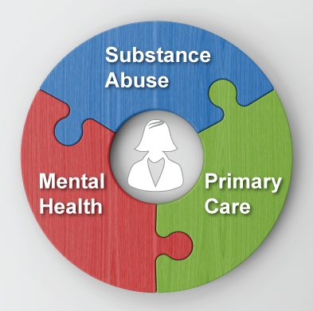
How has this topic been addressed in integrated care settings?
Certified Tobacco Treatment Specialist Training can be offered to clinical professionals from a variety of fields (social work, medicine, nursing, counselling)
https://eccovia.com/resources-getting-started-integrating-primary-care-behavioral-health/
(Ruebush, 2019)
Notes:
Script:
A local example of how nicotine use has been addressed in integrated care settings is the ”certified tobacco treatment specialist training” which was developed by the Duke Cancer Center and the UNC School of Medicine Nicotine Dependence Center. This training can be offered to clinical professionals from various fields, such as social work, medicine, counselling, nursing, and more. (Ruebush, 2019).

Slide 15
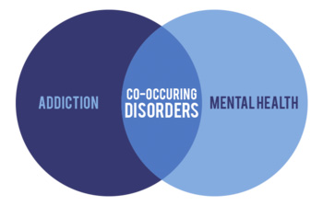
Is there a gap between recommendations and what is occuring in practice?
Research on integrated treatment approaches lacking
Need for comprehensive assessment
High rates of smoking and low rates of reduction or cessation
Gaps in care for co-occuring disorders
Increase availability of culturally sensitive care
Involve natural supports & community resources where appropriate
Increase use of harm reduction
(Crockford & Addington, 2017)
https://www.oit.edu/academics/degrees/marriage-family-therapy-masters/substance-abuse-and-addiction
Notes:
Script:
There is a lack of specific research about nicotine use disorder and smoking reduction or cessation among those with schizophrenia which should be amended to increase knowledge about and access to best practices for the treatment of nicotine use disorder in this population. Comprehensive assessment for substance use disorders should be initiated upon intake and continued throughout mental health treatment for clients with schizophrenia who initially present with a substance use disorder and those who do not to screen for and treat nicotine and other substance use disorders. High rates of smoking and low rates of smoking reduction or cessation are often seen as inevitable by clinicians working with this populations and as such may go unaddressed. Clients with schizophrenia or other psychotic disorders may be barred from participating in some substance disorder treatment programs because of their mental health diagnosis. There needs to be increased availability of culturally sensitive care by enhancing clinician training to include culturally sensitive care practices and increasing the number and accessibility of culturally sensitive care options. Natural supports should be involved in nicotine use disorder treatment when possible and with the approval of the client to support their recovery journey. Community resources should also be incorporated into treatment to enhance client support and treatment outcomes. Clinicians should make greater use of harm reduction strategies such as nicotine replacement therapies to more effectively support clients in their recovery from nicotine use disorder.

Slide 16
Recommendation for Improving Access, Screening, and Culturally Sensitive Care
All first episode psychosis patients should be carefully assessed for CODS
Use MI OARS skills to assess for nicotine use. You might ask:
“What are your thoughts about stopping/cutting down?
What do you not like about smoking?
What do you enjoy about smoking?
What would be different in your life if you no longer smoked?”
Elicit & increase change talk
Consider sources of pressure for client, including family & cultural pressures
https://summitsmartfarms.com/how-to-assess-your-culture/
(Stewart et al., 2010), (Ruebush, 2019)
Notes:
Script:
In terms of screening and assessment, Stewart et al. (2010) recommends that all first episode psychosis patients should be carefully assessed for co-occuring disorders, including substance use disorders. Ruebush (2019) recommends using motivational interviewing skills such as open-ended questions, affirmations, reflections, and summaries when assessing for co-occuring disorders with someone who experiences psychosis. The author suggests assessing for nicotine use with the following questions: what are your thoughts about stopping or cutting down? What do you like and not like about smoking? What would be different in your life if you no longer smoked? During all phases of treatment, including screening, assessment, and provision of care it is helpful to try to elicit and increase change talk from the client. Additionally, be sure to consider the different sources of pressure a client might be experiencing, in particular consider possible family and cultural pressures the client may be facing, as well as any stigmas they may face.

Slide 17
Examples of Culturally Sensitive Care
Native American, Indigenous, & Alaskan Natives (Legha & Novins, 2012)
Community & family involvement, relationships & respect, open-door policy, flexibility (Legha & Novins, 2012, p. 690)
African-Americans
Spirituality, family and community ties, “legacy of storytelling” (Antai-Otong, 2002, p. 3)
Indian, Arab, Persian, and Middle Eastern and descendant communities
Hookah/Shisha – socializing, flavorings, psychoeducation about health effects (Qasim et al., 2019; Soneji et al., 2020; Ruebush, 2019)
https://www.3blmedia.com/sites/www.3blmedia.com/files/image_4.png
Notes:
Script:
Literature is lacking about culturally sensitive care practices with those who have schizophrenia and nicotine use disorder. Findings from other studies about culturally sensitive care and substance use treatment can be adapted to support individuals and communities with both schizophrenia and nicotine use disorder. For working with Native American, Indigenous, and Alaskan Native peoples, including community and family involvement, emphasizing the therapeutic relationship and fostering respect for clients, instituting open-door policies that value clients over strict timetables, and flexibility in “meeting people where they’re at” in their recovery journey may be helpful approaches. When working with African-Americans, incorporating spirituality (as defined by the individual and their specific community contexts), including family and community ties, and honoring and uplifting storytelling traditions can increase the cultural sensitivity of care. Originating in India, hookah use became popular in Arab, Persian, and Middle Eastern communities; and has grown in popularity in the United States over time, especially among youth and young adults. It may be helpful to consider the social aspects of hookah use, individual’s preference towards tobacco flavorings, and possible misconceptions that people who use hookahs might have about the health effects of hookah use compared to cigarettes or other forms of tobacco when engaging in treatment with these communities. Culture is specific, both communal and individualized, as well as intersectional. It is important to be in regular communication with individuals and communities about their particular preferences regarding care.

Slide 18
Summary
Nicotine use is highly prevalent in populations with psychosis
Reduces effects of heightened startle response & has short term effects on negative symptoms
Focus on harm reduction strategies rather than abstinence, as abstinence often does not work with this population. Effective EBPS include:
Combined nicotine replacement therapy w/ pharmacotherapy (patches, lozenges), MI, CBT, contingency management, ACT, & multimodal interventions
Always incorporate knowledge of “stages of change” in treatment planning, goal setting, and evaluation. Adjust treatment as needed based on stage of change
Future research should identify effective, culturally sensitive nicotine treatments specific to those with schizophrenia
https://www.vectorstock.com/royalty-free-vector/graphic-cartoon-character-problem-solving-vector-36904178
Notes:
Script:
We hope that you have enjoyed viewing our presentation. We would like to end by reviewing some of the major takeaways on best practices for treating nicotine use in populations with psychosis, so that you can incorporate them into your own practice. The first thing to remember is that nicotine use is highly prevalent in populations with severe mental health conditions, such as schizophrenia and psychosis. Using nicotine is appealing for these populations because it may reduce stress, improve negative symptoms in the short term, and regulate startle response. Remember that completely stopping nicotine use is often difficult for those with SPMI who are dependent on nicotine, so it is best practice to take a harm reduction approach. When engaging in treatment planning, goal setting, and treatment evaluation, always remember to incorporate information about the “stages of change” and adjust accordingly based on where the client is at. Be flexible and open-minded with clients, as it is normal to fluctuate between the stages of change. EBP’s that have shown to be effective with this population include combined nicotine replacement therapy with pharmacotherapy such as patches and lozenges, MI, CBT, contingency management, and assertive community treatment. Multimodal interventions that incorporate several of these techniques are especially effective. While the recommendations mentioned in this presentation are useful, we found there are still many gaps in the literature and there is a need for more research on this topic. In particular, future research should identify and study effective, culturally sensitive nicotine treatments specific to those with schizophrenia and psychosis.
Image: https://www.vectorstock.com/royalty-free-vector/graphic-cartoon-character-problem-solving-vector-36904178

Slide 19
References
American Professional Agency. (2020, March 17). Teletherapy Best Practices – COVID 19 Pandemic. Amityville
Antai-Otong D. (2002). Culturally sensitive treatment of African Americans with substance-related disorders. Journal of psychosocial nursing and mental health services, 40(7), 14–21. https://doi.org/10.3928/0279-3695-20020701-09
Britannica, T. Editors of Encyclopedia (2019, September 17). startle reaction. Encyclopedia Britannica. https://www.britannica.com/science/startle-reaction
Brunette, M. F., Pratt, S. I., Bartels, S. J., Scherer, E. A., Sigmon, S. C., Ferron, J. C., Santos, M., Williams, G. E., Kosydar, S., Wolfe, R. S., Lotz, D., & Capuchino, K. (2018). Randomized Trial of Interventions for Smoking Cessation Among Medicaid Beneficiaries With Mental Illness. Psychiatric services (Washington, D.C.), 69(3), 274–280. https://doi.org/10.1176/appi.ps.201700245
Cather, C., Pachas, G. N., Cieslak, K. M., & Evins, A. E. (2017). Achieving Smoking Cessation in Individuals with Schizophrenia: Special Considerations. CNS drugs, 31(6), 471–481. https://doi.org/10.1007/s40263-017-0438-8
Centers for Disease Control and Prevention. (2021). Adult Tobacco Use Infographics [Infographic]. CDC.gov. https://www.cdc.gov/tobacco/infographics/adult/index.htm
Crockford, D., & Addington, D. (2017). Canadian Schizophrenia Guidelines: Schizophrenia and Other Psychotic Disorders with Coexisting Substance Use Disorders. Canadian journal of psychiatry. Revue canadienne de psychiatrie, 62(9), 624–634. https://doi.org/10.1177/070674371772019

Slide 20
References
Das, S., & Prochaska, J. J. (2017). Innovative approaches to support smoking cessation for individuals with mental illness and co-occurring substance use disorders. Expert review of respiratory medicine, 11(10), 841–850. https://doi.org/10.1080/17476348.2017.1361823
Heiberg, I. H., Jacobsen, B. K., Nesvag, R., Bramness, J. G., Reichborn-Kjennerud, T., Naess, O., Ystrom, E., Hultman, C. M., & Hoye, A. (2018). Total and cause-specific standardized mortality ratios in patients with schizophrenia and/or substance use disorder. PLoS ONE, 13(8), 1-17. https://doi.org/10.1371/journal.pone.0202028
Kopelovich, S. L., Monroe-DeVita, M., Buck, B. E., Brenner, C., Moser, L., Jarskog, L. F., Harker, S., & Chwastiak, L. A. (2021). Community Mental Health Care Delivery During the COVID-19 Pandemic: Practical Strategies for Improving Care for People with Serious Mental Illness. Community mental health journal, 57(3), 405–415. https://doi.org/10.1007/s10597-020-00662-z
Kortrijk, H. E., Mulder, C. L., van Vliet, D., van Leeuwen, C., Jochems, E., & Staring, A. B. (2013). Changes in motivation for treatment in precontemplating dually diagnosed patients receiving assertive community treatment. Community mental health journal, 49(6), 733–741. https://doi.org/10.1007/s10597-012-9582-2

Slide 21
References
Legha, R. K., & Novins, D. (2012). The role of culture in substance abuse treatment programs for American Indian and Alaska Native communities. Psychiatric Services, 63(7), 686-692. https://doi.org/10.1176/appi.ps.201100399
Lum, A., Skelton, E., Robinson, M., Guillaumier, A., Wynne, O., Gartner, C., Borland, R., Baker, A., Dunlop, A., Wilkinson, R. B., & Bonevski, B. (2022). Barriers and facilitators to using vaporised nicotine products as smoking cessation aids among people receiving treatment for substance use disorder. Addictive behaviors, 124, 107097. https://doi.org/10.1016/j.addbeh.2021.107097
Mackowick, K. M., Lynch, M. J., Weinberger, A. H., & George, T. P. (2012). Treatment of tobacco dependence in people with mental health and addictive disorders. Current psychiatry reports, 14(5), 478–485. https://doi.org/10.1007/s11920-012-0299-2
Manseau, M., & Bogenschutz, M. (2016). Substance Use Disorders and Schizophrenia. Focus (American Psychiatric Publishing), 14(3), 333–342. https://doi.org/10.1176/appi.focus.20160008

Slide 22
References
Penzenstadler, L., Soares, C., Anci, E., Molodynski, A., & Khazaal, Y. (2019). Effect of Assertive Community Treatment for Patients with Substance Use Disorder: A Systematic Review. European addiction research, 25(2), 56–67. https://doi.org/10.1159/000496742
Pinho, S., Rocha, V., & Vieira-Coelho, M. A. (2021). Effectiveness of multimodal interventions focused on smoking cessation in patients with schizophrenia: A systematic review. Schizophrenia research, 231, 145–153. https://doi.org/10.1016/j.schres.2021.03.012
Pratt, S. L., Sargent, J., Daniels, L., Santos, M. M., & Brunette, M. (2016). Appeal of electronic cigarettes in smokers with serious mental illness. Addictive Behaviors, 59, 30-34. http://dx.doi.org/10.1016/j.addbeh.2016.03.009
Qasim, H., Alarabi, A. B., Alzoubi, K. H., Karim, Z. A., Alshbool, F. Z., & Khasawneh, F. T. (2019). The effects of hookah/waterpipe smoking on general health and the cardiovascular system. Environmental health and preventive medicine, 24(1), 58. https://doi.org/10.1186/s12199-019-0811-y
Quigley, H. & MacCabe, J. H. (2019). The relationship between nicotine and psychosis. Therapeutic Advances in Psychopharmacology, 9, 1-12. https://doi.org/10.1177/2045125319859969
Ruebush, E. (2019, October). Tobacco use & treatment. [PowerPoint]. UNC-Chapel Hill PrimeCare Sakai site.
Notes:
(Ruebush, 2019)

Slide 23
References
Sabe, M., Zhao, N., & Kaiser, S. (2020). Cannabis, nicotine and the negative symptoms of schizophrenia: Systematic review and meta-analysis of observational studies. Neuroscience and Biobehavioral Reviews, 116, 415-425. https://doi.org/10.1016/j.neubiorev.2020.07.007
Soneji, S., Knutzen, K. E., Gravely, S., Elton-Marshall, T., Sargent, J., Lambert, E., Hilmi, N., Sharma, E., Jackson, K. J., Wang, B., Robinson, J., Driezen, P., Bover Manderski, M., Bansal-Travers, M., Hyland, A., Travers, M., Yang, D. H., Dang, R., & Fong, G. T. (2021). Transitions in frequency of hookah smoking among youth and adults: findings from waves 1 and 2 of the Population Assessment of Tobacco and Health (PATH) study, 2013-15. Addiction (Abingdon, England), 116(4), 936–948. https://doi.org/10.1111/add.15250
Substance Abuse and Mental Health Services Administration. (2008, October). Building your treatment program. Rockville. https://store.samhsa.gov/sites/default/files/d7/priv/buildingyourprogram-act_1.pdf
Steinberg, M. L., Ziedonis, D. M., Krejci, J. A., & Brandon, T. H. (2004). Motivational interviewing with personalized feedback: a brief intervention for motivating smokers with schizophrenia to seek treatment for tobacco dependence. Journal of consulting and clinical psychology, 72(4), 723–728. https://doi.org/10.1037/0022-006X.72.4.723
Stewart, T., Goulding, S. M., Pringle, M., Esterberg, M. L., & Compton, M. T. (2010). A descriptive study of nicotine, alcohol, and cannabis use in urban, socially disadvantaged, predominantly African-American patients with first-episode nonaffective psychosis. Clinical Schizophrenia & Related Psychoses, 3(4), 217-225. https://www.clinicalschizophrenia.net/articles/a-descriptive-study-of-nicotine-alcohol-and-cannabis-use-in-urban-socially-disadvantaged-predominantly-africanamerican-p.pdf

Slide 24
References
Vinci C. (2020). Cognitive Behavioral and Mindfulness-Based Interventions for Smoking Cessation: a Review of the Recent Literature. Current oncology reports, 22(6), 58. https://doi.org/10.1007/s11912-020-00915-w
Ziedonis, D. M. (2015, October 24). Ziedonis, D. M. (2015). Integrating Recovery-Oriented Practices for Individuals with Co-Occurring Disorders: With Tobacco & Schizophrenia Case Example. Massachusetts; University of Massachusetts Medical School. https://doi.org/10.13028/87rx-rn71

