Slide 1
Caregiver Education & Transgender Youth Healthcare
By Lee Doyle, 2021-2022 UNC Primecare Trainee
Notes:
Audio Transcript: Hi, I’m Lee Doyle, a Primecare Trainee who was placed at Duke Child and Adolescent Gender Care Clinic. Today I’ll be providing an overview about the importance of providing caregiver education when working with transgender and gender expansive youth and their families.

Slide 2
TABLE OF CONTENTS
01
02
03
04
BACKGROUND
BEST PRACTICES
Definitions, Prevalence, Outcomes
Guidelines for Supporting Caregivers
GAPS IN CARE
RECOMMENDATIONS
Barriers for TGE Youth Healthcare
Improving TGE Healthcare
Notes:
Audio Transcript: As an agenda for this brief presentation, I’ll first introduce some definitions of terms, data on prevalence, and health outcomes. I’ll then discuss some best practices to supporting caregivers of transgender and gender expansive youth. I’ll then go into some challenges and barriers to healthcare for TGE youth and their families. Lastly, I’ll review some ways we as providers can better serve caregivers of TGE youth.

Slide 3
01
BACKGROUND
Definitions, Prevalence, and Health Outcomes
Notes:
Audio Transcript: Let’s first start with some introductory information.

Slide 4
DEFINITIONS
Transgender and Gender Expansive Youth (TGE)
Caregiver
Family Rejection
The continual denial of acceptance, affection, or care by one or multiple family members.
A person who attends to the needs of and provides assistance to someone else who is not fully independent, such as a child or an ill adult.
Umbrella term used to describe youth who transcend conventional expectations of gender identity or expression, including but not limited to youth who identify as transsexual, genderqueer, nonbinary, etc.
PFLAG Glossary; APA Dictionary; Psychology Dictionary
Notes:
Audio Transcript: Firstly, I use the acronym TGE to refer to transgender and gender expansive youth as an umbrella term for all youth who transcend conventional binary gender in terms of their identity or expression.
Secondly, I use the term caregiver instead of parent in this presentation because not all youth are raised by their biological parents. Moreover, TGE youth experience higher rates of homelessness, unstable housing, and family rejection than their cisgender peers and live with other family members, adoptive parents, friends, or chosen family.
Lastly, I’ll be using the term family rejection which means the continual denial of acceptance, affection, or care by one or multiple family members.

Slide 5
Prevalence
150,000
13%
14x
Youth ages 13 to 17 who identify as transgender in the U.S.
TGE youth described their parents as fully supportive of their gender identity.
TGE youth whose parents are not fully supportive of their gender identity are 14x more likely to attempt suicide.
Herman et al., 2017; Newhook, 2018; Hill et al., 2010
Notes:
Audio Transcript:
The Williams Institute estimates that about 150,000 youth age 13-17 identify as transgender in the US. Only 13% of TGE youth describe their parents as fully supportive of their gender identity. A study of 400 trans youth in Canada found that youth whose gender identities are not strongly supported by their parents have an attempted suicide rate that is 14 times higher than that of supported youth (Hill et al., 2010).

Slide 6
OUTCOMES OF FAMILY REJECTION
ANXIETY
DEPRESSION
AGRESSION
SELF-HARM
Newhook et al., 2018
Notes:
Audio Transcript: Family rejection is associated with increased biological stress responsivity. This sustained high levels of stress responsivity in early and middle childhood for TGE youth are key predictors of maladaptive stress responses including anxiety, depression, aggression, and self-harm.
The short and long-term consequences for transgender youth who do not have family support of their gender identities and expression include low self-esteem, low life satisfaction, poor mental health, lack of adequate housing, post-traumatic stress, and suicidal thoughts and attempts (Newhook et al., 2018).

Slide 7
—Travers et al., 2012
“[A]nything less than strong support may have deleterious effects on a child’s wellbeing.”
Notes:
Audio Transcript: Family support and acceptance are so incredibly crucial for TGE youth. Researchers from the Trans Pulse Project in Ontario concluded that “anything less than strong support may have deleterious effects on a child’s wellbeing. Lack of strong caregiver support is predictive of negative health and wellbeing outcomes for TGE youth.

Slide 8
CAREGIVER SUPPORT + AFFIRMING CARE = PROTECTIVE FACTORS
Travers et al., 2012; Tordoff et al., 2022
Notes:
Audio Transcript: All is not lost for TGE youth and families. Evidence shows that family and caregiver support and access to gender affirming healthcare are two crucial protective factors for TGE youth.
TGE youth who have strong parental support for their gender identity and expression report higher life satisfaction, self-esteem, better mental health, and adequate housing compared to those without strong parental support, comparable with their cisgender peers.
Yet TGE youth are often unable to access gender affirming healthcare without their caregivers support. When TGE youth receive the gender affirming care they need, their mental health drastically improves.
A recent cohort study of 104 TGE youth found that receipt of gender affirming healthcare (e.g., pubertal blockers, gender affirming hormones) was associated with 60% lower odds of moderate or severe depression and 73% lower odds of suicidality over a 12-month follow up (Tordoff et al., 2022).

Slide 9
02
BEST PRACTICES
Guidelines for Supporting Caregivers
Notes:
Audio Transcript: Behavioral health providers are well positioned to help support caregivers of TGE youth so they can better support their TGE youth. In this next section, I’ll review some of the best practices for providers serving caregivers of TGE youth.

Slide 10
SUPPORTING CAREGIVERS
Provide Psychoeducation
Allowing space for families to express reactions to their child’s gender
Emphasizing the protective power of family acceptance
Utilizing multiple modalities of support
Giving families opportunities for allyship and advocacy
Connecting families to TGE community resources
Centering intersectional approaches and concerns
Malpas et al., 2021
Notes:
A 2021 systematic review of family based interventions for TGE youth found these 7 common strategies among 32 articles of clinical practice recommendations.
Firstly, providing psychoeducation about gender diversity is key. Many caregivers are coming with biases and beliefs that TGE identities are pathological or perverse. Providing factual information that gender diversity is healthy and normal aspect of life an important first step.
Allowing space for caregivers’ emotions and reactions is also crucial. Make sure to spend time alone with the caregivers to allow for caregivers to speak and express their reactions freely and cause harm to the caregiver/child relationship.
Link caregivers to multiple forms of support—parent support groups, online resources and parent groups, or perhaps their own therapist. Providing caregivers with avenues to advocate for their children is a significant way for them to become supportive of their TGE youth and the local community.
Connect caregivers local community resources such as LGBTQ centers, GSAs, PFLAG chapters, LGBTQ youth programs and summer camps, can help them and their TGE child get additional social support and access to services that address other needs. And lastly, gender identity may not be the only identity the caregiver may need support around. Perhaps a caregiver is concerned about their TGE child’s acceptance in their faith community? Or safety in their conservative community on a military base? Do research to find gender affirming resources and groups across intersectional identities.

Slide 11
03
GAPS IN CARE
Barriers to gender affirming healthcare
Notes:
In this next section, I’m going to review some barriers to affirming healthcare for TGE youth that caregivers have cited in the literature.

Slide 12
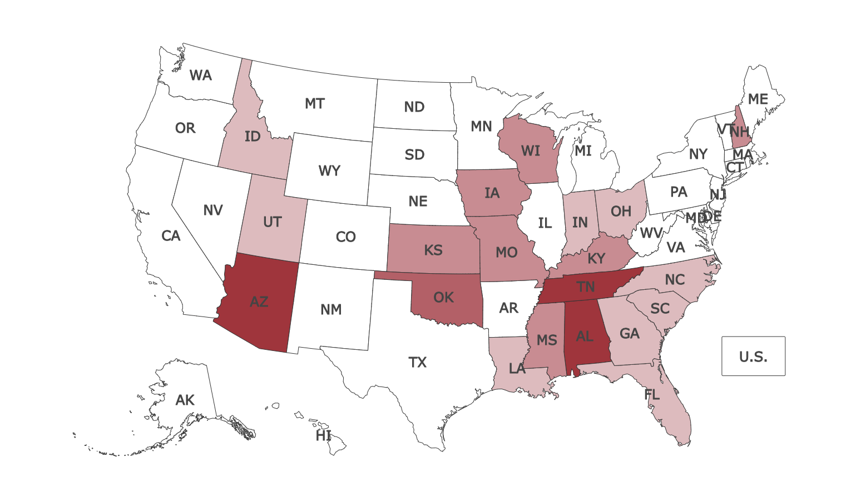
LEGISLATION
37 bills across 19 states propose to ban, limit, or criminalize gender affirming healthcare for TGE youth
Matouk & Wald, 2022; Kidd et al., 2021; Photo credit: Freedom for All
Notes:
Audio transcript: 2022 has been a record-breaking year for legislation attempting to ban, limit or criminalize gender affirming care for TGE youth under 18. For example, last week, Arkansas passed a bill prohibiting doctors from treating TGE minors with gender affirming medical care such as puberty blockers and gender affirming surgeries. And, as of this week in April 2022, 37 similar bills have been proposed across 19 other states around the country (Matouk & Wald, 2022 ). Freedom For All’s legislation tracking map pictured here shows the states with bills to ban gender affirming care for TGE youth. The darker color signifies multiple bills to limit, ban, and criminalize TGE healthcare.
According to the Williams Institute, 58,200 TGE youth risk losing access to gender affirming care due to state bans and policies (Conron et al., 2022)
According to the Trevor Project’s 2022 report, 85 percent of trans and nonbinary youth say that their mental health has suffered due to recent state-level attacks on trans rights. Gender-affirming care can reduce emotional distress, improve their sense of well-being and reduce the risk of suicide.
Caregivers of TGE youth are scared that these laws will lead to worsening mental health and suicidality for their youth. One parent was quoted “This could mean death for my child.” (Kidd et al, 2021)

Slide 13
PROVIDER KNOWLEDGE
“That’s ridiculous that I am some[one] who doesn’t know anything and I had no idea there was even such a thing as a trans-man…so I’m trying to get up to speed, and I’m supposed to be educating the physicians? That’s a joke” (Gridley et al., 2016).
Notes:
Audio Transcript:
Many providers are uneducated or ill-informed about TGE communities and their healthcare. According to the Pulse Project Study in Canada, 80% of TGE and 71.4% of parents rated their family doctor as less than knowledgeable about healthcare for trans youth. This scenario is frustrating for caregivers and potentially harmful for TGE youth. In the Gridley study cited here, caregivers, who are often new to TGE identities and looking for guidance from professionals, reported finding themselves having to correct their providers when they used inaccurate information or offensive language.

Slide 14
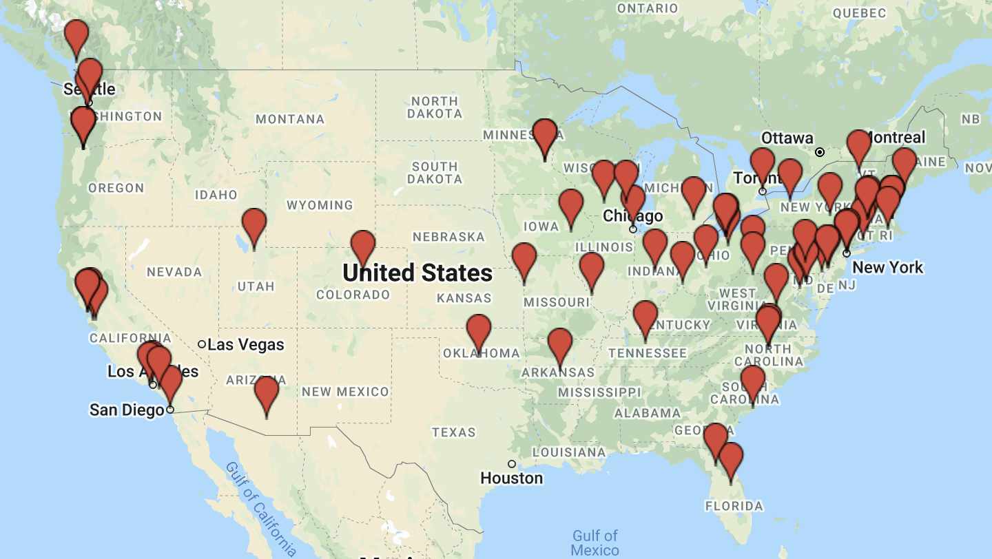
PROVIDER SCARCITY
”My child needs to see her [provider] NOW, and the first available appointment isn’t [for two months]. A long wait when in crisis mode.”
- Parent of 18-year-old girl
Temple Newhook et al., 2018
Notes:
Audio Transcript: There’s a distinct shortage of gender affirming providers. There’s only 60 pediatric gender clinics across the US; too few providers to see the growing demand for gender affirming care. As you can see on this map provided by, many predominantly rural states across the Midwest and South have no pediatric gender clinics. Many providers are prohibitively far, not within families’ insurance networks, accepting new patients, or meeting the patient age requirements.
Caregivers reported frustration with long wait times, such as the parent quoted here. Anecdotally, Duke Gender Clinic consistently had a 6 mo waitlist and had to turn away a dozen potential new patients and their families away to other providers each week.

Slide 15
OTHER BARRIERS TO CARE
CONSISTENCY
GATEKEEPING
DEADNAMING
INSURANCE
LIMITED ACCESS
CONSENT
Lack of consistently applied protocols
Many requirements to access treatment
Not using chosen name or pronouns
Exclusions of gender affirming treatment
To pubertal blockers & hormone treatments
Caregiver consent as requirement for treatment of minors
Gridley et al., 2016
Notes:
A Seattle based study on youth and caregiver perspectives of gender affirming healthcare reported these other common barriers.
Consistency refers to the lack of consistently applied protocols for TGE healthcare and shared that many clinicians were unaware of professional guidelines to serving TGE patients.
Gatekeeping refers to many TGE youth and families’ experiences of mental health providers specifically as being gatekeepers to hormone therapy and gender affirming surgeries and felt frustrated that they had to wait for a mental health provider’s approval to medically transition. Several participants described feeling that they had to prove they were “trans enough” to be cleared for treatment.
Deadnaming, or the act of saying a TGE person’s name given at birth, and misgendering by health professionals are common and very distressing to TGE youth. While often unintentional, some participants reported intentional and malicious deadnaming and misgendering by health professionals.
Many insurance companies refuse to cover gender-affirming healthcare, and many caregivers struggle to appeal for insurance to cover treatment or find alternative ways to afford treatment for their children.
Many TGE youth and families encounter a minimum age limit of 16 to start hormone therapy, which they felt was too late. Experiencing the puberty of their natal sex is terrifying and overwhelming to many TGE youth, and they feared the emotional and physiological consequences of delayed treatment.
Lastly, Caregiver consent was a frequently cited barrier to treatment of minors because many caregivers had difficulty accepting the bodily changes of gender affirming treatment.

Slide 16
04
RECOMMENDATIONS
Improving TGE Healthcare
Notes:
Audio Transcript: In this last section, I’ll go over some recommendations that we as providers can implement to better server TGE youth and their families.

Slide 17
Recommendations
AFFIRM
ACCESS
ADVOCATE
Mandate yearly training on TGE competency for all staff
Alter intake forms, electronic health records, billing systems, and patient notification systems to respect gender identity & chosen names
Ensure frontline staff are well-trained and respectful
Connect caregivers to local TGE resources, parent groups, family therapists, school guidelines, & referrals
Guide caregivers through insurance policy options and other funding options
Liaise with school districts and other community organizations to promote acceptance of all gender identities
Advocate for legal protections for TGE and gender affirming healthcare
Prioritize EB research that improve quality of care for TGE & families
Notes:
Audio transcript:
As providers, it’s important for us to create an affirming space for TGE youth and their families. We can do that by requiring yearly training on cultural competency for TGE communities for all staff. It is also very important that we alter all forms, electronic records, and any patient facing systems to respect patients’ gender identity and chosen name to avoid deadnaming and misgendering. Similarly, all staff who interact with TGE youth and families must be well-trained about TGE communities and trained how to ask for pronouns and chosen name. It may seem simple, but it makes a huge difference to TGE patient satisfaction.
As providers we are the access points for clients and their families to receive care. Use your case management skills to connect caregivers to local resources, especially peer supports for the caregivers themselves as well as a painting the roadmap ahead. Help caregivers strategize and problem solve insurance exclusions and funding options for treatment.
Lastly, it is our duty to advocate for and with our TGE patients and their families in the community. Go to local schools and community organizations and do educational programs about gender diversity. Go to your local and state representatives and advocate for legal protections for TGE and gender affirming healthcare. Protest the bills limiting gender affirming healthcare. And advocate for more evidence based research to improve healthcare for TGE youth and families. The field is still largely under-studied.

Slide 18
RESOURCES
American Academy of Pediatrics: “Ensuring Comprehensive Care and Support for Transgender and Gender-Diverse Children and Adolescents”
American Psychological Association: “Guidelines for Psychological Practice with Transgender and Gender Noncorforming People”
World Professional Association for Transgender Health
American Family Physician: “Caring for Transgender and Gender-Diverse Persons: What Clinicians Should Know”
Notes:
Audio Transcript: Here are some helpful resources for providers. While it does not appear so, the resources listed are hyperlinked here in the powerpoint.

Slide 19
THANKS!
Do you have any questions?
Lee Doyle They/them/theirs
UNC PrimeCare Trainee
ljdoyle@live.unc.edu

Slide 20
REFERENCES
American Psychological Association. (2022). APA Dictionary of Psychology. Retrieved April 3, 2022, from https://dictionary.apa.org/caregiver
Gridley, S. J., Crouch, J. M., Evans, Y., Eng, W., Antoon, E., Lyapustina, M., … Breland, D. J. (2016). Youth and Caregiver Perspectives on Barriers to Gender-Affirming Health Care for Transgender Youth. The Journal of Adolescent Health, 59(3), 254–261. doi:10.1016/j.jadohealth.2016.03.017
Hill, D. B., Menvielle, E., Sica, K. M., & Johnson, A. (2010). An affirmative intervention for families with gender variant children: parental ratings of child mental health and gender. Journal of Sex & Marital Therapy, 36(1), 6–23. doi:10.1080/00926230903375560
Human Rights Campaign. (2022). Interactive Map: Clinical Care Programs for Gender-Expansive Children and Adolescents - Human Rights Campaign. Retrieved April 2, 2022, from https://www.hrc.org/resources/interactive-map-clinical-care-programs-for-gender-nonconforming-childr
Kidd, K. M., Sequeira, G. M., Paglisotti, T., Katz-Wise, S. L., Kazmerski, T. M., Hillier, A., … Dowshen, N. (2021). “This Could Mean Death for My Child”: Parent Perspectives on Laws Banning Gender-Affirming Care for Transgender Adolescents. The Journal of Adolescent Health, 68(6), 1082–1088. doi:10.1016/j.jadohealth.2020.09.010
Malpas, J., Pellicane, M. J., & Glaeser, E. (2021). Family-Based Interventions with Transgender and Gender Expansive Youth: Systematic Review and Best Practice Recommendations. Transgender Health. doi:10.1089/trgh.2020.0165
Matouk, K., & Wald, M. (2022). Gender-affirming Care Saves Lives: Growing legislative attempts to limit, ban, or criminalize access to this critical model of medical care endangers the health and wellbeing of transgender and nonbinary youth. Columbia University Department of Psychiatry.
Newhook, J. T., Benson, K., Bridger, T., Crowther, C., & Sinnott, R. (2018). The transkidsnl study: healthcare and support needs of transgender children, youth, and families on the island of newfoundland. Canadian Journal of Community Mental Health, 37(2), 13–28. doi:10.7870/cjcmh-2018-009
Newhook, J. T., Winters, K., Pyne, J., Jamieson, A., Holmes, C., Feder, S., … Sinnott, M.-L. (2018). Teach your parents and providers well: Call for refocus on the health of trans and gender-diverse children. Canadian Family Physician, 64(5), 332–335.
PFLAG. (2022). PFLAG National Glossary of Terms | PFLAG. Retrieved April 3, 2022, from https://pflag.org/glossary
Psychology Dictionary. (2022). What is PARENTAL REJECTION? definition of PARENTAL REJECTION (Psychology Dictionary). Retrieved April 3, 2022, from https://psychologydictionary.org/parental-rejection/
Rafferty, J. (2018). Ensuring Comprehensive Care and Support for Transgender and Gender-Diverse Children and Adolescents. Pediatrics, 142(4). doi:10.1542/peds.2018-2162
Travers, R., Baur, G., Pyne, J., & Bradley, K. (2012). Impacts of strong parental support for trans youth: A report prepared for Children’s Aid Society of Toronto and Delisle Youth Services. (Trans Pulse Project, Ed.). Toronto: Trans Pulse.
Williams Institute. (2017, January 1). Age of Individuals Who Identify as Transgender in the United States - Williams Institute. Retrieved April 4, 2022, from https://williamsinstitute.law.ucla.edu/publications/age-trans-individuals-us/

Slide 21
ACKNOWLEDGEMENTS
This project was supported by the Health Resources and Services Administration (HRSA) of the U.S. Department of Health and Human Services (HHS), Behavioral Health Workforce Education and Training (BHWET) Program under M01HP31370, UNC-PrimeCare, $1,920,000.00, or the Opioid Workforce Expansion Program, Professional, (OWEP) under T98HP33425, UNC-PrimeCare-OUD, $1,350,000. Both programs are 100% financed with governmental sources. This information or content and conclusions are those of the author/s and should not be construed as the official position or policy of, nor should any endorsements be inferred by HRSA, HHS or the U.S. Government.

