Slide 1
The Opioid Epidemic, Harm Reduction, & Best Practices with Substance Use Treatment
How does this play a role in Integrated Healthcare?
By Jazmin Jimenez & Kennedy Glass
Notes:
Substance Use in Integrated Healthcare

Slide 2
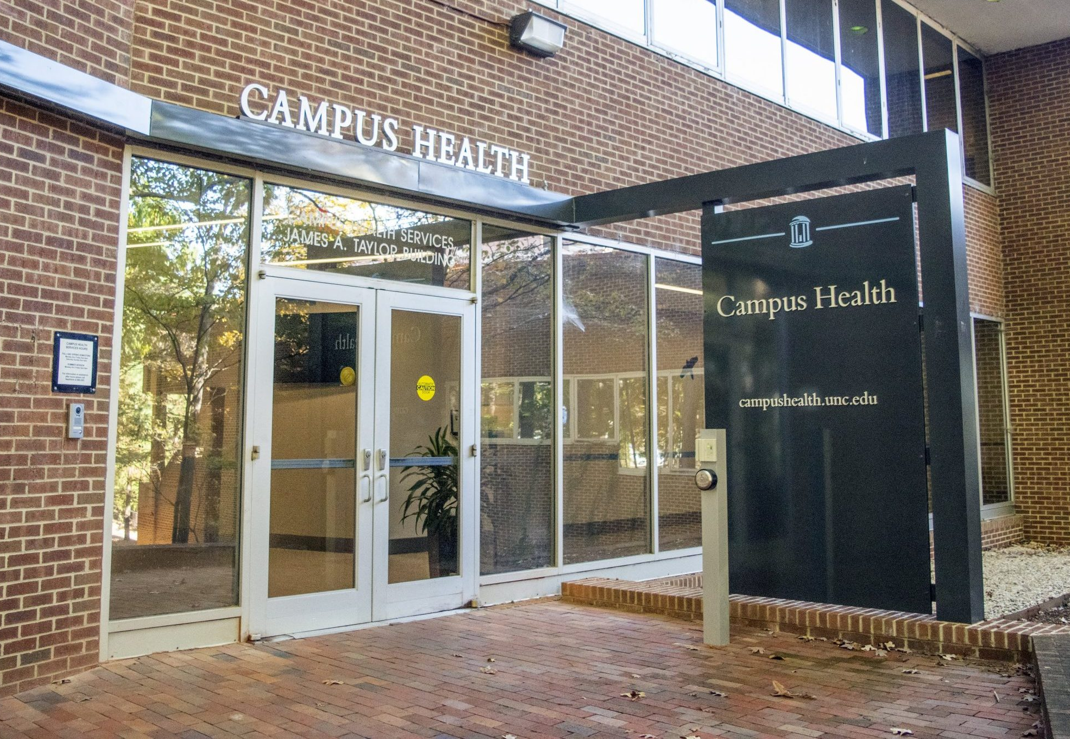
Introduction: What will we explore?
Background on substance use and opioid epidemic
The rise and risks of fentanyl
What is harm reduction and why it matters
How harm reduction fills the gap when discussing the opioid epidemic
Evidence Based Strategies
What has worked thus far
Co-occurring disorders with substance use
Integrated healthcare placements/settings?
Recommendations for best practices for substance use treatment
Harm reduction recommendation
Notes:
Introduction: What will we explore?
How does harm reduction fill the gap when discussing the Opioid Epidemic?
Why this matters…
To what extent does distribution of fentanyl test strips promote harm-reduction among adults? (18+)
How does this take place in integrated healthcare placements?

Slide 3
Important Definitions:
What is Substance Use?
Substance use is the medical term used to describe a pattern of using a substance (drug) that causes significant problems or distress
Substance use as a recognized medical brain disorder, refers to the abuse of illegal substances, such as:
marijuana
heroin
cocaine
methamphetamine
What is Harm Reduction?
Set of practical strategies and ideas aimed at reducing negative consequences associated with drug use
Harm Reduction is also:
A movement for social justice built on a belief in, and respect for, the rights of people who use drugs
What is Integrated Health?
An approach characterized by a high degree of collaboration and communication among health professionals
Involves sharing of information among team members related to patient care and the establishment of a comprehensive treatment plan to address the biological, psychological and social needs of the patient
Notes:
Integrated health - https://www.apa.org/health/integrated-health-care

Slide 4
What are some measures taken in Integrated Healthcare settings?

Slide 5
Substance Use Stigma/Health & Racial Disparities
Notes:
https://cabhp.asu.edu/sites/default/files/ihs-2018-main_overdose_naloxone_pres.pdf
https://healthydurham.org/cms/wp-content/uploads/2018/01/Partnership-Quarterly_Jan-2018_Root-Cause-RACISM.pdf
https://hphr.org/30-article-orlin/
https://drugpolicy.org/issues/race-and-drug-war
https://www.ncbi.nlm.nih.gov/pmc/articles/PMC7348456/

Slide 6
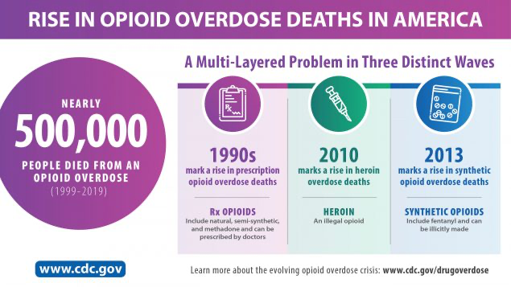
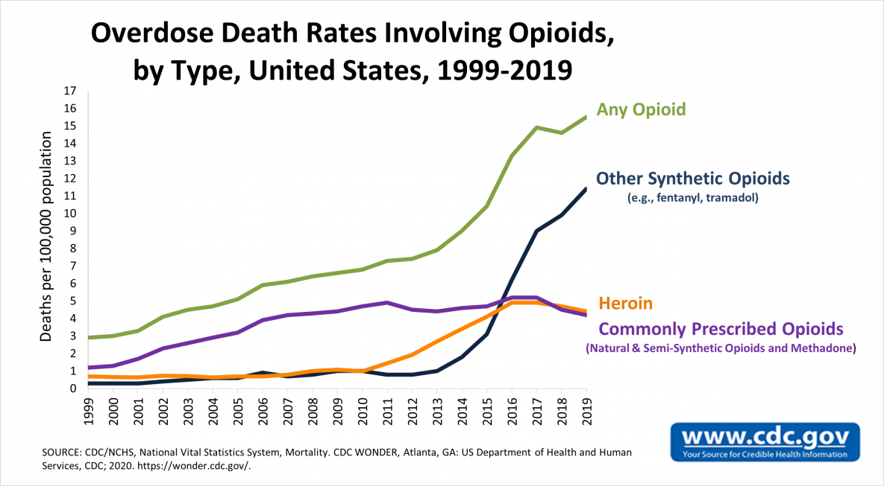
Why does this matter?
Opioid Overdoses on The Rise
Provisional data from CDC’s National Center for Health Statistics indicate that there were an estimated 100,306 drug overdose deaths in the United States during 12-month period ending in April 2021, an increase of 28.5% from the 78,056 deaths during the same period the year before.
Notes:
https://www.cdc.gov/nchs/pressroom/nchs_press_releases/2021/20211117.htm
https://www.cdc.gov/opioids/data/analysis-resources.html
https://www.cdc.gov/opioids/basics/fentanyl.html
https://www.cdc.gov/drugoverdose/deaths/index.html
https://www.commonwealthfund.org/blog/2022/overdose-deaths-surged-first-half-2021-underscoring-urgent-need-action

Slide 7
North Carolina Harm Reduction Coalition
Notes:
North Carolina Harm Reduction Coalition (NCHRC) is a statewide grassroots organization dedicated to the implementation of harm reduction interventions, public health strategies, drug policy transformation, and justice reform in North Carolina and throughout South

Slide 8
Evidence Based Strategies for Preventing Opioid Overdose

Slide 9
What has worked?
Naloxone
Medicated Assisted Treatment
Academic detailing
Eliminating Prior-Authorization Requirements
911 Good Samaritan Law
Syringe Services Programs
Notes:
Naloxone is a medicine that rapidly reverses an opioid overdose
Naloxone should be given to any person who shows signs of an opioid overdose or when an overdose is suspected. Naloxone can be given as a nasal spray or it can be injected into the muscle, under the skin, or into the veins

Slide 10
Co-occurring Disorders- What is the gap & barriers?
People with substance use disorders are at particular risk for developing one or more primary conditions or chronic diseases. The coexistence of both a mental illness and a substance use disorder, known as a co-occuring, is common among people in Medication-Assisted Treatment (MAT)
People with mental illness are more likely to experience a substance use disorder than those not affected by a mental illness. According to SAMHSA’s 2018 National Survey on Drug Use and Health, approximately 9.2 million adults in the United States have a co-occurring disorder
It is important to note that combining medications used in MAT with anxiety treatment medications can have serious adverse effects. Common benzodiazepines include Xanax, Valium, Klonopin among others.

Slide 11
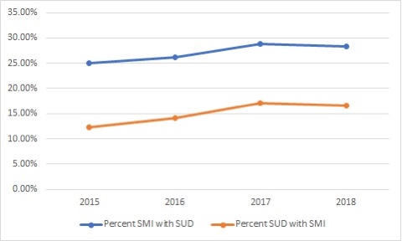
Most common mental disorders seen in MAT include:
Anxiety and mood disorders
Schizophrenia
Bipolar disorder
Major depressive disorder
Conduct disorders
Post-traumatic stress disorder
Attention deficit hyperactivity disorder
Patients being treated for mental disorders also often misuse the following types of substances:
Alcohol
Tobacco
Opioids
Stimulants
Marijuana
Hallucinogens
Prescription drugs
Notes:
Research indicates that 43 percent of people in SUD treatment for nonmedical use of prescription painkillers have a diagnosis or symptoms of mental health disorders, particularly depression and anxiety
Many individuals who develop substance use disorders (SUD) are also diagnosed with mental disorders, and vice versa. Multiple national population surveys have found that about half of those who experience a mental illness during their lives will also experience a substance use disorder and vice versa

Slide 12
Substance Use and The Pandemic
The U.S. is now facing two intersecting health crises, the ongoing opioid overdose epidemic and the COVID-19 pandemic.
Overdoses have also spiked since the onset of the pandemic. A reporting system called ODMAP shows that the early months of the pandemic brought an 18% increase nationwide in overdoses compared with those same months in 2019.
The trend has continued throughout 2020, according to the American Medical Association, which reported in December that more than 40 U.S. states have seen increases in opioid-related mortality along with ongoing concerns for those with substance use disorders.
Notes:
https://www.naadac.org/SUD-COVID-NIDA-update-webinar
https://www.apa.org/monitor/2021/03/substance-use-pandemic
https://nida.nih.gov/drug-topics/trends-statistics/overdose-death-rates

Slide 13
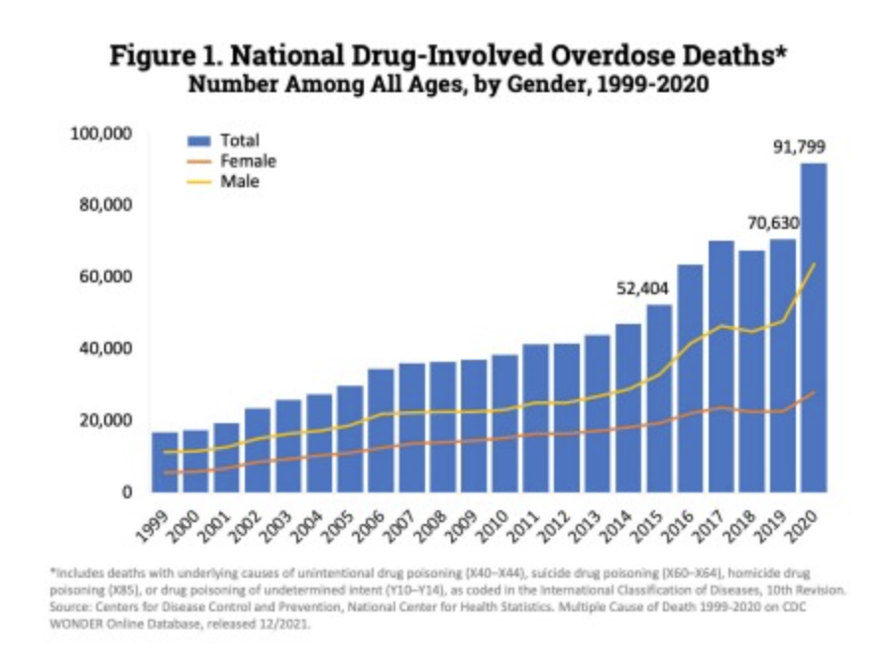
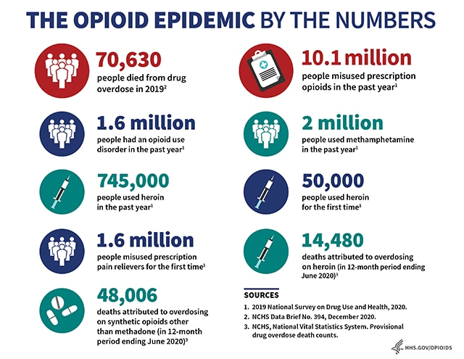
Prevalence Who’s experiencing this crisis?
Notes:
https://www.usda.gov/topics/opioids
https://www.cdc.gov/nchs/pressroom/nchs_press_releases/2021/20211117.htm

Slide 14
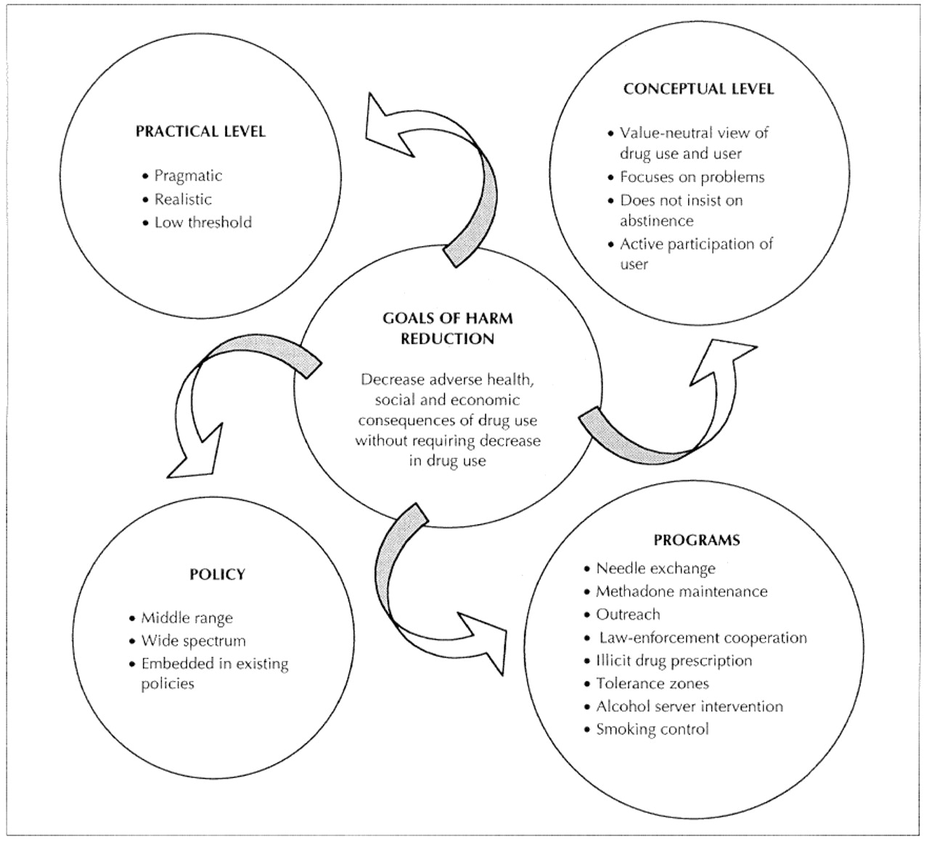
Harm Reduction Goals
Notes:
https://harmreduction.org/about-us/principles-of-harm-reduction/

Slide 15
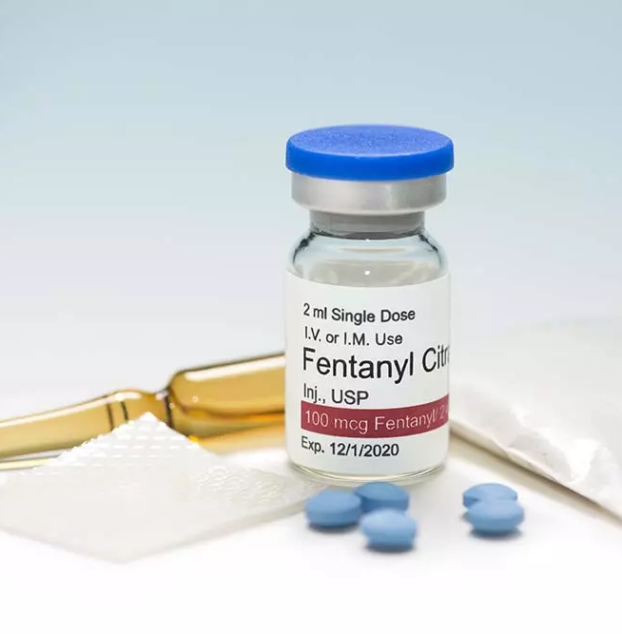
What is Fentanyl?
Fentanyl is a synthetic opioid that is 80-100 times stronger than morphine
Under the supervision of a licensed medical professional, fentanyl has a legitimate medical use. Pharmaceutical Fentanyl was developed for pain management treatment of cancer patients, applied in a patch on the skin
Fentanyl works by binding to the body's opioid receptors, which are found in areas of the brain that control pain and emotions.
Effects include extreme happiness, drowsiness, nausea, confusion, constipation, sedation, tolerance, addiction, respiratory depression and arrest, unconsciousness, coma, and death
Fentanyl and other synthetic opioids are the most common drugs involved in overdose deaths
Notes:
https://www.dea.gov/factsheets/fentanyl
https://www.dea.gov/resources/facts-about-fentanyl
https://www.csun.edu/shc/news/opioids-and-fentanyl-important-information-college-students
https://drugabusestatistics.org/fentanyl-abuse-statistics/
https://www.eleanorhealth.com/blog/fentanyl

Slide 16
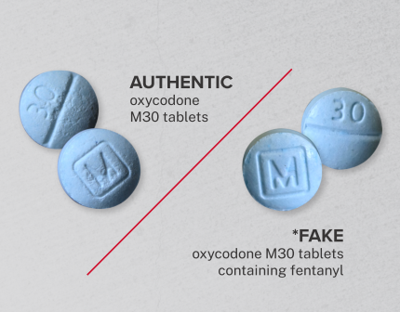
Risks of Fentanyl
Notes:
Fentanyl is being mixed in with other substances to increase the potency of the drug, sold as powders and nasal sprays, and increasingly pressed into pills made to look like legitimate prescription opioids. Because there is no official oversight or quality control, these counterfeit pills often contain lethal doses of fentanyl, with none of the promised drug.
There is significant risk that substances have been intentionally contaminated with fentanyl. Because of its potency and low cost, drug dealers have been mixing fentanyl with other drugs including heroin, methamphetamine, and cocaine, increasing the likelihood of a fatal interaction.
According to the CDC, synthetic opioids (like fentanyl) are the primary driver of overdose deaths in the United States. Comparison between 12 months-ending January 31, 2020 and the 12 months-ending January 31, 2021 during this period:
Overdose deaths involving opioids rose 38.1 percent.
Overdose deaths involving synthetic opioids (primarily illicitly manufactured fentanyl) rose 55.6 percent and appear to be the primary driver of the increase in total drug overdose deaths.
Picture: https://www.montanarightnow.com/news/state/lewis-and-clark-sheriff-four-dead-from-pills-laced-with-fentanyl/article_6bf2c68d-cfed-562c-b9f8-21ca45e67f91.html

Slide 17
Harm Reduction Recommendations
Follow a trauma-informed care model (TIC)
Facilitate evidence-based use of Fentanyl Testing Strips (FTS) and drug checking utilization in community and clinical settings
Implementing Syringe Services Program (SSP) - CDC-SAMHSA Harm Reduction Technical Assistance Program
Widening avoid overdose reversal treatments - Naloxone
Promote evidence-based harm reduction services, including those that are integrated with health care delivery
Mobile Crisis Intervention Services Planning Grants and State Option in Medicaid
MAT - Medication Assisted Treatment
Develop educational materials and programs to reduce stigma. Increase access to, and continue to develop accurate, non-judgmental education programs on safer drug use and overdose prevention strategies
Language Shifts - focus on language that de-stigmatizes folks experiencing substance use
Notes:
https://www.hhs.gov/overdose-prevention/harm-reduction
https://drugpolicy.org/drug-facts/harm-reduction-fentanyl-synthetic-opioids
https://www.cdc.gov/drugoverdose/pdf/pubs/2018-evidence-based-strategies.pdf
https://socialwork.buffalo.edu/social-research/institutes-centers/institute-on-trauma-and-trauma-informed-care/what-is-trauma-informed-care.html

Slide 18
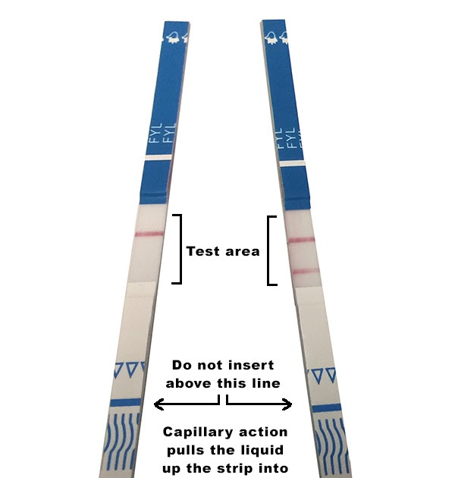
Fentanyl Test Strips (FTS)
Fentanyl test strips are a form of inexpensive drug testing technology that was originally developed for urinalysis, but which have been shown to be effective at detecting the presence of fentanyl and fentanyl-analogs in drug samples prior to ingestion
A 2018 study jointly conducted by researchers at Brown University, Boston Medical Center, and Johns Hopkins University in collaboration with law enforcement agencies sought to validate the efficacy of FTS for use in detecting fentanyl in drug samples
Notes:
The study found that the test strips were accurate at detecting fentanyl when it was present in samples of street drugs provided by law enforcement, and unlikely to produce false negative results

Slide 19
In Closing: Additional strategies for improved care & access + resources
Additional Resources:
North Carolina Harm Reduction Coalition- https://www.nchrc.org
Centers for Disease Control - https://harmreductionhelp.cdc.gov/s/
U.S Department of Health and Human Services- https://www.hhs.gov/overdose-prevention/harm-reduction
Harm Reduction Coalition Organization– https://harmreduction.org
Substance Abuse and Mental Health Services Administration- https://www.samhsa.gov/find-help/harm-reduction
Drug Policy Alliance - https://drugpolicy.org
Notes:
https://www.tfah.org/story/new-data-underscores-impact-of-covid-19-pandemic-on-americans-mental-health-substance-use-and-suicide/
https://www.aachc.org/wp-content/uploads/2020/02/2.11.20-Stacey-Cope-SUD-and-Harm-Reduction.pdf

Slide 20
This project was supported by the Health Resources and Services Administration (HRSA) of the U.S. Department of Health and Human Services (HHS), Behavioral Health Workforce Education and Training (BHWET) Program under M01HP31370, UNC-PrimeCare, $1,920,000.00, or the Opioid Workforce Expansion Program -- Professional, (OWEP) under T98HP33425, UNC-PrimeCare-OUD, $1,350,000. Both programs are 100% financed with governmental sources. This information or content and conclusions are those of the author/s and should not be construed as the official position or policy of, nor should any endorsements be inferred by HRSA, HHS or the U.S. Government.

Slide 21
References
American Medical Association . (2022, February). AMA overdose epidemic report. Retrieved April 3, 2022, from https://www.ama-assn.org/system/files/ama-overdose-epidemic-report.pdf
American Psychological Association. (n.d.). Integrated Health Care. American Psychological Association. Retrieved March 1, 2022, from https://www.apa.org/health/integrated-health-care
Assistant Secretary for Public Affairs (ASPA). (2022, February 15). Harm reduction. Overdose Prevention Strategy. Retrieved March 18, 2022, from https://www.hhs.gov/overdose-prevention/harm-reduction
Assistant Secretary for Public Affairs (ASPA). (2022, February 15). Harm reduction. Overdose Prevention Strategy. Retrieved March 7, 2022, from https://www.hhs.gov/overdose-prevention/harm-reduction
Centers for Disease Control and Prevention. (n.d.). Evidence-based strategies for preventing opioid overdose : What's working in the United States : An introduction for public health, law enforcement, local organizations, and others striving to serve their community. Centers for Disease Control and Prevention. Retrieved March 27, 2022, from https://stacks.cdc.gov/view/cdc/59393
Co-occurring disorders and other health conditions. SAMHSA. (n.d.). Retrieved March 16, 2022, from https://www.samhsa.gov/medication-assisted-treatment/medications-counseling-related-conditions/co-occurring-disorders
Fentanyl testing to prevent overdose - leg.state.nv.us. (n.d.). Retrieved March 17, 2022, from https://www.leg.state.nv.us/App/NELIS/REL/81st2021/ExhibitDocument/OpenExhibitDocument?exhibitId=52569&fileDownloadName=AB345_Fentanyl%20Test%20Strips%20Infosheet_Dr.%20Stephanie%20Woodard_DHHS.pdf
Substance Abuse / Chemical Dependency. Johns Hopkins Medicine. (n.d.). Retrieved March 27, 2022, from https://www.hopkinsmedicine.org/health/conditions-and-diseases/substance-abuse-chemical-dependency
U.S. Department of Health and Human Services. (2022, March 26). Naloxone drug facts. National Institutes of Health. Retrieved April 3, 2022, from https://nida.nih.gov/publications/drugfacts/naloxone
What is mental health? What Is Mental Health? | MentalHealth.gov. (n.d.). Retrieved March 16, 2022, from https://www.mentalhealth.gov/basics/what-is-mental-health
Disclaimer: We do not own any of the images used for this presentation.

Slide 22
References
Baumgartner, J., & Radley, D. (2022, February 7). Overdose deaths surged in the first half of 2021, underscoring urgent need for action. Commonwealth Fund. Retrieved March 22, 2022, from https://www.commonwealthfund.org/blog/2022/overdose-deaths-surged-first-half-2021-underscoring-urgent-need-action
Bierens, J. (n.d.). Root Cause? RACISM: Approaching the Partnership for a Healthy Durham with a Racial Equity Lens. Retrieved March 5, 2022, from https://healthydurham.org/cms/wp-content/uploads/2021/06/Racial-Equity-Task-Force-Meeting-3232021.pdf
Carroll, J., Green, T., & Noonan, R. (2020, October 22). Evidence-based strategies for preventing opioid overdose: What's working in the United States. Centers for Disease Control and Prevention. Retrieved March 17, 2022, from https://www.cdc.gov/drugoverdose/featured-topics/evidence-based-strategies.html
Centers for Disease Control and Prevention. (2020, October 22). Evidence-based strategies for preventing opioid overdose: What's working in the United States. Centers for Disease Control and Prevention. Retrieved April 3, 2022, from https://www.cdc.gov/drugoverdose/featured-topics/evidence-based-strategies.html
Centers for Disease Control and Prevention. (2021, February 16). What is Fentanyl? Centers for Disease Control and Prevention. Retrieved March 19, 2022, from https://www.cdc.gov/opioids/basics/fentanyl.html
Centers for Disease Control and Prevention. (2021, March 10). Opioid data analysis and resources. Centers for Disease Control and Prevention. Retrieved March 9, 2022, from https://www.cdc.gov/opioids/data/analysis-resources.html
Centers for Disease Control and Prevention. (2021, November 17). Drug overdose deaths in the U.S. top 100,000 annually. Centers for Disease Control and Prevention. Retrieved March 3, 2022, from https://www.cdc.gov/nchs/pressroom/nchs_press_releases/2021/20211117.htm
Centers for Disease Control and Prevention. (2022, February 22). Drug overdose deaths. Centers for Disease Control and Prevention. Retrieved April 3, 2022, from https://www.cdc.gov/drugoverdose/deaths/index.html
Cope, S. (n.d.). Arizona State University. Overdose Prevention, Recognition, & Response. Retrieved March 3, 2022, from https://cabhp.asu.edu/sites/default/files/collaborative-protocol.pdf
Cruz , V. D. L. (2022, February 11). What you need to know about fentanyl: Eleanor health. Eleanor Health - Recovery. For. Life. Retrieved March 12, 2022, from https://www.eleanorhealth.com/blog/fentanyl
Facts about fentanyl. DEA. (n.d.). Retrieved March 5, 2022, from https://www.dea.gov/resources/facts-about-fentanyl
Fentanyl abuse statistics. NCDAS. (2022, March 14). Retrieved March 15, 2022, from https://drugabusestatistics.org/fentanyl-abuse-statistics/

Slide 23
References
The Institute on Trauma and Trauma-informed care (ITTIC). (ITTIC) - University at Buffalo School of Social Work - University at Buffalo. (2022, March 4). Retrieved March 15, 2022, from https://socialwork.buffalo.edu/social-research/institutes-centers/institute-on-trauma-and-trauma-informed-care.html
Kitty, M. J. (2021, August 24). The new opioid epidemic, introducing fentanyl the latest killer. Retrieved March 11, 2022, from https://drkittay.com/fentanyl/
National Harm Reduction Coalition. (2021, May 23). Harm reduction principles. National Harm Reduction Coalition. Retrieved March 8, 2022, from https://harmreduction.org/about-us/principles-of-harm-reduction/
Opioid misuse in rural America. USDA. (n.d.). Retrieved March 2, 2022, from https://www.usda.gov/topics/opioids
Opioids and fentanyl: Important information for college students. California State University, Northridge. (2019, December 13). Retrieved March 9, 2022, from https://www.csun.edu/shc/news/opioids-and-fentanyl-important-information-college-students
Orlin, K. (2021). The War on Drugs & Racial Health Disparities in incarceration. HPHR Journal Formerly Harvard Public Health Review. Retrieved March 2, 2022, from https://hphr.org/30-article-orlin/
Panchal, N., Garfield, R., Cox, C., & Artiga , S. (2021, August 13). Substance use issues are worsening alongside access to care. KFF. Retrieved March 5, 2022, from https://www.kff.org/policy-watch/substance-use-issues-are-worsening-alongside-access-to-care/
Phil Drake. (2022, February 23). Lewis and Clark Sheriff: Four dead from pills laced with fentanyl. ABC FOX Montana. Retrieved March 12, 2022, from https://www.montanarightnow.com/news/state/lewis-and-clark-sheriff-four-dead-from-pills-laced-with-fentanyl/article_6bf2c68d-cfed-562c-b9f8-21ca45e67f91.html
Race and the Drug War. Drug Policy Alliance. (n.d.). Retrieved March 9, 2022, from https://drugpolicy.org/issues/race-and-drug-war
Trust for America's Health . (n.d.). Substance misuse and mental health. Retrieved March 9, 2022, from https://www.tfah.org/issue-details/substance-misuse-mental-health/
What's a harm reduction approach to the use of fentanyl and other synthetic opioids? Drug Policy Alliance. (n.d.). Retrieved March 3, 2022, from https://drugpolicy.org/drug-facts/harm-reduction-fentanyl-synthetic-opioids
Wogen, J., & Restrepo, M. T. (2020, June). Human rights, stigma, and substance use. Health and human rights. Retrieved March 3, 2022, from https://www.ncbi.nlm.nih.gov/pmc/articles/PMC7348456/

