Slide 1
Syphilis: The Costs of Stigma
By Zoe Jennings
UNC Primecare-OUD 2021-2022

Slide 2
Syphilis: Myths and Realities
Syphilis is a sexually transmitted infection (STI) that has affected health for centuries.
Syphilis can only be spread through oral, anal and vaginal sex.
You would know if you had syphilis.
Jackman et al., 2021; Mayo Clinic, 2021; CDC, 2022
Notes:
So, to get started, we are going to go through some myths and realities of syphilis.
-So the first statement I’d like you to consider is syphilis is a sexually transmitted infection that has affected health for centuries. Consider whether that’s a myth or a reality.
-Ok, next: syphilis can only be spread through oral, anal and vaginal sex. Think about that one carefully.
And lastly: you would know if you had syphilis. Think about whether that’s a myth or reality.

Slide 3
Syphilis: Myths and Realities
MYTH!
Primary syphilis: Painless sore(s) (often missed or confused for other conditions)
Secondary syphilis: Rash, headache, fever, other symptoms
Latent syphilis: Symptoms go away, but the bacteria will stay in a person’s body for years.
Syphilis can only be spread through oral, anal and vaginal sex.
Syphilis is a sexually transmitted infection (STI) that has affected health for centuries.
You would know if you had syphilis.
MYTH!
Syphilis can spread from skin-to-skin contact. Syphilis can also spread from a birth parent to an unborn baby. When a baby is born with syphilis, this is called congenital syphilis.
TRUE!
Jackman et al., 2021; Mayo Clinic, 2021; CDC, 2022
Notes:
Ok, so now take a look at whether you got these right.
So, yes, it is true that syphilis is a sexually transmitted infection that has affected human health for centuries, and we are going to talk about this more in a minute.
But no, it is a myth that syphilis can only be spread through oral, anal and vaginal sex. Syphilis can also be spread through close skin-to-skin contact – so when one person’s skin contacts an open sore on another person’s skin – but this typically occurs during sex. Also, syphilis can be spread from a birth parent to an unborn baby. When a baby is born with syphilis, this is called congenital syphilis.
And, finally, you would know if you had syphilis. This is a myth. So, in the primary stage of syphilis, people will often get one or more sores – but these are painless, they could be in places you don’t see, like the anus, and you could mistake them for other things, like an ingrown hair. After some weeks, if untreated, this will usually progress to a rash. People may have other symptoms like fevers and headaches, but all of these symptoms, again, can be confused for other conditions. Eventually, regardless of whether syphilis is treated, all symptoms go away, but the bacteria remains in a person’s body and will stay there for years.

Slide 4
Syphilis: Myths and Realities
Syphilis is curable.
People don’t really get syphilis anymore.
CDC, 2021; CDC, 2022
Notes:
-Ok, our last 2 myths and realities.
-The first is syphilis is curable. Think about it: is that true, or is syphilis something you have for life?
-And last, people don’t really get syphilis anymore. So think about that one: is it true, or did syphilis go away with the Victorian era?

Slide 5
Syphilis: Myths and Realities
People don’t really get syphilis anymore.
Syphilis is curable.
TRUE!
People who have had syphilis for less than a year can often be cured with one penicillin injection.
MYTH!
CDC, 2021; CDC, 2022
Notes:
Alright, so check and see if you got these right.
First, yes! Syphilis is definitely curable. For those who have had syphilis for less than a year, it can usually be treated with just one injection of penicillin.
Next, people don’t really get syphilis anymore. And this is definitely wrong, as we are about to talk about more.

Slide 6
Syphilis: A Heartbreaking & Brief History
Tuskegee Syphilis Study begins
Penicillin becomes best treatment for syphilis - but not offered to participants in Tuskegee study
Syphilis cases begin to rise
15th century
1937
1999
2014-2019
1932
Mid-1940s
2000 - 2013
Syphilis cases double; congenital syphilis cases quadruple
680,000 people under treatment for syphilis
about 60,000 babies born annually with congenital syphilis
Syphilis almost eliminated in the U.S.
1st syphilis outbreak recorded
CDC, 2021; Chen, 2021
Notes:
So, before we go any further, we are going to go through a brief history of syphilis.
Just to give you an idea of how long this infection has plagued us, the first syphilis outbreak was recorded in the 15th century, so a very long time.
Skipping ahead several centuries, let’s look at the 1930s. In 1932, the infamous Tuskegee Syphilis Study began. This was an effort by scientists to record the quote ”natural history of syphilis.” In doing so, researchers recruited 600 Black men to participate in the study, without telling them what they were studying. At this time, syphilis was extremely widespread in the U.S. By the mid-1940s, penicillin had become a very effective treatment for syphilis, but participants in the Tuskegee study were not told about it or offered it, and they continued to spread syphilis to their partners and suffer the long-term consequences of untreated syphilis. There’s a lot more to said about this and the legacy of distrust it left behind, but I’ll stop there.
So, here’s another heartbreaking part of this history. In 1999, the U.S. had almost eliminated syphilis. Over 80% of counties in the U.S. were recording 0 cases. It was a huge opportunity. But then, for reasons we will discuss, cases began climbing in the 2000s. Then, between 2014 and 2019, cases skyrocketed.

Slide 7
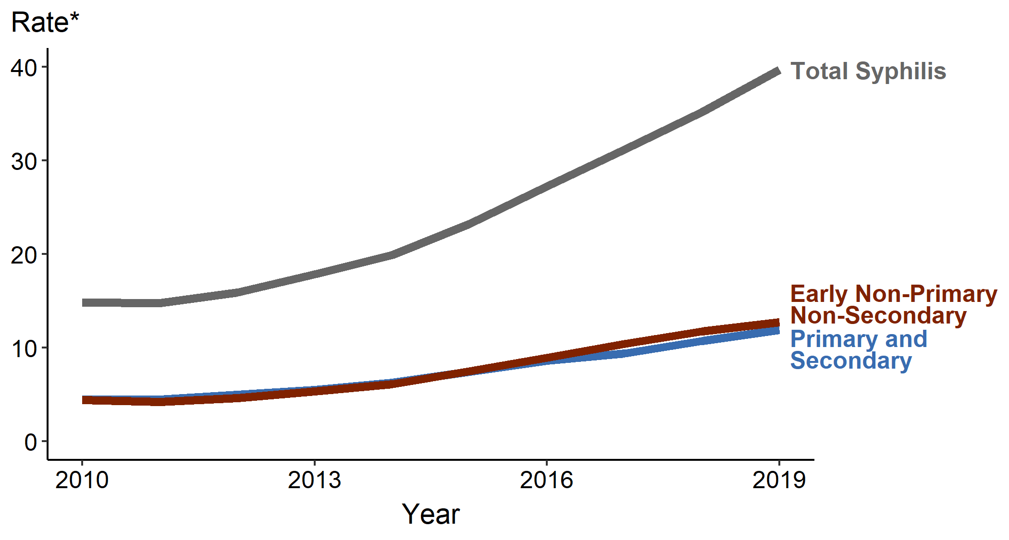
Why the rise?
Very little CDC funding for STIs (other than HIV)
Growth of online dating and hookup apps
Increase in drug use
Better HIV prevention may have led to more condomless sex (risk compensation)
Syphilis – rates of reported cases by stage of infection, 2010-2019 (CDC, 2021)
*Rates per 100,000 people
Schmidt et al., 2019; CDC, 2021; Chen, 2021; Henderson, 2022
Notes:
So, why the huge increase?
-I’m not going to say a ton about this, but the first reason is very little funding for STIs. The CDC asked for more money in 2000 to really wipe out syphilis, and they never got it and funding has been mostly stagnant since.
-Also, some have posited that the growth of online dating and hookup apps have meant that people have more sexual partners, and more anonymous sexual partners,. This makes may be harder for contact tracers to notify the sexual partners of people with syphlilis, as people may not know the names or contact information for their partners.
-We have seen an increase in certain types of drug use in this period,. Drug use, particularly the use of methamphetamine, has been associated with risky sexual behaviours, including having multiple or concurrent sex partner, inconsistent condom use and exchange of sex for drugs or money.⁸
-Also, HIV prevention has really transformed in recently years, particularly with the advent of really effective anti-retroviral therapies which eliminate the risk of transmitting HIV to a partner, and medications like PrEP, or pre-exposure prophylaxis, which make it basically impossible for a person to be infected with HIV. Because of this greatly reduced risk of transmitting HIV, there is a theory that more people may have opted not to use condoms, which increases the transmission of other STIs.

Slide 8
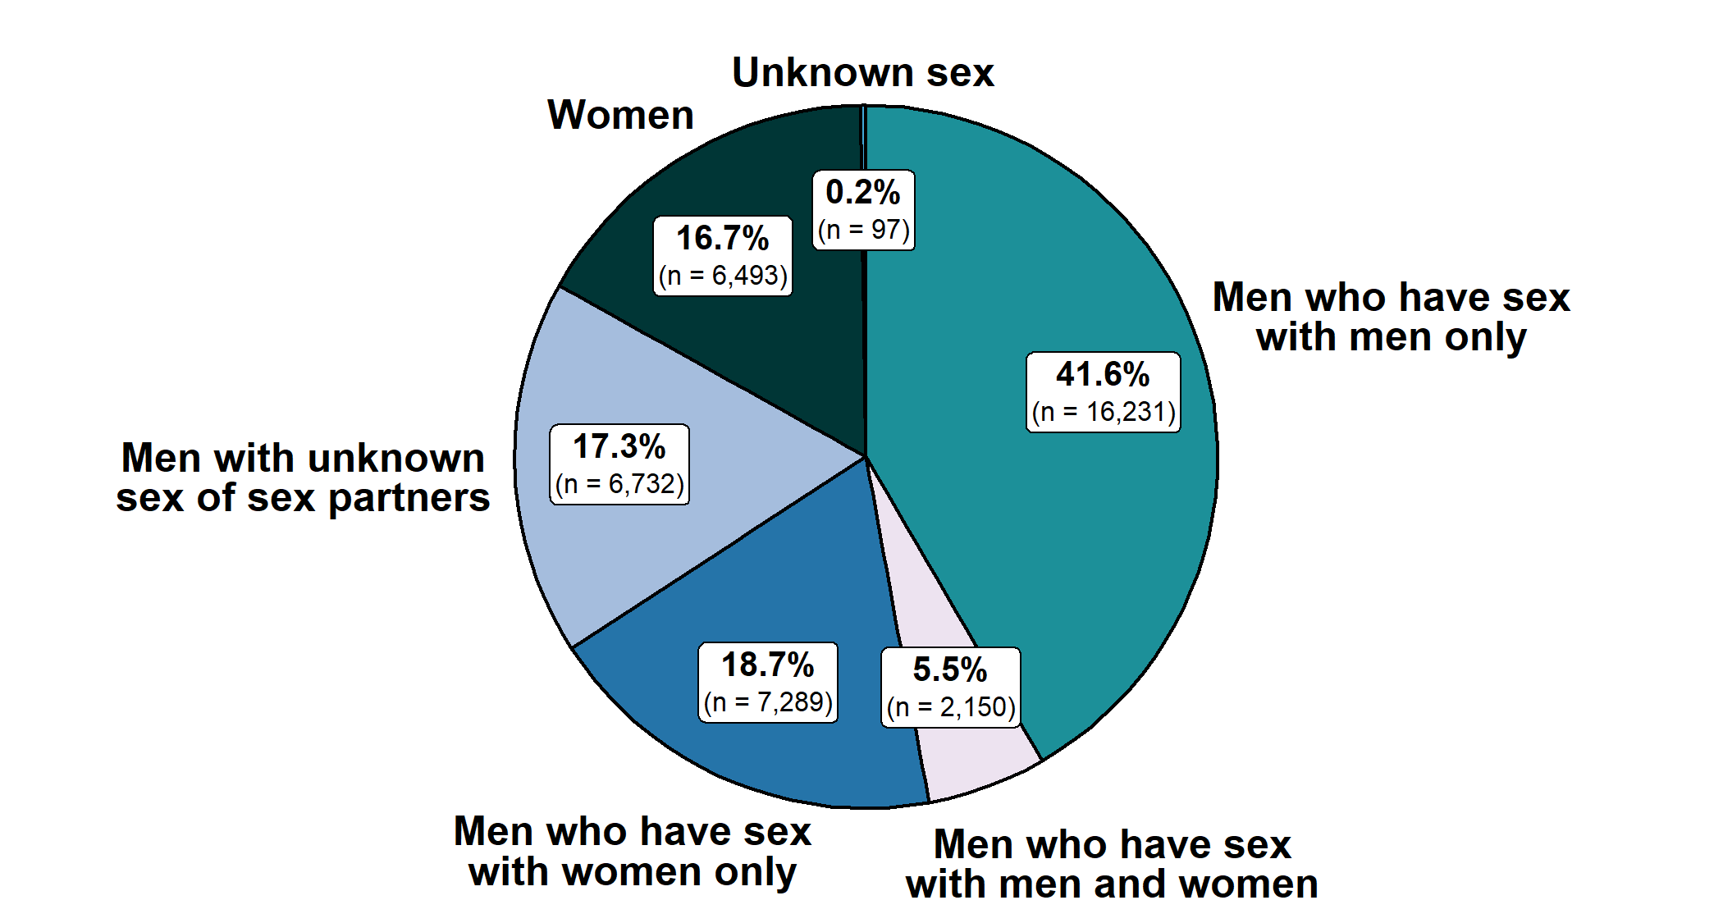
Who is most affected?
Men who have sex with men (MSM) – particularly those living with HIV
People who use methamphetamine, heroin or injection drugs
Women
Black, American Indian/Alaska Native, Native Hawaiian/Other Pacific Islanders, Hispanic/Latinx adults
Primary and secondary syphilis – distribution of cases by sex and sex of partners, U.S., 2019 (CDC, 2021)
CDC, 2021; Chen, 2021
Notes:
-of note, I know that some of these terms may not be specific – for instance, the terms men and women don’t specify whether these are cisgender men and women, or women-identifying people. Also we don’t get any information about nonbinary people. I chose to use these terms because this is what the statistics reported, but I apologize for the lack of inclusion or specificity in these statistics.
-one of the most affected groups is men who have sex with men – this is a term often used in public health. As you can see from the graph of the right – men who have sex with men and men who have sex with both men and women make up almost half of all cases of primary and secondary syphilis in 2019.
-also, people who use methamphetamine, injection drugs or heroin are often affected.
-women. -- Syphilis is not as common among women as it is among men, but there has been a really dramatic increase in syphilis cases among women in recent years. Between 2015 and 2019, rates of primary and secondary syphilis increased 178%.
-In terms of racial disparities, rates of primary and secondary syphilis are more than 4 times higher among Black people than among White people. Rates are also more than 2 times higher among American Indian and Alaskan Native, Native Hawaiians and Other Pacific Islanders, and Hispanic/Latinx people.
It’s important to note that disparities by race are not because of a difference in sexual activity; it’s often because of a complicated mix of a lack of access to screening and prevention, distrust of healthcare, and other factors. Also, if there are a high number of people in a community infected with an STI, more people are likely to get infected, regardless of the amount and type of sexual activity they have.

Slide 9
But what’s the big deal?
Adults
Babies
If syphilis goes untreated for years, it can cause organ damage.
Syphilis (and any STI) increases risk of being infected with and transmitting HIV.
“We have more congenital syphilis cases today in America than we ever had pediatric AIDS.”
-David Harvey, executive director of the National Coalition of STD Directors.
Babies with congenital syphilis face a 40% chance of miscarriage, being stillborn or dying soon after birth.
Those who survive may have bone or brain deformations, or other conditions.
Many countries – including Belarus, Cuba, Sri Lanka and China – have wiped out congenital syphilis.
CDC 2021; Chen, 2021
Notes:
But what’s the big deal about syphilis? If symptoms eventually go away, who cares.
-so for adults, if syphilis goes untreated for years, it can cause organ damage. This may include neurological issues, blindness and other complications.
-Also, syphilis and really any STI increase the risk of being infected with HIV. An HIV-positive person with syphilis has a higher risk of transmitting HIV. So this is why it’s so important that HIV and STI funding and services be integrated.
-Syphilis is really, really serious for babies. Babies with congenital syphilis face a 40% change of miscarriage, being stillborn or dying soon after birth. Those who survive may have bone or brain deformations, or other conditions.
-Just to give you perspective, many countries – including Belarus, Cuba, Sri Lanka dn China, have wiped out congenital syphilis. Meanwhile, the U.S. is seeing a huge increase.
And I just wanted to include a quote from David Harvey, the executive director of the National Coalition of STD Directors, for context: We have more congenital syphilis cases today than we ever had pediatric AIDS.

Slide 10
Stigma
Why should it be any more shameful to catch an infection from sex than it is from shaking hands, a kiss or being coughed upon? … I suspect it is because shame and stigma are effective weapons of control that have been used throughout history to marginalize women, people of color and the L.G.B.T.Q.+ community.
S.T.I.s are generally higher in these groups: a combination of biology… and traditionally people in these groups have less access to health care because of economic marginalization or prejudice, which leads to less access to screening and treatment.”
“No diagnosis, apart from cancer, can as reliably bring a woman to tears as an S.T.I…
-Dr. Jen Gunter, OB/GYN, 2019
Notes:
And finally, one of the biggest obstacles to preventing and treating syphilis is stigma. And this is really what motivated me to do this presentation, as I think stigma is a form of social control that keeps STIs in the closet. I wanted to include this quote. So, it goes on, and I’m not going to read all of it, but it really gets to the heart of the issue, I think.

Slide 11
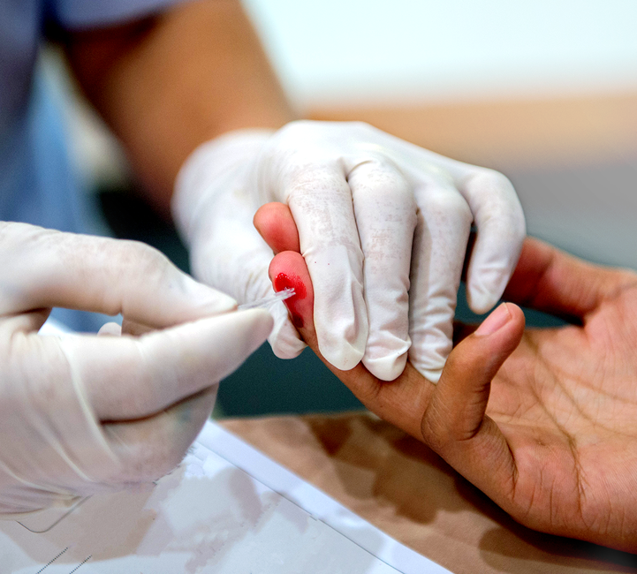
Ways that care practices fall short
Dividing HIV testing from other STI testing
Failing to help patients get to treatment
Assuming that patients will prioritize syphilis treatment over other needs
Chen, 2021; NASTAD & NCSD, 2014
Notes:
Alright, so what are the ways that care practices are not being effective at treating and preventing syphilis, and deviating from evidence-informed practices?
-So one way is that they focus on treating HIV, without testing for other STIs at the same frequency. As we’ve seen, being infected with one can really affect a person’s susceptibility to being infected with the other, so it is essential that these tests be coupled, for better prevention of both.
-Also, many clinics fail to help patients get to treatment. Not all clinics stock penicillin, so they may send someone to get treated at the emergency room or health department. However, people may not be able to get to these appointments, and clinics often fail to follow up to make sure people are successfully treated.
-Also, too often, practices assume that patients will prioritize syphilis treatment over other needs.
Often, especially once patients are in the latent stage of syphilis and all their symptoms have gone away, they will feel fine. It can be hard for patients to be motivated to treat their syphilis when nothing seems to be wrong with them, especially if they are dealing treated with more acute crises like abuse, mental health issues, homelessness or drug withdrawal.

Slide 12
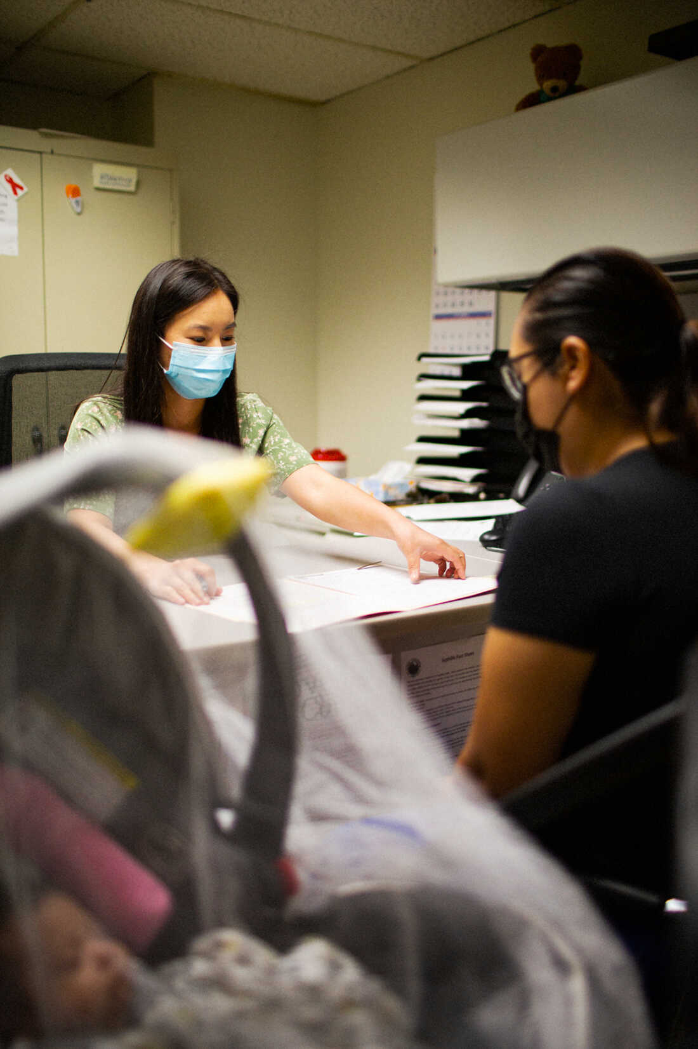
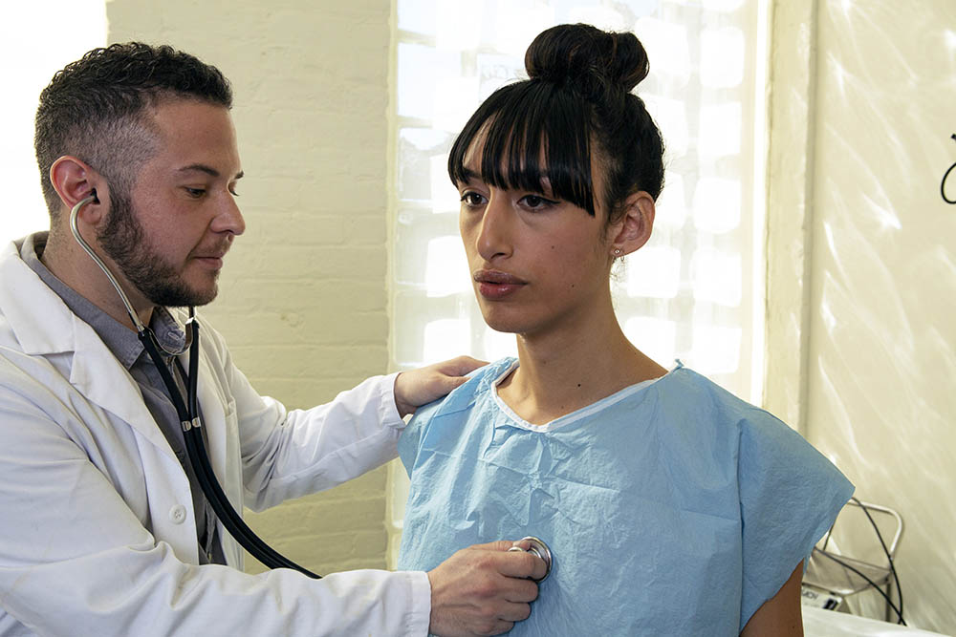
Evidence—informed practices
Help connect patients to convenient testing and treatment
Make testing for syphilis (and other STIs) routine, like screening for hypertension and diabetes
Lee et al., 2020; NASTAD & NCSD, 2014; Valentine et al., 2022; Henderson, 2022
Notes:
I want to first say that a lot of the information I found was about specific timelines for screening and antibiotic regimens. Those kinds of clinical recommendatilons are outside the scope of this presentation, so I did not include them.
Help patients access convenient testing and treatment
- as we discussed previously, some clinics will refer their patients to health departments to get treated for syphilis without following up to see if they got treated. Syphilis treatment is somewhat complicated because the recommended treatment is an injection, so patients have to go somewhere to get injected, they can’t just pick up an oral antibiotic at a pharmacy. Also, patients that seem to have more advanced syphilis may need 3 injections a week apart. social workers and care managers can help patients finding a treatment site close to them, where they feel comfortable being treated. Transportation is also often a barrier for some patients, so social workers and care managers can help to problem-solve around these barriers. Also, recognize that, because of stigma, some patients may not want to be treated in their own communities, particularly in rural areas where they may know people working at the health department – honor patients concerns about this when helping to find a place for them to be treated.
-Make testing for syphilis and other STIs routine, like screening for hypertension and diabetes
This not only helps to catch more cases of syphilis and prevent them from advancing, but to destigmatize syphilis, as it is treated as a commonplace condition just like others. -

Slide 13
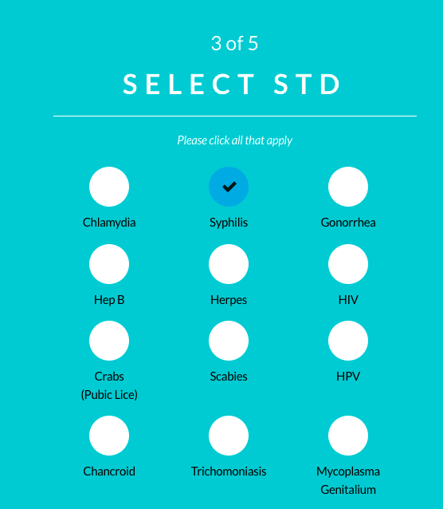
Evidence-informed practices
Offer patients the opportunity to engage in frank discussions about sexuality, sexual behaviors, testing and treatment – but don’t push it
Integrate partner notification systems into clinical practices
Tellyourpartner.org; NASTAD & NCSD, 2014; Lee et al., 2020; Villar-Loubet, et al.; Ware-Pressley, 2021
Notes:
-Many providers may avoid uncomfortable conversations around sex, but it’s really key to have frank discussions around sexual practices and testing and treatment.
-this has go to beyond recommending condom use. Providers, care managers and social workers need to have conversations about what symptoms to look for, the importance of routine screening, and how to access testing. However, recognize that some patients may find questions about their sex lives invasive, so don’t push when patients are unwilling to share. Proactively providing education and the opportunity to talk about sex, if a patient wants, can still make a big difference.
-Integrate partner notification systems into clinical practice
-When someone is diagnosed with syphilis, the health department is notified, and they are tasked with informing that person’s partners of the diagnosis. But health departments are often swamped and aren’t always able to follow up on cases. Encourage patients to notify their partners through anonymous online services like tellyourpartner.org, which allows participants to anonymously text sexual partners to notify them of their STI. So these pictures are from that platform – you can see you enter in someone’s number and the STIs that you have, and it anonymously texts them.

Slide 14
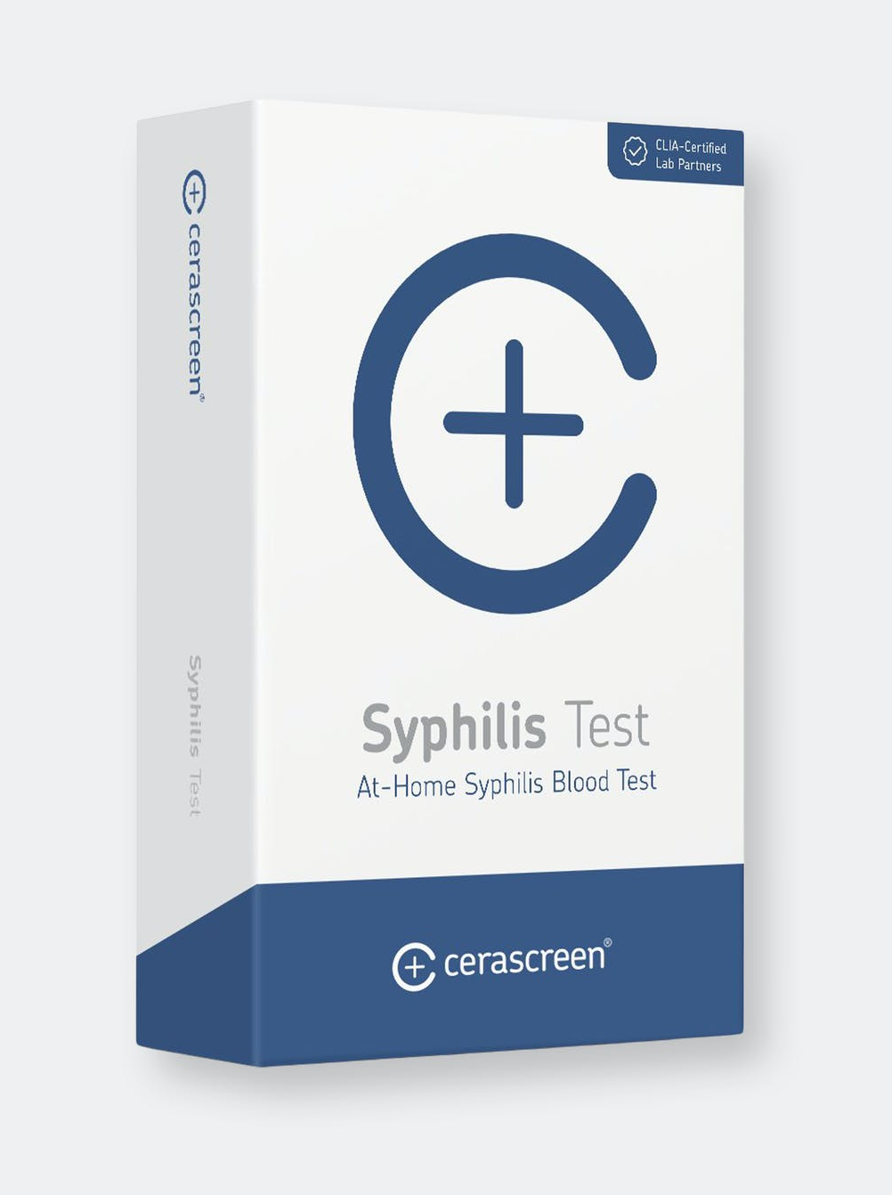
Evidence-informed practices
When possible, integrate telehealth and at-home testing into clinical practices
Integrate STI screening or referrals into substance use services
Connect patients to other services to meet their needs
Valentine, 2022; Murali & Jayaraman, 2018; NASTAD & NCSD, 2014; Chen, 2021; Abad et. al, 2015;
Notes:
-also, when possible, Integrate telehealth and at-home testing into clinical practice
-As we’ve talked about, particularly in rural areas, patients may fear being recognized if they go to their local health department or an STD clinic to get tested. Telehealth and at-home testing, where available, can make a big difference. However, not all states or jurisdictions offer free tests, and they are pretty expensive otherwise– California recently passed a new law that the state must cover all at-home tests ordered by healthcare providers. Similarly, the health care departments in Washington DC and Alabama send free at-home tests (with discreet packaging) to those that request it. I don’t think we’re there yet in North Carolina, but hopefully at some point we will be.
-Integrate STI screening or referrals into substance use services
Because there is such a strong overlap between STIs and substance use (particularly methamphetamines and injection drug use), it is important to really strongly link the two. So, substance use clinics should link patients to STI screening and treatment, and sexual health settings should link patients to substance use screening and treatment.
-Connect patients to other services to meet their needs.
Along these lines, This not only helps patients to be in a stable place emotionally where they can address their syphilis but helps to build trust with providers in a clinic, so that patients can be retained in care. So, this could mean connecting patients to substance use or mental health services, shelter or financial assistance, domestic violence services, or helping them to access food. Even helping to meet patients immediate needs – having snacks on hand, or offering patients a food voucher if you have a cafeteria in your building -- can make a big difference.

Slide 15
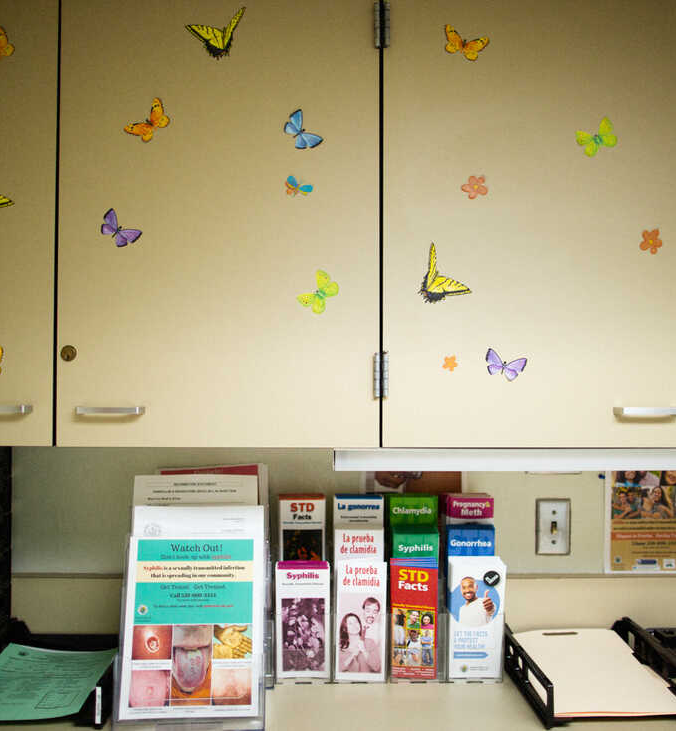
Interventions for stigma
Change language: STD v. STI; ”clean” v. dirty test results
STI counseling: normalize the experience of having an STI
Syphilis or other STI diagnoses can bring back trauma – connect patients to mental health support
Castaneda, 2018; C, 2017; Duberman, 2022
Notes:
So, next, I wanted to talk about interventions to destigmatize syphilis and other STIs. These are not necessarily evidence-based, as there’s not a lot of research on stigma interventions, since there’s also not a lot of funding for stigma interventions, but this is what some people in the field suggest.
-The first is shifting language.
So, really making an effort not to say that a test comes back ”clean” or “dirty” – and instead using the terms “negative” and positive” to talk about test results. There is also an ongoing debate about the terms sexually transmitted infection verses sexually transmitted disease that I don’t have time to get into, but I’ve included a link where you can read more about this.
-also, normalizing the experience of having an STI can really combat stigma.
Historically, a lot of institutions, have used scare tactics to get people to use condoms or get tested. I’m sure many people who have had sex ed are familiar with this – you are shown really graphic pictures of advanced STIs. A more effective approach for clinicians and social workers is to normalize the experience of having an STI – 10s of millions of people have STIs and most go on to live healthy, happy sexual lives
-Lastly, a diagnosis of syphilis or another STI can bring up trauma for a lot of people – for people living with HIV, it may remind them of their HIV diagnosis, or another STI diagnosis which caused them to learn their partner was cheating on them. It may be important to connect these people to a social worker within the clinic, or to longer term therapy.

Slide 16
Interventions for stigma
We can all be anti-stigma advocates
Public anti-stigma campaigns: Triad Health Project “Stop the STIgma”
C, 2022; Triad Health Project, 2022
Notes:
So, more interventions for stigma.
-The first is on a personal level. So, there are a lot of champions for certain medical conditions – cancer, diabetes, even increasingly, champions for HIV– but there are really few champions for STIs and that experience. It’s not glamorous or popular. I think it’s really on us, as integrated care professionals, to be those champions, so that we can really bring the experience of STIs to light.
-Also, there are some amazing public anti-stigma campaigns. The Triad Health Project in Greensboro has one such campaign, and I’ve included some of the images from that campaign – here are some of the shirts you can buy, and they have all these conversation starters around how to talk about being tested with friends, family and partners.

Slide 17
Culturally sensitive care
Take time to build trust and rapport-- many of the those most at risk for syphilis are those with well-justified distrust of the medical system
Have signs and materials that depict gender and sexual minorities of color
Chen, 2021; NASTAD & NCSD, 2014
Notes:
Moving on to recommendations for culturally sensitive care.
-So, first, a lot of the groups most at risk for syphilis are those with well-justified distrust of the medical system, including sexual and gender minorities, racial minorities, and people who use drugs. It takes time to build trust and rapport with these patients – I think, in our clinic, this may mean that patients no-show multiple times for appoitnments, and continuing to work with them to get them into clinic. Also being really transparent about what the process will look like – this is where you check in, this is where you park, this is what treatment you will receive.
-Finally, really making use signs and materials depict sexual minorities of color. These are one ofhte groups most at risk of being infected with syphilis, visual reminders that they belong in a clinic are really improatnt

Slide 18
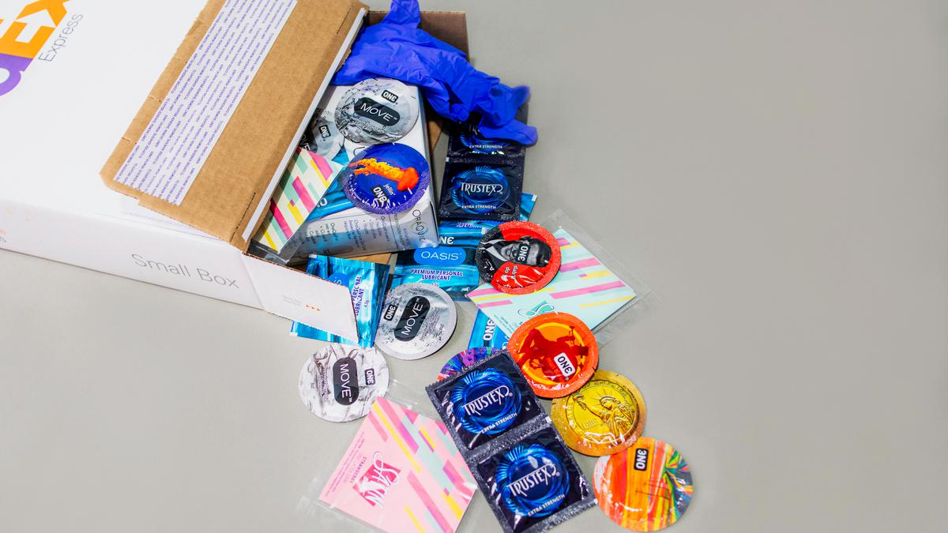
Culturally sensitive care
Partner with trusted organizations (key stakeholders in community, syringe access services)
Harm reduction
Rodriguez, 2017; Frost, n.d.; Murali & Jayaraman, 2018; Martinez et al., 2014
Notes:
-It can also be important to partner with trusted organizations that people in specific communities trust.
For instance, partnering with syringe service sites and harm reduction organizations so that you can make STI services more accessible to people who use drugs. Similarly, partnering with trusted immigrant or refugee organizations, to help make services accessible to hard-to-reach popualtions.
Also, offering harm reduction techniques for certain populations can be really helpful.
So, for a sex worker, it may be really unrealistic that they will be able to reduce their number of partners to reduce their risk, so offering condoms and lubricant can be really important. Lube is a part of the picture that isn’t discussed enough, particularly for people who use methamphetamine, because people who use meth may engage in longer and sometimes rougher sex, because of the way meth affects the body, so they may be more susceptible to bruising and tear, which open up the possibility for infection transmission. Thus, lubricant can help to reduce this.
Also, setting up community advisory boards can be a really key way of getting input from sexual, gender and racial minorities in the community. This can offer really key insights into barriers that patients face and ways to retain care. It can also be a really empowering experience for patients.

Slide 19
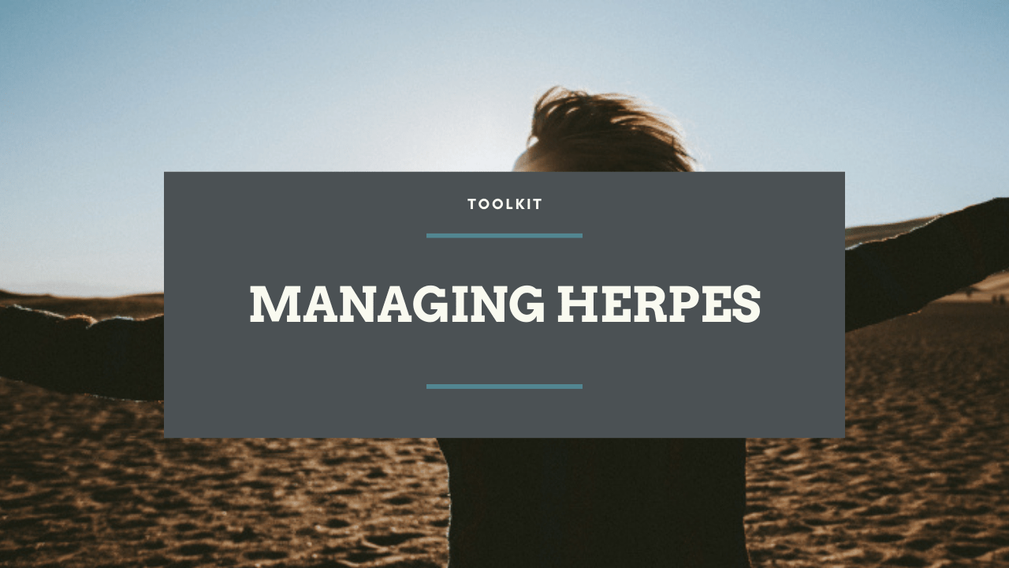
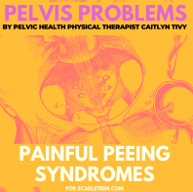
Recommendations
Triad Health Project
The STI Project – lots of great resources for people experiencing stigma and shame after an STI diagnosis
Dr. Jen Gunter editorial about STIs
Scarleteen – sex education for young people (but, really, all of us)
Notes:
And finally, I would like to close with some recommendations for further information. So, the first is Triad Health Project, the organization in Greensboro that I previously mentioned that has such an amazing anti-stigma campaign.
The next one is the STI Project – this is an amazing campaign started by a women with a viral STI that offers a lot of great resources for people expeirenceing stigma and shame after an STI diagnosis – in particular, there’s a lot about genital herpes which can be really helpful for people with that diagnosis. Some of the content is not free, but there are lots of free blog posts.
I’ve also included a link to the editorial from the gynecologist, Jen Gunter, that I quoted earlier in the presentation, about stigma.
I’ve also included a link to a really great Planned Parenthood writer named Anna C. who writes about STIs and stigma.
And finally, I’ve included a link to a website called Scarleteen – it has a wealth of really inclusive, amazing sexual health information. It’s great for young people, but it’s also great for, really, all of us, all of us who ever felt like we had a question about sex but were too ashamed to ask.

Slide 20
References
C, A. (2017, November 20). STD awareness: STI vs. STD … what’s the difference? http://advocatesaz.org/2017/11/20/std-awareness-sti-vs-std-whats-the-difference/
C, A. (2020, March 25). STD awareness: Stigma and sexually transmitted diseases. https://www.plannedparenthoodaction.org/planned-parenthood-advocates-arizona/blog/std-awareness-stigma-and-sexually-transmitted-diseases
Castaneda, R. (2018, June 18). 6 strategies for breaking the stigma of living with an STD. US News & World Report. https://health.usnews.com/health-care/patient-advice/slideshows/6-strategies-for-breaking-the-stigma-of-living-with-an-std
CDC. (2021, April 7). Syphilis—Rates of reported cases by stage of infection, United States, 2010–2019. http://www.cdc.gov/std/statistics/2019/figures/SYPH-1.htm
Centers for Disease Control. (2021a, April 19). National overview—Sexually transmitted disease surveillance, 2019. http://www.cdc.gov/std/statistics/2019/overview.htm
Centers for Disease Control. (2021b, May 3). Tuskegee study—Timeline—CDC - NCHHSTP. http://www.cdc.gov/tuskegee/timeline.htm
Centers for Disease Control. (2022, March 15). STD facts—Syphilis. http://www.cdc.gov/std/syphilis/stdfact-syphilis.htm
Chen, C. (2021a, November 1). Syphilis is resurging in the U.S., a sign of public health’s funding crisis. NPR. https://www.npr.org/sections/health-shots/2021/11/01/1050568646/syphilis-std-public-health-funding
Chen, C. (2021b, November 23). Why the U.S. hasn’t stopped syphilis From killing babies. Undark Magazine. https://undark.org/2021/11/23/why-the-us-hasnt-stopped-syphilis-from-killing-babies/
Duberman, E. (2022, March 25). [In person].

Slide 21
References
Frost, T. (n.d.). Harm reduction for engagement. Harm Reduction Coalition. chrome-extension://efaidnbmnnnibpcajpcglclefindmkaj/viewer.html?pdfurl=https%3A%2F%2Fwww.essentialaccess.org%2Fsites%2Fdefault%2Ffiles%2Ffiles%2Fca-cs%2FBO-4-Frost-Harm-Reduction-STI-Prevention-Treatment.pdf&clen=24510404&chunk=true
Gunter, J. (2019, August 13). Why sexually transmitted infections can’t shake their stigma. The New York Times. https://www.nytimes.com/2019/08/13/style/sti-stigma-sexual-transmitted-infections.html
Henderson, E. (2022, January 5). With sexually transmitted infections off the charts, California pushes at-home tests. News-Medical.Net. https://www.news-medical.net/news/20220105/With-sexually-transmitted-infections-off-the-charts-California-pushes-at-home-tests.aspx
Lee, N.-Y., Chen, Y.-C., Liu, H.-Y., Li, C.-Y., Li, C.-W., Ko, W.-C., & Ko, N.-Y. (2020). Increased repeat syphilis among HIV-infected patients: A nationwide population-based cohort study in Taiwan. Medicine, 99(28), e21132. https://doi.org/10.1097/MD.0000000000021132
Martinez, O., Wu, E., Moya, E., Chavez-Baray, S., Dodge, B., Shults, A., & Lopez-Rios, J. (2014). Overcoming issues and challenges in serving the sexual health needs of Latino immigrants in the United States. The Eta Sigma Gamman, 31, 43–51.
Mayo Clinic. (2021, September 25). Syphilis—Diagnosis and treatment. https://www.mayoclinic.org/diseases-conditions/syphilis/diagnosis-treatment/drc-20351762
Murali, V., & Jayaraman, S. (2018). Substance use disorders and sexually transmitted infections: A public health perspective. BJPsych Advances, 24(3), 161–166. https://doi.org/10.1192/bja.2017.14
NASTAD, & NCSD. (2014). Addressing stigma: A blueprint for improving HIV/STD prevention and care outcomes for Black & Latino gay men. chrome-extension://efaidnbmnnnibpcajpcglclefindmkaj/viewer.html?pdfurl=https%3A%2F%2Fwww.ncsddc.org%2Fwp-content%2Fuploads%2F2017%2F08%2Fnastad_ncsd_report_addressing_stigma_may_2014.pdf.pdf&clen=2081379&chunk=true
Planned Parenthood. (n.d.). What is syphilis? Planned Parenthood. https://www.plannedparenthood.org/learn/stds-hiv-safer-sex/syphili

Slide 22
References
Rodriguez, C. (2017, January 10). Harm reduction 101: Approaching syphilis prevention for people who use drugs. California Syphilis Prevention Summit. chrome-extension://efaidnbmnnnibpcajpcglclefindmkaj/viewer.html?pdfurl=http%3A%2F%2Fpublichealth.lacounty.gov%2Fdhsp%2FPresentations%2FSyphilis%2FRodriguez_HarmReduction.pdf&clen=2576145&chunk=true
Schmidt, R., Carson, P. J., & Jansen, R. J. (2019). Resurgence of syphilis in the United States: An assessment of contributing factors. Infectious Diseases: Research and Treatment, 12, 1178633719883282. https://doi.org/10.1177/1178633719883282
Singh, A. E. (2019). How to address the resurgence of syphilis in Canada. CMAJ, 191(50), E1367–E1368. https://doi.org/10.1503/cmaj.191075
Valentine, J. A., Delgado, L. F., Haderxhanaj, L. T., & Hogben, M. (2022). Improving sexual health in U.S. rural communities: Reducing the impact of stigma. AIDS and Behavior, 26(S1), 90–99. https://doi.org/10.1007/s10461-021-03416-4
Villar-Loubet, O. M., Vamos, S., Jones, D. L., Lopez, E., & Weiss, S. M. (2011). A cultural perspective on sexual health: HIV positive and negative monolingual Hispanic women in south Florida. Hispanic Health Care International : The Official Journal of the National Association of Hispanic Nurses, 9(2), 82–90. https://doi.org/10.1891/1540-4153.9.2.82
Ware-Pressley, M. (2021, October 15). Innovative methods to reduce stigma and mitigate the STI epidemic impacting young adults with HIV. AIDS Education and Training Centers National Coordinating Resource Center (AETC NCRC). https://aidsetc.org/blog/innovative-methods-reduce-stigma-and-mitigate-sti-epidemic-impacting-young-adults-hiv

Slide 23
Picture References
When not specified on slides, pictures were found from the following websites:
NPR
NAM AIDS MAP
POZ
Planned Parenthood Great Plains
San Francisco AIDS Foundation
The Gender Spectrum Collection
Verishop

Slide 24
This project was supported by the Health Resources and Services Administration (HRSA) of the U.S. Department of Health and Human Services (HHS), Behavioral Health Workforce Education and Training (BHWET) Program under M01HP31370, UNC-PrimeCare, $1,920,000.00, or the Opioid Workforce Expansion Program -- Professional, (OWEP) under T98HP33425, UNC-PrimeCare-OUD, $1,350,000. Both programs are 100% financed with governmental sources. This information or content and conclusions are those of the author/s and should not be construed as the official position or policy of, nor should any endorsements be inferred by HRSA, HHS or the U.S. Government.

