Slide 1

Improving Medication Adherence Among People Living with HIV and Behavioral Health Challenges
By: Jessica James

Slide 2
Introduction
~10-28% of people living with HIV have co-occurring SUDs and mental illnesses.
People living with HIV are as much 20x more likely to have experienced trauma than the general population
People living with both HIV and SUDs may delay HIV treatment initiation and underutilize SUD treatment.
People living with HIV and a co-occurring SUD are less likely to receive Antiretroviral Therapy (ART) and other clinical assessments (e.g., viral load testing)
HIV with co-occurring MI (Mental Illness) and/or SUD (Substance Use Disorders)
>1M people in the US live with HIV (Human Immunodeficiency Virus)

Slide 3
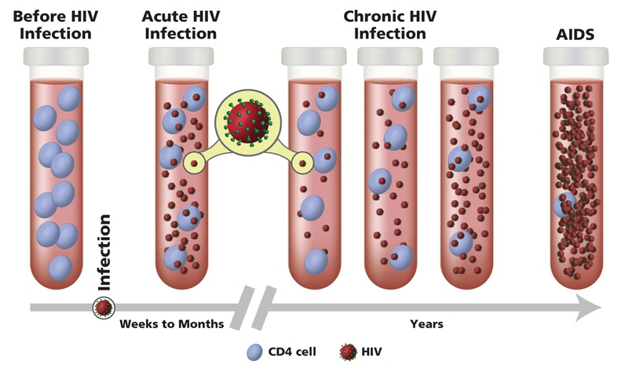
HIV Overview
HIV
3 Stages of HIV
Retrovirus that infects CD4+ T Cells (type of white blood cells)
  Weakens response to bacterial infections
  If untreated, can lead to AIDS (Acquired Immunodeficiency Syndrome)

Slide 4
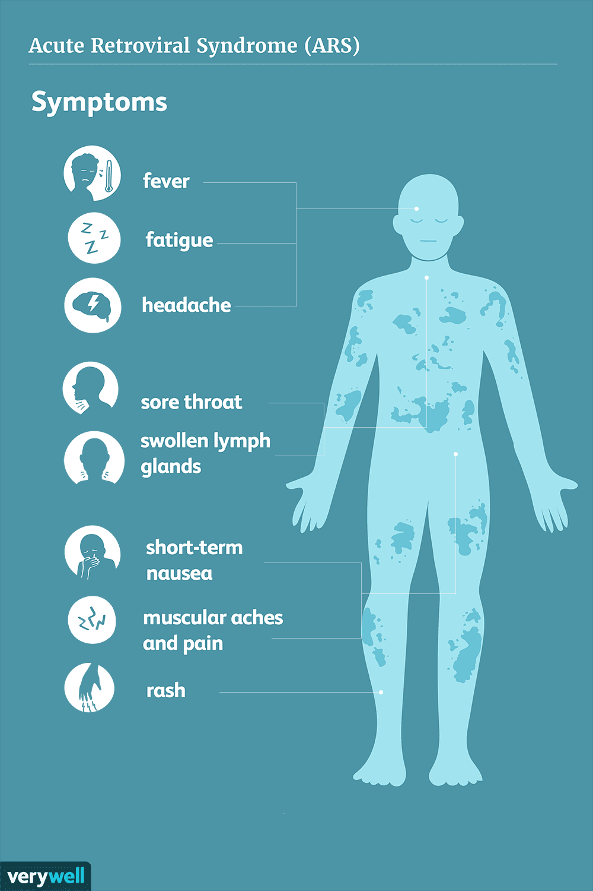
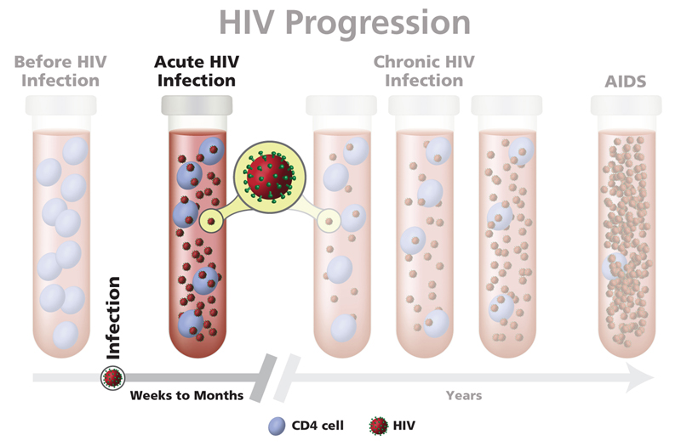
Stage 1: Acute HIV Infection
HIV is very prevalent in blood and is very contagious
Some experience flu-like symptoms
Others may not feel sick right away or at all

Slide 5
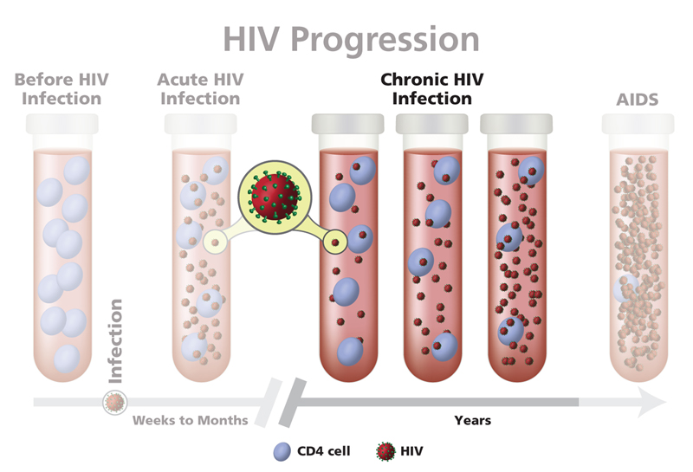
Stage 2: Chronic HIV Infection
Also called asymptomatic or clinical latency
  HIV is active but slower
  May be asymptomatic (still transmissible)
Medicine may prevent Stage 3
When close to stage 3
  ↑ HIV in blood (viral load)
  ↓ CD4 cell count

Slide 6
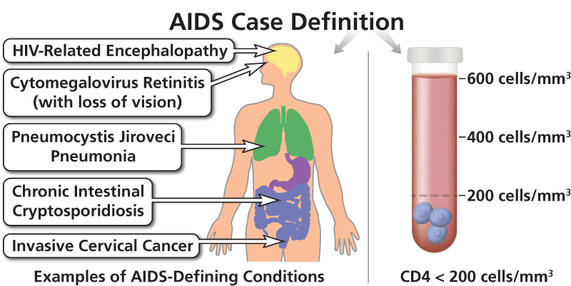
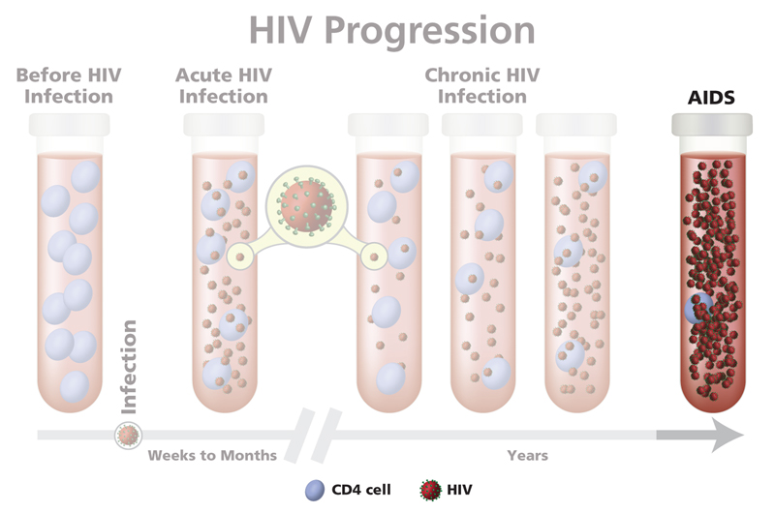
Stage 3: Acquired Immunodeficiency Syndrome
Most severe phase
Immune system is extremely weak, increasing number of severe illnesses
High viral loads increase odds of transmission
Without treatment, people with AIDS typically survive 3 years

Slide 7
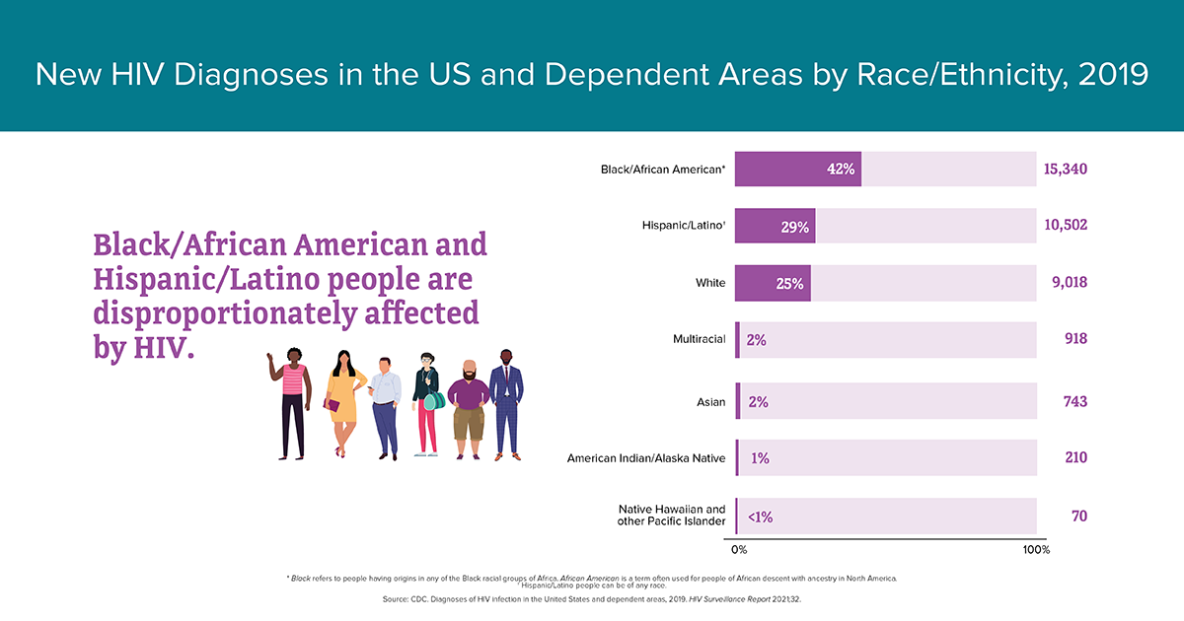
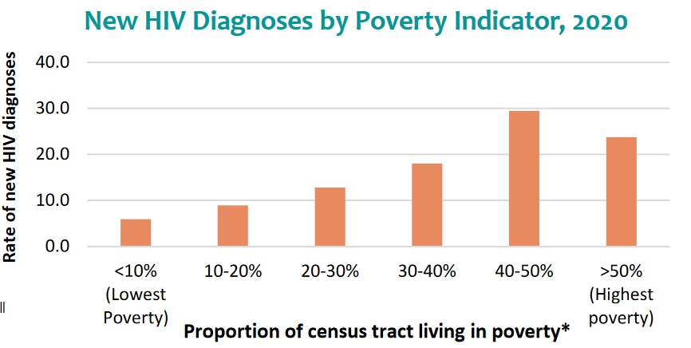
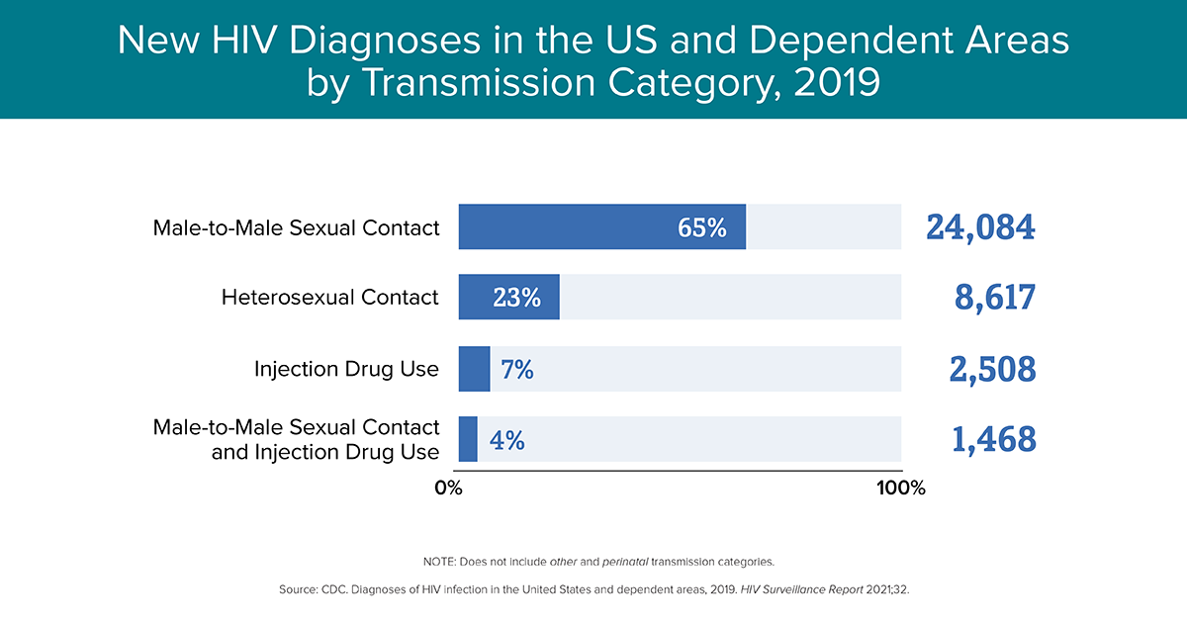

Slide 8

How can substance use affect a person Living with HIV?
Substance Use Disorder
Increased viral load
AIDS related morbidity
Low immune system, liver disease, and immune deficiency disease
Illicit substances weaken the blood brain barrier, allowing HIV into the brain and resulting in neuroinflammation (brain swelling)
Some recreational drugs can have adverse interactions with HIV medicines
Drugs and alcohol use can make it difficult for people with HIV to adhere to a daily HIV treatment regiment

Slide 9
Anti-retroviral therapy (ART)
ART
Decreased HIV viral load in bodily fluids
Improved health outcomes
Potentially eliminate viral load and transmission
Decreased mortality
Manageable chronic disease
(Terminal without ART)
Anti-Retroviral Therapy (ART) is a combination of medications that block HIV replication
If a client does not have HIV, provide primary and secondary HIV prevention strategies
  Primary HIV prevention reduces the incidence of transmission (i.e., fewer people get HIV),
    Harm reduction
    Safer sex education
    Condom use
    Syringe service programs
  Secondary HIV prevention reduces the prevalence and severity of the disease through early detection and prompt intervention
    PrEP and PEP
      Pre-Exposure Prophylaxis (PrEP)
      Post-Exposure Prophylaxis (PEP)

Slide 10
Barriers to Accessing CARE
Additional service needs (e.g. housing, employment, child-care, food security)
SUD and HIV stigma and discrimination
When HIV, SUD, and mental disorder treatments are fragmented, clients are at greater risk of dropping out of treatment as a result of:
  Fear
  Stigma
  Escalating substance use
  Mental disorder symptomatology
  Difficulties adhering to ART
  Concern about decreases in viral suppression
Co-occurring HIV, SUDs, and mental disorders
Obstacles that racial/ethnic minorities often face in accessing care
Psychological stressors affecting individual and community health outcomes
Incarceration and criminal justice system barriers
Complexities of medical comorbidities (e.g. viral hepatitis)

Slide 11
Recommended practices
SUD treatment programs need to be well-equipped to provide HIV risk assessments, testing, counseling, and linkage to HIV care providers
PrEP and PEP prescriptions for those who do not have HIV to reduce their risk of contracting HIV
Tailored and integrated services are necessary to achieve both HIV and SUD related treatment goals
Recommendations for SUD Treatment Providers when working with PLWHA
Providers should offer universal HIV screenings for people experiencing a SUD
For clients experiencing a SUD who are not living with HIV, providers can implement ongoing HIV screenings and testing, prescribe PrEP and PEP, provide education on harm reduction strategies, and implement counseling programs to support continued SUD recovery and prevent HIV
SUD treatment providers can quickly link clients with HIV to HIV primary care
Providers must receive training to effectively implement screening, assessment, and treatment programs
The co-occurrence of a SUD and HIV requires an integrated treatment plan that assesses and addresses the client’s social stressors and support systems while acknowledging potential client co-morbidities
Case managers are essential for developing and implementing an integrated treatment plans
Case managers and providers should establish a network of referrals for services not provided

Slide 12
Important Considerations
Appropriately Diagnosing Individuals
Understanding SUD and HIV symptomatology leads to effective diagnosis and treatment strategies.
Supporting Consistent ART Use
For people with HIV and a co-occurring SUD who need additional support to adhere to ART, providers can provide:
HIV education on de-stigmatization, routes of transmission, and the importance of testing
Strategies to prevent HIV transmission
HIV Treatment program policies
Confidentiality rules and expectations
Local HIV-specific resources, including testing sites and hotlines
Available medical and social services and how to obtain them
Monitoring Medication Interactions
Providers must understand interactions between ART, medications for SUDs (e.g., methadone, buprenorphine, naltrexone), and pharmacotherapies for mental disorders to closely monitor for interactions between prescribed medications
Providers should be able to discern whether a symptom is due to HIV or a SUD
Differential diagnoses are key to ensuring individuals get the individualized care they need, and that they do not experience possible adverse drug reactions or interactions if taking HIV medications
Additionally, providers should consider the interactions between prescribed medications and other drugs

Slide 13
Provider Strategies
Universal HIV Testing
  In the US, about 14% of >1M people with HIV do not know they have the disease (Centers for Disease Control and Prevention, 2020)
  Testing identifies an individual’s HIV status and is the first step in linking those newly diagnosed with HIV to care. Testing also helps prevent HIV transmission and new infections (Mayo Clinic, 2020).
  Individuals who are undiagnosed or unaware of their HIV status account for nearly 40% of ongoing HIV transmissions
  Treatment providers should prescribe PEP to those who may have been exposed to HIV, and risk reduction counseling and intervention for clients at risk for infection
  HIV counseling should be part of a SUD provider’s approach, both before and after testing.
  Counseling is an opportunity to help people assess their risks, encourage and reinforce harm reduction and prevention strategies, and refer people with HIV to clinical care. Counselors should be specifically trained in HIV counseling.

Slide 14
Provider Strategies (Cont.)
Assess for specific SUD type and severity to determine SUD treatment plan
Coordinate and integrate care for people with HIV and SUD
Provide case management to address ancillary service needs and build referral networks for clients
Provide counseling to support treatment adherence
Train providers on the availability of services in their communities
Train providers and clinic staff on cultural, ethical and cross-cutting issues:
  Implicit bias and HIV- and SUD related stigma
  Stigmatizing attitudes are still pervasive within the United States and can negatively impact an individual’s willingness to seek care and remain engaged in it. Stigmatizing beliefs may be related to fear of transmission or ideas about who is at risk for being diagnosed with HIV or a SUD
Shame and guilt
Homophobia
Anger and hostility
Frustration
Over-identification
Denial
Racial, gender, and economic inequity
Burnout
Powerlessness, helplessness, loss of control
While working with this client population, providers may need to confront the following treatment obstacles:

Slide 15
Treatment and prevention
Harm Reduction Strategies
Overdose prevention
Prevention of infectious complications
Syringe service programs (SSPs)
Pre‐exposure prophylaxis (PrEP)
Pharmacologic treatment
Methadone
Buprenorphine/naloxone (Suboxone®)
Naltrexone
Outreach and education
Supervised injection facilities (SIFs)
Brief Intervention
Raising the patient’s awareness of their substance use
Informing the patient about the health consequences of substance use, especially how substance use can affect HIV disease and treatment
Helping the patient understand the negative social, legal, financial, and physical consequences of her/his use
Motivating the patient to consider positive behavior change(s)
https://harmreduction.org
Motivational Interviewing (MI)
Goal-directed SUD intervention that stems from person-centered counseling
Counseling style that raises awareness of a client’s internal discrepancies about substance use, focuses on helping clients resolve their ambivalence about SUD, and can promote their motivation to change
Underlying this approach is the principle that a client’s motivation to change is essential to bringing about actual change
Focus is on enhancing intrinsic motivation
Provider helps the client see “where they are” and “where they want to be”
Incorporates four interwoven processes: Partnership, Acceptance, Compassion, and Evocation (PACE)
Rooted in the trans-theoretical model of the stages of change framework
Based on 4 processes: Engaging, Focusing, Evoking, and Planning
Research-proven procedure for working with individuals with at-risk use and less severe abuse behaviors
Can be successful when transported into specialist treatment settings and performed by alcohol and drug counselors

Slide 16
Treatment and prevention (cont.)
No pharmacological agents are approved by the FDA for treating cocaine (or other similarly acting stimulants), cannabis (marijuana, hashish), or benzodiazepine use disorders.
PrEP and PEP
Strategy in which people who are at an increased risk of getting HIV routinely take one or more antiretroviral drugs to reduce their risk of contracting HIV.
PEP (Post-Exposure Prophylaxis)
The use of antiretroviral drugs after a single high-risk event to stop HIV seroconversion
PEP must be started within 72 hours of a possible exposure to HIV.
PrEP reduces the risk of getting HIV from sex by about 99%.
PrEP reduces the risk of getting HIV from injection drug use by at least 74%.
There have been many scientific advances in the past 5 years in the identification of multiple cannabinoid receptors, and research is underway to explore reciprocal pharmacological agents.
There are over 65 medications in development for cocaine addiction.
PrEP (Pre-Exposure Prophylaxis)
Stimulants, Marijuana, and Benzodiazepine
Additional Treatments
Anti-Retroviral Therapy (ART)
Contingency Management (CM)
Cognitive Behavioral Therapy (CBT)
HIV Navigation Services STEPS to Care (HNS–STEPS to Care)
Medication Assisted Treatment (MAT)
The use of medications, in combination with counseling and behavioral therapies
Aims to provide a “whole-patient” approach to the treatment of
Opioid use disorders
Alcohol use disorders

Slide 17
Integrated Care
Definition of Integrated Care
(from the World Health Organization (WHO) Regional Office of Europe)
What services can mental health providers add to Integrated care teams?
(adapted from an American Psychological Association fact sheet for policymakers):
Cognitive, capacity, diagnostic, and personality assessments that differentiate normal processes from pathologic states, side effects of medications, adjustment reactions, or combinations of these problems
Behavioral health assessment and treatment that provide individuals with the self-management skills necessary to effectively manage their chronic conditions
Diagnosis and treatment of mental and behavioral health problems (e.g., depression, suicide risk, anxiety disorders, addiction, and insomnia)
Consultation and recommendations to family members, significant others, and other health care providers with the client’s consent
“Integrated health services delivery is defined as an approach to strengthen people-centered health systems through the promotion of the comprehensive delivery of quality services across the life-course, designed according to the multidimensional needs of the population and the individual and delivered by a coordinated multidisciplinary team of providers working across settings and levels of care.”
Key Components of Integrated Care Models for PLWHA
Treatment of HIV/HCV
Behavioral health services
Access to PrEP
Additional harm reduction services (SSP, naloxone, etc.)
SUD treatment
SBIRT Model
Screening
Referral to Treatment
Brief Intervention

Slide 18
culturally sensitive care
5 essential elements contribute to cultural competence
Valuing diversity
Cultural self-assessment
Dynamics of difference
Institutionalization of cultural knowledge
Adaptations to diversity
Weiss (2007) recommends these six steps to improve cross-cultural communication with clients
Slow down
Use plain, nonpsychiatric language
Show or draw pictures
Limit the amount of information provided at one time.
Use the “teach-back” method. Ask the client, in a nonthreatening way, to explain or show what he or she has been told
Create a shame-free environment that encourages questions and participation
50% of racially and ethnically diverse clients end treatment or counseling after one visit with a mental health practitioner
Cultural competency to provide culturally sensitive care
  Clients respond best to providers who are representative of their communities or otherwise respect their background and identities
  Providers should become familiar with “person-first” language, issues around race, ethnicity, gender, and socioeconomic status, and create a learning environment where they can continually grow their cultural understanding.

Slide 19
Culturally Responsive
Evaluation and Treatment Planning
Step 1:
Engage clients
Step 2:
Familiarize clients and their families with treatment and evaluation processes
Step 3:
Endorse collaboration in interviews, assessments, and treatment planning
Step 4:
Integrate culturally relevant information and themes
Step 5:
Gather culturally relevant collateral information
Step 6:
Select culturally appropriate screening and assessment tools
Step 7:
Determine readiness and motivation for change
Step 8:
Provide culturally responsive case management
Step 9:
Incorporate Cultural Factors Into Treatment Planning
https://store.samhsa.gov/sites/default/files/d7/priv/sma14-4849.pdf

Slide 20
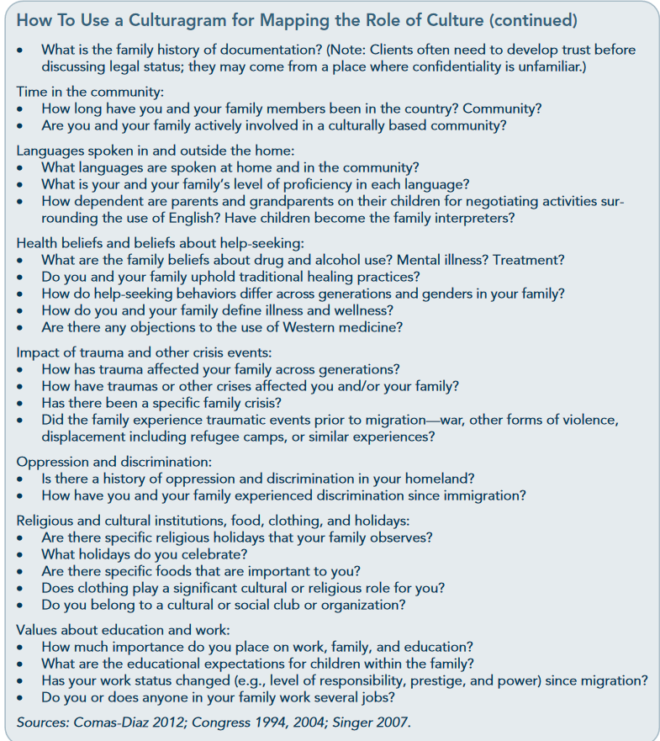
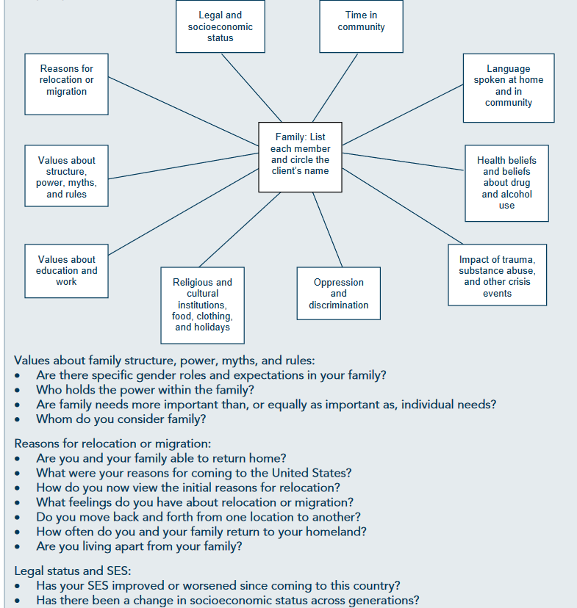
Culturagram:
An assessment Tool

Slide 21
Resources for more information on HIV and SUDs
https://nida.nih.gov/drug-topics/hiv
https://hivinfo.nih.gov/understanding-hiv/fact-sheets/hiv-and-substance-use
https://www.dukehealth.org/locations/duke-prep-clinic-hiv-prevention
https://www.thenationalcouncil.org/program/center-of-excellence/
https://epi.dph.ncdhhs.gov/cd/hiv/program.html
https://adap.directory/north-carolina
https://epi.dph.ncdhhs.gov/cd/hiv/docs/NC2017-2021_IntegratedPreventionandCarePlan_9-30-16.pdf

Slide 22
Thank you

Slide 23
References
Center for Substance Abuse Treatment (US). (2014). Improving Cultural Competence. Substance Abuse and Mental Health Services Administration (US).
Center of Excellence For Integrated Health Solutions. National Council for Mental Wellbeing. (2022, April 6). Retrieved April 7, 2022, from https://www.thenationalcouncil.org/program/center-of-excellence/
Centers for Disease Control and Prevention. (2021, June 1). About HIV/AIDS. About HIV. Retrieved April 7, 2022, from https://www.cdc.gov/hiv/basics/whatishiv.html
Centers for Disease Control and Prevention. (2022, March 28). HIV Risk and Prevention: Post-exposure prophylaxis (PEP). Centers for Disease Control and Prevention. Retrieved April 7, 2022, from https://www.cdc.gov/hiv/risk/pep/index.html
IHAP. (2008, February). Integrated Health Care for an Aging Population. IHAP - A Fact Sheet for Policymakers. Retrieved April 7, 2022, from https://www.apa.org/pi/aging/ihap-factsheet-policymakers.pdf
Marx, M., & Corwin, M. A. (2014, June). Screening, Brief Intervention, and Referral to Treatment: Addressing Substance Abuse in HIV Care Settings. HIV Provider Reference Series. Retrieved April 7, 2022, from https://aidsetc.org/sites/default/files/resources_files/sbirt.pdf
National Institutes of Health. (2021, August). HIV and Substance Use. Living with HIV. Retrieved April 7, 2022, from https://hivinfo.nih.gov/understanding-hiv/fact-sheets/hiv-and-substance-use
NC Department of Health and Human Services. (2021, November). North Carolina HIV/STD/Hepatitis Surveillance Report. NC DPH: HIV/STD Facts & Figures. Retrieved April 7, 2022, from https://epi.dph.ncdhhs.gov/cd/stds/annualrpts.html
SAMHSA. (2020, November). Prevention and Treatment of HIV Among People Living with Substance Use and/or Mental Disorders. Publications and Digital Products. Retrieved April 7, 2022, from https://store.samhsa.gov/product/Prevention-and-Treatment-of-HIV-Among-People-Living-with-Substance-Use-and-or-Mental-Disorders/PEP20-06-03-001
SAMHSA. (2021, January). Advisory: Treating Substance Use Disorders Among People with HIV. Publications and Digital Products. Retrieved April 7, 2022, from https://store.samhsa.gov/product/advisory-treating-substance-use-disorders-among-people-hiv/pep20-06-04-007
SAMHSA. (2021, January). Advisory: Using Motivational Interviewing in Substance Use Disorder Treatment. SAMHSA Advisory. Retrieved April 7, 2022, from https://store.samhsa.gov/product/advisory-using-motivational-interviewing-substance-use-disorder-treatment/pep20-02-02-014
Substance Abuse and Mental Health Services Administration and Health Resources and Services Administration. (2016). The Case for Behavioral Health Screening in HIV Care Settings. SAMHSA-HRSA Center for Integrated Health Solutions. Retrieved April 7, 2022, from https://store.samhsa.gov/sites/default/files/d7/priv/sma16-4999.pdf
U.S. Department of Veterans Affairs. (2015, January 20). Integrated Mental Health Care for Health Care Providers. Integrated Mental Health Care - HIV. Retrieved April 7, 2022, from https://www.hiv.va.gov/provider/integrated-mental-health.asp
UMBC. (n.d.). Infectious Disease with a Focus on HIV. Center for Community Collaboration. Retrieved April 7, 2022, from https://communitycollaboration.umbc.edu/harm-reduction/infectious-disease-with-a-focus-on-hiv/
World Health Organization Regional Office for Europe. (2016, October). Integrated care models: an overview. Retrieved April 7, 2022, from https://www.apa.org/pi/aging/ihap-factsheet-policymakers.pdf

Slide 24
