Slide 1
Creative Writing Interventions for Substance Use Disorder Treatment
Ellen Louise Ray

Slide 2
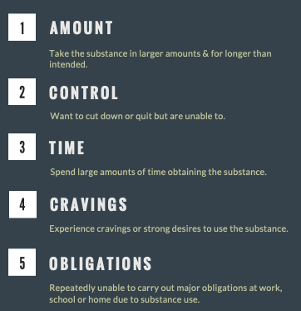
Substance Use Disorders: Diagnostic Criteria
A substance use disorder is diagnosed by the presence of two or more of the following eleven criteria over a 12-month period
(Recovery Research Institute, n.d.)

Slide 3
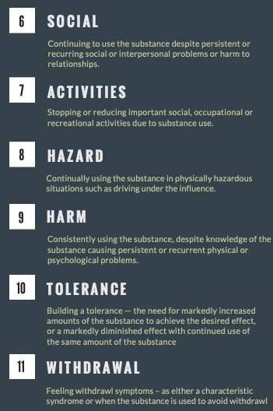
Substance Use Disorders: Diagnostic Criteria
A substance use disorder is diagnosed by the presence of two or more of the following eleven criteria over a 12-month period
(Recovery Research Institute, n.d.)

Slide 4
Prevalence & Impact
20.3 million diagnoses
In 2018, 20.3 million individuals in the United States were diagnosed with substance use disorders (SAMSHA, 2019a).
7.7 million COD
As of 2017, 7.7 million people in the US also had a co-occurring mental health disorder (Han et al., 2017)
11.8 million deaths a year
Problematic use of alcohol, drugs, and tobacco is the cause of death for 11.8 million people each year, which makes substance use more deadly than all the cancers combined (Ritchie & Roser, 2019).
70,630 overdoses
In 2019, 70,630 individuals in the United States died due to drug overdoses (Centers for Disease Control, 2022)
5 overdoses a day in NC
In North Carolina in 2019, approximately 5 people were dying every day from an opioid overdose (North Carolina Department of Health and Human Services, 2020).
$3.73 trillion a year
As of 2019, substance use disorders were draining approximately $3.73 trillion from the United States economy every year (Recovery Centers of America, 2019)

Slide 5
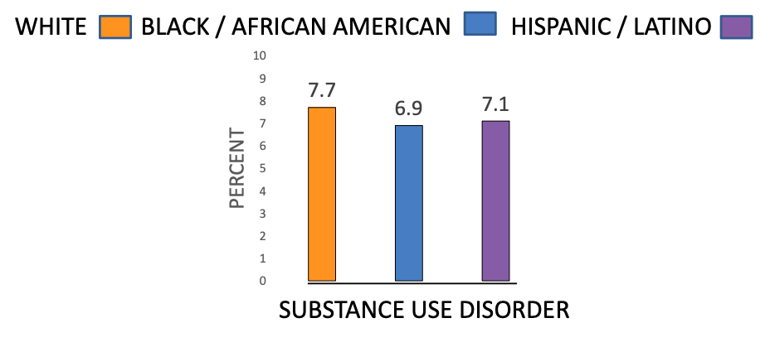
Inequities
(SAMHSA, 2019b)
Black Americans and other racial and ethnic minorities have a prevalence of SUDs that is equal to or lower than that of White Americans yet experience disproportionately negative health & social consequences (Vilsaint, 2021)
Over the last 18 years, drug overdose deaths from stimulants have disproportionately impacted Black and American Indian/Alaska Native individuals even though usage rates of these substances do not differ significantly between ethnic identities (Centers for Disease Control, 2021)

Slide 6
Inequities
Individuals from racial and ethnic minorities who engage in SUD treatment have poorer outcomes and more negative treatment experiences than non-Hispanic whites (Burlew et al., 2021)
Black Americans in recovery from SUD are 3 times more likely to be denied housing and 3 times less likely to be hired compared to White Americans in recovery (Vilsaint, 2021)
This discrimination towards ethnic and racial minorities in recovery leads to higher levels of psychological distress, lower quality of life, and greater risk of returning to use (Vilsaint, 2021)

Slide 7
SUD Treatment: We Need New Approaches
4-5 years:
It takes individuals recovering from Alcohol Use Disorder (AUD) 4-5 years to reach a point when their chance of returning to problematic use drops below 15%. It takes even longer for those recovering from Opioid Use Disorders (OUD) (White & Kelly, 2011).
Multiple Attempts:
It generally takes two to three serious attempts at recovery for individuals to be successful; it takes more attempts for those without strong social support (Kelly et al., 2017)
15 Years:
On average, it takes 15 years for a person in recovery from substance use disorder to attain a quality of life on par with the general population (Recovery Research Institute, 2020)
40-60%:
40-60% of those who achieve recovery from a SUD will return to use. Returns to use can lead to fatal overdoses, particularly for individuals with OUD (NIDA, 2020)

Slide 8
Could creative writing interventions help?
Treatment of the chronic disease of SUD necessitates shifting individuals’ deeply rooted behaviors and requires a multifaceted approach that targets multiple areas of the brain (NIDA, 2020).
For SUD treatment to be effective for diverse populations, it must address the needs of the whole person and consider physical, spiritual, emotional, mental, and social health (NIDA, 2020).
Creative writing group therapy is by nature a multimodal intervention that stimulates the cognitive regions of the brain, the senses, the emotions, and the imagination while providing meaningful engagement with others. As a result, it leads to positive social, psychological, and physiological outcomes (Fancort & Finn, 2019).

Slide 9
Serving Diverse Populations
Creative and expressive writing interventions have proven particularly effective for…
Men who identify as gay (Pachankis & Goldfried, 2010)
Women, adolescents, and sexual assault survivors (Aletraris et al., 2014)
Individuals who were previously incarcerated (Proctor et al., 2011)
At-risk African American youth (Kliewer et al., 2011)
Hispanic youth (Hirai et al., 2020)

Slide 10
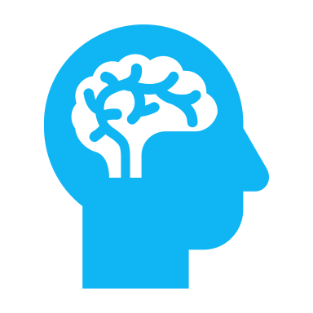
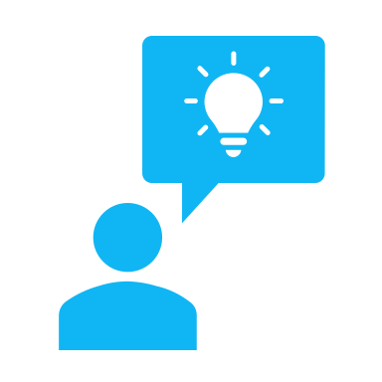
What the research says…
Therapeutic creative writing interventions can aid in SUD recovery and improve individuals’ quality of life by enhancing executive functioning, social connectedness, and overall wellbeing. These interventions also offer clients a new coping skill to use when faced with intense thoughts, feelings, or cravings.

Slide 11
Executive Functioning
Creative writing groups as an add-on to typical substance use treatment have been shown to improve quality of life and executive functioning (Tarp et al., 2019).
Increased executive functioning is associated with increased ability to resist cravings to use; individuals with higher executive functioning skills are more likely to successfully rewire their brains and avoid a return to use (Merritt, 2019).

Slide 12
Social Connectedness
For those with SUD, creative writing instruction has been shown to improve self-esteem, present-moment awareness, gratitude, and the ability to feel connection in relationships (Hellum et al., 2017)
Creative writing group therapy can improve individuals’ self-confidence and social skills, aid in their self-expression, self-awareness, and communication skills, and promote improved trust amongst group members (Snead et al., 2015)
Because social connection provides such a powerful natural reward, it blunts the desire for the artificial rewards of a substance and helps individuals maintain recovery (Merritt, 2019).

Slide 13
Physical & Psychological Wellbeing
Writing about one’s traumatic experiences has been shown to improve immune system functioning and many other measures of physical health (Stuckey & Nobel, 2010)
Engaging in the creative arts can enhance mood and psychological state, decrease stress, and improve physiological health (Stuckey & Nobel, 2010)
Therapeutic creative writing interventions can reduce the cravings to use while also decreasing trauma symptoms and improving depression, anxiety, and physical health (Snead et al., 2015)

Slide 14
Coping Skills
Creative writing interventions provide clients with a new go-to coping skill. Clients who continue to write on their own reap its therapeutic benefits even without any clinical debriefing (Gripsrud et al., 2016; Snead et al., 2015)
Focusing on the nuances of the world (instead of focusing on one’s triggers and cues) while honing the skill of writing can increase motivation for sustained recovery (Hellum et al., 2017)
Creative writing therapy groups can increase the joy and pleasure clients get from reading and writing—this provides clients with a positive replacement activity for substance use (Tarp et al., 2020)

Slide 15
Benefits for Clients
Increased inspiration and motivation for living (Tarp et al., 2020)
Felt sense of play, joy, and fun (Tarp et al., 2020)
Can inspire clients to both read and write for pleasure (Hellum et al., 2017; Tarp et al., 2020)
Can support clients to create a healthy distance between themselves and their emotions, troubling experiences, and cravings (Tarp et al., 2020)
Felt sense of closeness and connection with other clients & therapist (Tarp et al., 2020)
Experience of being vulnerable and radically accepted by others (Tarp et al., 2020)

Slide 16
But, how does it work?
Allowing individuals with SUDs to express themselves through poetry and other creative writing enables them to communicate thoughts, feelings, and ideas that otherwise seem inaccessible or inexpressible (Hellum et al., 2017)
Writing down painful thoughts and experiences provides a sense of release that can relieve somatic symptoms and increase wellbeing (Gripsrud et al., 2016)
Participation in a creative writing group gives clients new tools with which to express themselves, which promotes self-esteem and communication skills (Hellum et al., 2017)
The group setting, and the practice of sharing one’s writing, promotes a sense of being part of a whole and helps clients hone their social skills. This also allows clients to feel part of a group without the activity of substance use as the unifying force (Hellum et al., 2017)
Arts therapies increase motivation for change by encouraging clients to use their imaginations and make choices (Aletraris et al., 2014)

Slide 17
Interprofessional Collaboration
Tarp et al. (2020) and Hellum et al. (2017) found strong benefits in inviting professional writers to lead writing workshops while including therapists that clients already knew & worked with as group participants—this interprofessional approach allows for emotional support as well as the chance to learn a new skill from an expert
Using professional authors as the leaders also was connected with increases in clients’ self-esteem (Hellum et al., 2017; Tarp et al., 2020)
Having a therapist as a participant-observer in these groups promoted clients’ sense of safety and improved client-therapist rapport (Hellum et al., 2017; Tarp et al., 2020). Therapists also reported seeing new sides of their clients and learning about them more deeply through participating in the writing workshops (Tarp et al., 2020)

Slide 18
The Need vs. The Reality
Complementary and alternative medical practices (including arts-based therapies) have shown to provide better care for diverse population groups with unique needs
The Patient Protection and Affordable Care Act (PPACA) of 2010 encouraged the inclusion of complementary and alternative medical practices (such as art, music, and creative writing therapy) alongside more traditional evidence-based practices, but many insurance companies still do not cover these interventions
(Aletraris et al., 2014)

Slide 19
Current Landscape
A 2014 study of a national sample revealed that 36.8% of SUD treatment centers offered some type of arts-based therapy
Programs with a higher proportion of female clients were more likely to offer arts-based therapies
Programs that accepted Medicaid were far less likely to offer arts-based therapies to clients
(Aletraris et al., 2014)

Slide 20
Bringing Creative Writing into Your Treatment Groups
Permission
Give clients direct permission to write however they want
Freedom
Emphasize that spelling, grammar, and punctuation do not matter and that there is no need to use fancy words
Choice
Give clients the option to opt-out of writing exercises and/or write about something else that is coming up for them
Sharing
Invite clients to share of their work with the group but make it clear that they are in charge of what and how much they share
Modeling
When time allows, write with the clients and model vulnerability by reading from your own writing—this humanizes you and can help with rapport
Affirmation
Affirm the positive aspects of clients’ texts (rather than giving feedback on what can be improved)
(Hellum et al., 2017; Merriam Donovan et al., 2019; Tarp et al., 2020)

Slide 21
Recommended Approaches
Try to bring together a diverse group of clients in the group; this allows for a wider range of writing styles and lived experiences that adds livelihood to the group
Don’t feel like the prompts must all be connected to problematic substance use; the research shows that this is not necessary for the experience to be therapeutic
Give choices as much as possible—multiple prompts or multiple ways to address a prompt
Ask clients to listen with curiosity, acknowledge similarities of differences between themselves and other group members, and offer genuine respect—this leads to greater feelings of self-confidence among clients
(Hellum et al., 2017; Merriam Donovan et al., 2019; Tarp et al., 2020)

Slide 22
Structuring the Group
Ground
Brief grounding or mindfulness exercise
Read
Collectively read a published poem that explores thoughts, feelings, images, or behaviors that connect with the group’s current needs or themes. Invite all clients to take turns in the reading.
Discuss
Invite clients to share what lines, images, emotions, or themes in the poems resonated with them
Create
Offer clients a prompt connected with the published poem AND give them permission to go in any direction that feels right
Share
Invite clients to read their work aloud to the group (but don’t force them to). Encourage group to actively listen and be prepared to share what resonated with them.
Celebrate
Ask group members to offer specific affirming feedback about what they heard in the work that struck them. Model this by giving feedback yourself.
(Hellum et al., 2017; Merriam Donovan et al., 2019; Tarp et al., 2020)

Slide 23
Keep in Mind…
Creative and expressive writing often bring up powerful emotions; if you’re in an agency where clients also have access to an individual therapist, encourage them to make use of this resource
Encourage clients to check in with you at the end of group if they are needing support
You don't have to be an expert writer to run a meaningful creative writing group
(Snead et al., 2015)

Slide 24
In Closing…
Substance Use Disorders impact tens of millions of individuals in the US every year but many treatment centers don’t offer the kind of multifaceted, holistic approach that brings about sustained recovery
Creative writing interventions are holistic, multifaceted approaches that can lead to positive social, psychological, and physiological outcomes including enhanced executive functioning, social connectedness, physical wellbeing, and coping skills
Therapeutic creative writing groups offer a great opportunity for interprofessional collaboration between mental health/substance use therapists and local writers
Even if you’re not an experienced writer, you can offer a therapeutic creative writing group to your clients—just create space for writing, sharing, and offering affirmations

Slide 25
Resources
Aletraris, L., Paino, M., Edmond, M. B., Roman, P. M., & Bride, B. E. (2014). The use of art and music therapy in substance abuse treatment programs. Journal of Addictions Nursing, 25(4), 190-196. https://doi.org/10.1097/JAN.0000000000000048
Burlew, K., McCuistian, C., & Szapocznik, J. (2021). Racial/ethnic equity in substance use treatment research: The way forward. Addiction Science & Clinical Practice, 16(1), 1-50. https://doi.org/10.1186/s13722-021-00256-4
Centers for Disease Control. (2021). Cocaine and Psychostimulant-involved Overdose Deaths Disproportionately Affect Racial and Ethnic Minority Groups. Centers for Disease Control. https://www.cdc.gov/drugoverdose/featured-topics/psychostimulant-cocaine-race-ethnic-minorities.html
Centers for Disease Control. (2022). Drug overdose deaths. Centers for Disease Control. https://www.cdc.gov/drugoverdose/deaths/index.html
Fancourt, D. & Finn, S. (2019). What is the evidence on the role of the arts in improving health and well-being? A scoping review. World Health Organization. https://apps.who.int/iris/bitstream/handle/10665/329834/9789289054553-eng.pdf

Slide 26
Resources
Gripsrud, B. H., Brassil, K. J., Summers, B., Søiland, H., Kronowitz, S., & Lode, K. (2016). Capturing the experience: Reflections of women with breast cancer engaged in an expressive writing intervention. Cancer Nursing, 39(4), E51-E60. https://doi.org/10.1097/NCC.0000000000000300
Han B, Compton WM, Blanco C, Colpe LJ. (2017). Prevalence, Treatment, And Unmet Treatment Needs Of US Adults With Mental Health And Substance Use Disorders. Health Aff Proj Hope. 2017;36(10):1739-1747. https://doi.org/10.1377/hlthaff.2017.0584
Hellum, R., Jensen, S., & Nielsen, A. (2017). Is training in creative writing a feasible treatment adjunct for clients suffering from chronic alcohol-use disorder? Nordisk Alkohol- & Narkotikatidskrift : NAT, 34(4), 299-313. https://doi.org/10.1177/1455072517696507
Hirai, M., Dolma, S., Vernon, L. L., & Clum, G. A. (2020). A longitudinal investigation of the efficacy of online expressive writing interventions for hispanic students exposed to traumatic events: Competing theories of action. Psychology & Health, 35(12), 1459-1476. https://doi.org/10.1080/08870446.2020.1758324
Kelly, J. F., Bergman, B. G., Hoeppner, B. B., Vilsaint, C., & White, W. L. (2017). Prevalence and pathways of recovery from drug and alcohol problems in the united states population: Implications for practice, research, and policy. Drug and Alcohol Dependence, 181, 162-169. https://doi.org/10.1016/j.drugalcdep.2017.09.028

Slide 27
Resources
Kliewer, W., Lepore, S. J., Farrell, A. D., Allison, K. W., Meyer, A. L., Sullivan, T. N., & Greene, A. Y. (2011). A school-based expressive writing intervention for at-risk urban adolescents' aggressive behavior and emotional lability. Journal of Clinical Child and Adolescent Psychology, 40(5), 693-705. https://doi.org/10.1080/15374416.2011.597092
Merriam Donovan, A., Dubrasky, D., Sorensen, S. and Corser, G. (2019) Poetic licence to write resistance: women resisting intimate partner violence through poetry, Critical and Radical Social Work, vol 7 no 2, 155–171, https://doi.org/10.1332/204986019X15567130270699
Merritt, P. (2019). Lecture 11: The Neurobiology of Addiction The Reward Pathway. YouTube. https://www.youtube.com/watch?v=x0uqQYhw6Es
National Institute on Drug Abuse (NIDA). (2020). Drugs, Brains, and Behavior: The Science of Addiction. National Institutes of Health. https://nida.nih.gov/publications/drugs-brains-behavior-science-addiction/treatment-recovery
Pachankis, J. E., & Goldfried, M. R. (2010). Expressive writing for gay-related stress: Psychosocial benefits and mechanisms underlying improvement. Journal of Consulting and Clinical Psychology, 78(1), 98-110. https://doi.org/10.1037/a0017580
Proctor, S. L., Hoffmann, N. G., & Allison, S. (2012). The effectiveness of interactive journaling in reducing recidivism among substance-dependent jail inmates. International Journal of Offender Therapy and Comparative Criminology, 56(2), 317-332. https://doi.org/10.1177/0306624X11399274

Slide 28
Resources
Recovery Centers of America. (2019). Economic cost of substance abuse disorder in the United States, 2019. Recovery Centers of America. https://recoverycentersofamerica.com/resource/economic-cost-of-substance-abuse-disorder-in-united-states-2019/
Recovery Research Institute. (2020). 10 things we’ve learned from the National Recovery Study – Recovery Month 2020. https://www.recoveryanswers.org/media/10-things-weve-learned-from-the-national-recovery-study-recovery-month-2020/
Recovery Research Institute. (n.d.) Severity levels of substance use disorder. https://www.recoveryanswers.org/media/diagnosing-substance-use-disorders-the-severity-levels-infographic/
Ritchie, H. & Roser, M. (2019). “Drug Use.” OurWorldInData.org. https://ourworldindata.org/drug-use
Snead, B., Pakstis, D., Evans, B., & Nelson, R. (2015). The use of creative writing interventions in substance abuse treatment. Therapeutic Recreation Journal, 49(2), 179.
Stuckey, H. L., & Nobel, J. (2010). The connection between art, healing, and public health: A review of current literature. American Journal of Public Health (1971), 100(2), 254-263. https://doi.org/10.2105/AJPH.2008.156497

Slide 29
Resources
Substance Abuse and Mental Health Services Administration (SAMSHA). (2019a). Key substance use and mental health indicators in the United States: Results from the 2018 national survey on drug use and health. Department of Health and Human Services. https://www.samhsa.gov/data/sites/default/files/cbhsq-reports/NSDUHNationalFindingsReport2018/NSDUHNationalFindingsReport2018.pdf
Substance Abuse and Mental Health Services Administration (SAMSHA). (2019b). Results from the 2018 National Survey on Drug Use and Health: Detailed tables. Rockville, MD: Center for Behavioral Health Statistics and Quality, Substance Abuse and Mental Health Services Administration. https://www.samhsa.gov/data/sites/default/files/cbhsq-reports/NSDUHDetailedTabs2018R2/NSDUHDetailedTabs2018.pdf
Tarp, K., Hellum, R., Rasmussen, A. J., & Nielsen, A. S. (2020). Can creative writing, as an add-on to treatment for alcohol use disorder, support rehabilitation? Alcoholism Treatment Quarterly, 38(2), 231-249. https://doi.org/10.1080/07347324.2019.1636736
Vilsaint, C. L. (2021). Racial-Ethnic Disparities in Substance Use Disorder. Recovery Research Institute. https://mghcme.org/app/uploads/2021/02/Vilsaint_-2021_Racial-Disparities-in-SUD.pdf
White, W. L., & Kelly, J. F. (2011). Recovery management: What if we really believed that addiction was a chronic disorder? In J. F. Kelly & W. L. White (Eds.), Addiction recovery management: Theory, research and practice (pp. 67-84). Totowa, NJ, US: Humana Press.

Slide 30
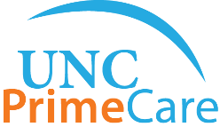
This project was supported by the Health Resources and Services Administration (HRSA) of the U.S. Department of Health and Human Services (HHS), Behavioral Health Workforce Education and Training (BHWET) Program under M01HP31370, UNC-PrimeCare, $1,920,000.00, or the Opioid Workforce Expansion Program -- Professional, (OWEP) under T98HP33425, UNC-PrimeCare-OUD, $1,350,000. Both programs are 100% financed with governmental sources. This information or content and conclusions are those of the author/s and should not be construed as the official position or policy of, nor should any endorsements be inferred by HRSA, HHS or the U.S. Government.

