Slide 1
COVID-19 Impact on Residential Substance Use Treatment
Lainey Johnson and Samantha Puckett

Slide 2
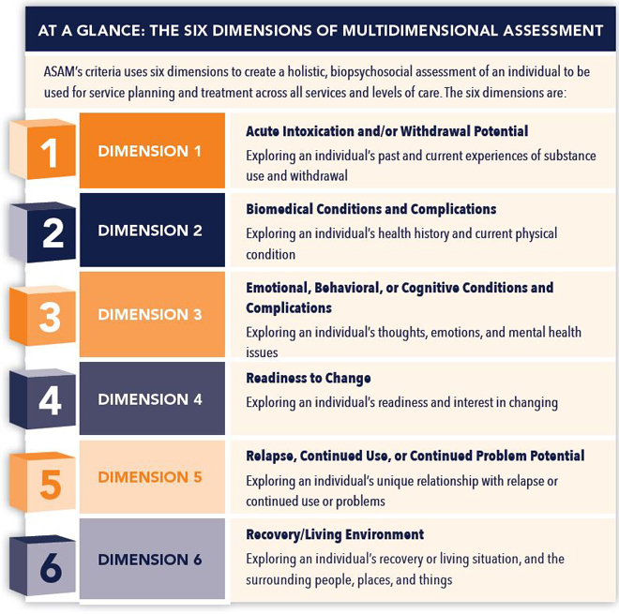
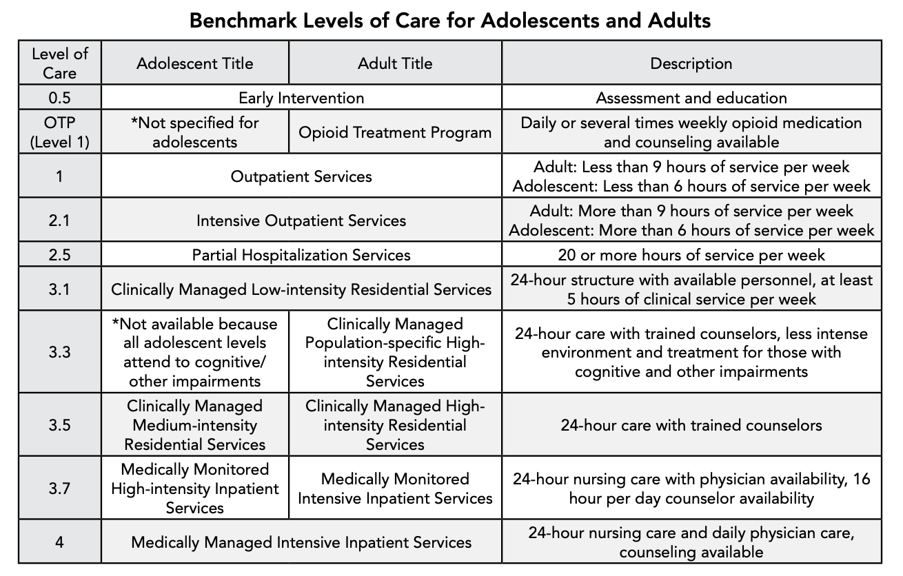
Substance Use Treatment Continuum of Care

Slide 3
Horizons Program Overview
Program Components:
OB-GYN Perinatal Care
MAT
Psychiatry
Outpatient Therapy (group and individual)
Residential Treatment (including all the above)

Slide 4
COVID-19 and Substance Use: A “perfect storm” of factors leading to increased drug use
Increase in Use:
Although we cannot attribute all increased drug use in the last two years to COVID-19, “experts agree based on research and clinical observation that pandemic-related strains, from economic stress and loneliness to general anxiety about the virus, are a major driver for the increase” (Abramson, 2021)
“Resilience promoting activities” have been more difficult to access or engage in (i.e., social interactions)
Increase in Overdoses:
The pandemic has also increased likelihood of dying of overdose, because “people are more likely to die when they are using drugs alone” (Abramson, 2021)
Decrease in access to treatment:
Healthcare systems are overwhelmed by COVID-19, so “people can’t always access the care they need” (Abramson, 2021)
The stigma surrounding substance use treatment still exists and perhaps is even exacerbated by the pandemic
Notes:
APA Link: https://www.apa.org/monitor/2021/03/substance-use-pandemic

Slide 6
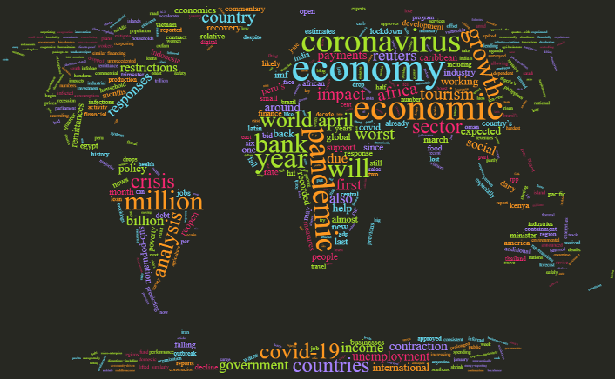
SIX major themes of covid-19 impact on residential treatment
Program-Level Impacts
Staff Impacts
Client Impacts
Use of Telehealth
Program Needs
Positive Effects

Slide 7
Program-Level Impacts
Policy and procedure changes
Insufficient resources to implement infection control measures
Decreased revenue from diminished client census
Client retention
Reduction of services

Slide 8
Staff impacts
Layoffs
Furloughs
Increased physical and emotional fatigue

Slide 9
Client Impacts
Threats to SUD recovery
Delayed treatment initiation
Receipt of fewer services while in treatment Lower retention
Economic and psychosocial barriers to community re-entry

Slide 10
Use of Telehealth
Technical and interpersonal challenges associated with telehealth visits
Reduced reimbursements for services

Slide 11
Program Needs
Personal protective equipment (PPE)
Stimulus funding
Hazard pay
Consistent public health guidance

Slide 12
Positive effects
Increased attention to hygiene and health
Telehealth expansion
Operational improvements
Official recognition of substance use disorder treatment as an essential health care service

Slide 13
Quotes from Horizon’s annual report
2020-2021 Report
“Don’t have to wake up early and get ready for Zoom groups, which is nice, but she does not feel that she gets as much out of the groups on Zoom as she would in-person. There are regular tech issues, you can’t see everyone’s face (people who aren’t on camera), harder to connect with peers”
Zoom is convenient but she said for her it would have been a big incentive to get up for in-person and she thinks that would have been good for her (instead of staying in pajamas all day), and having to socialize in person would have been good for her
She has done both Zoom and in-person and she thinks that in-person makes a bigger impact. But she said that zoom really helps when your kids are sick since it lets you still participate, and you are not just alone and sad in your apartment
One person thinks attendance will be better and it will be easier to stay awake in person
2019-2020 Report
Issues about not being allowed to have jobs. Need a job to transition out of program but need to quarantine.

Slide 14
How are clients coping?
Maintaining resilience
Relying on others in the program for support
Recovery
Holidays
Attending virtual mutual-aid support groups
Community building activities
Engaging in spiritual exploration

Slide 15
Addressing the Problem: Recommendations
CDC | North Carolina | Orange County, NC
Get vaccinated and stay up to date on covid-19 vaccines Wear a mask Stay 6 feet away from others Avoid poorly ventilated spaces and crowds Test to prevent spread to others Wash hands often Cover coughs and sneezes Clean and disinfect Monitor health daily Follow recommendations for quarantine/isolation Take precautions when traveling | No current restrictions Get Vaccinated-find vaccination locations at MySpot.nc.gov If unvaccinated practice the 3 W’s: -Wear a mask in all indoor public settings -Wait 6 feet apart in all public settings -Wash your hands often Avoid gatherings if unvaccinated Avoid traveling if unvaccinated | Get Vaccination and Booster (www.orangecountync.gov/getyourshot) Get Tested Wear a Mask Avoid large gatherings ***As of March 7, 2022, face covering are not required in public***

Slide 16
Addressing the Problem: integrated approaches
Community resilience
Develop and expand integrated primary care, addiction, and mental health care systems
Protective social policies can improve living conditions and access for addiction care services
Integrate IT solutions to strengthen and modernize the addiction care system
Implement professional education about SUD and co-occurring disorders
Mobilization of community social capital
Strengthening of cross-national collaboration

Slide 17
Recommendations: Health equity
CDC Definition of Health Equity: “Health equity is when all members of society enjoy a fair and just opportunity to be as healthy as possible. Public health policies and programs centered around the specific needs of communities can promote health equity”
“Although SUD are prevalent among all racial groups, the burden of disease is disproportionate among Black, Latinx, and Indigenous people.” (Farahmand, 2020)
“COVID-19 data shows that Black/African American, Hispanic/Latino, American Indian and Alaska Native persons in the United States experience higher rates of COVID-19-related hospitalization and death compared with non-Hispanic White populations.” (CDC)
Notes:
CDC Link: https://www.cdc.gov/coronavirus/2019-ncov/community/health-equity/race-ethnicity.html#:~:text=Impact%20of%20Racial%20Inequities%20on%20Our%20Nation%27s%20Health,-Racism%2C%20either%20structural&text=COVID%2D19%20data%20shows%20that,with%20non%2DHispanic%20White%20populations

Slide 18
Recommendations: culturally sensitive care
Implementation of supportive, not punitive, measures
Standardized screenings with individualized responses
Cultural humility and cultural sensitivity in patient-centered care provision
Patients are the experts of their experience
Listen to the needs of individuals and communities
Learn to acknowledge and work against stigma, judgment, and discrimination

Slide 19
Recommendations: how to stay up-to-date and informed
COVID-19 and substance use in the news
Look around! Be curious, ask questions
Advocate

Slide 20
This project was supported by the Health Resources and Services Administration (HRSA) of the U.S. Department of Health and Human Services (HHS), Behavioral Health Workforce Education and Training (BHWET) Program under M01HP31370, UNC-PrimeCare, $1,920,000.00, or the Opioid Workforce Expansion Program -- Professional, (OWEP) under T98HP33425, UNC-PrimeCare-OUD, $1,350,000. Both programs are 100% financed with governmental sources. This information or content and conclusions are those of the author/s and should not be construed as the official position or policy of, nor should any endorsements be inferred by HRSA, HHS or the U.S. Government.

Slide 21
References (SP)
Diaz-Martinez, J., Tamargo, J. A., Delgado-Enciso, I., Liu, Q., Acuña, L., Laverde, E., Barbieri, M. A., Trepka, M. J., Campa, A., Siminski, S., Gorbach, P. M., & Baum, M. K. (2021). Resilience, anxiety, stress, and substance use patterns during COVID-19 pandemic in the Miami Adult Studies on HIV (MASH) cohort. AIDS and Behavior, 25(11), 3658–3668. https://doi.org/10.1007/s10461-021-03292-y
Jemberie, W. B., Stewart Williams, J., Eriksson, M., Grönlund, A.-S., Ng, N., Blom Nilsson, M., Padyab, M., Priest, K. C., Sandlund, M., Snellman, F., McCarty, D., & Lundgren, L. M. (2020). Substance use disorders and COVID-19: Multi-faceted problems which require multi-pronged solutions. Frontiers in Psychiatry, 11. https://doi.org/10.3389/fpsyt.2020.00714
National Center for Immunization and Respiratory Diseases (NCIRD), Division of Viral Diseases. (2022, January 20). How to protect yourself & others. Centers for Disease Control and Prevention. Retrieved February 9, 2022, from https://www.cdc.gov/coronavirus/2019-ncov/prevent-getting-sick/prevention.html?CDC_AA_refVal=https%3A%2F%2Fwww.cdc.gov%2Fcoronavirus%2F2019-ncov%2Fyour-health%2Fneed-to-know.html
Pagano, A., Hosakote, S., Kapiteni, K., Straus, E. R., Wong, J., & Guydish, J. R. (2021). Impacts of covid-19 on residential treatment programs for substance use disorder. Journal of Substance Abuse Treatment, 123, 108255. https://doi.org/10.1016/j.jsat.2020.108255
Public Health Officials Urging Vaccination and Boosters Against COVID-19 Omicron Variant. (2022, January 5). Orange County North Carolina. Retrieved February 8, 2022, from https://www.orangecountync.gov/DocumentCenter/View/18536/Public-Health-Officials-Urging-Vaccination-and-Boosters-Against-COVID-19-Omicron-Variant-FINAL.
The State of North Carolina. (2022). Current Restrictions & Recommendations. nc.gov. Retrieved February 9, 2022, from https://www.nc.gov/covid-19/current-restrictions-recommendations

Slide 22
References (LJ)
Abramson, A. (2021, March 1). Substance use during the pandemic. American Psychological Association. Retrieved from https://www.apa.org/monitor/2021/03/substance-use-pandemic
American Society of Addiction Medicine (2015). An introduction to the ASAM criteria for patients and families. Retrieved from https://www.asam.org/
Centers for Disease Control and Prevention. (2022, January 25). Health equity considerations and racial and ethnic minority groups. Centers for Disease Control and Prevention. Retrieved from https://www.cdc.gov/coronavirus/2019-ncov/community/health-equity/race-ethnicity.html#:~:text=Impact%20of%20Racial%20Inequities%20on%20Our%20Nation%27s%20Health,-Racism%2C%20either%20structural&text=COVID%2D19%20data%20shows%20that,with%20non%2DHispanic%20White%20populations
Centers for Disease Control and Prevention. (2021, March 17). Understanding the opioid overdose epidemic. Centers for Disease Control and Prevention. Retrieved from https://www.cdc.gov/opioids/basics/epidemic.html#:~:text=The%20first%20wave%20began%20with,overdose%20deaths%20involving%20heroin4
Farahmand, P., Arshed, A., & Bradley, M. V. (2020). Systemic racism and substance use disorders. Psychiatric Annals, 50(11), 494-498.
Goldberg, E. (2021, January 4). 'Relapsing left and right': Trying to overcome addiction in a pandemic. The New York Times. Retrieved from https://www.nytimes.com/2021/01/04/nyregion/addiction-treatment-coronavirus-new-york-new-jersey.html
Panchal, N., Garfield, R., Cox, C., & Artiga, S. (2021, August 13). Substance use issues are worsening alongside access to care. KFF. Retrieved from https://www.kff.org/policy-watch/substance-use-issues-are-worsening-alongside-access-to-care/

