Slide 1
The Benefits of Medication-Assisted Treatment (MAT) Programs in outpatient primary care settings
By Sonia Payerpaj and Jessica Stutz

Slide 2
What is Medication assisted treatment?
A proven pharmacological treatment for opioid use disorder
Evidence-based as effective in reducing opioid use and helping people lead normal lives
Treatment involves removing dependence first, which is the need to take drugs to avoid withdrawal. Treatment then focuses on controlling addiction, which is the intense craving for the drug and subsequent compulsive use. (SafeProject, n.d.).
FDA approved medications
Agonist drugs: methadone and buprenorphine
Activate opioid receptors in the brain
Prevent painful opioid withdrawal symptoms without causing euphoria
Antagonist drugs: naltrexone
Blocks the effects of opioids
Source: Centers for Disease Control and Prevention | National Center for Injury Prevention and Control

Slide 3
Benefits of mat
Numerous studies show that MAT contributes to significant reductions in opioid use, criminal activity, overdose, and other risky behaviors such as unprotected intercourse (Mattick et al., 2014).
Entry into treatment is voluntary. Compulsory treatment programs through legal and social welfare systems are less effective than voluntary treatment (Leukfeld & Tims, 1988).
MAT suppresses cravings, assists with withdrawal symptoms and allows patients to stabilize their physical dependency.
Stability allows MAT patients to achieve healthy social, psychological, and lifestyle changes.
Recommended ancillary treatment strategies like counseling and psychosocial support trend fixed, safe, and predictable doses of medications (Ayanga et al., 2016)

Slide 4
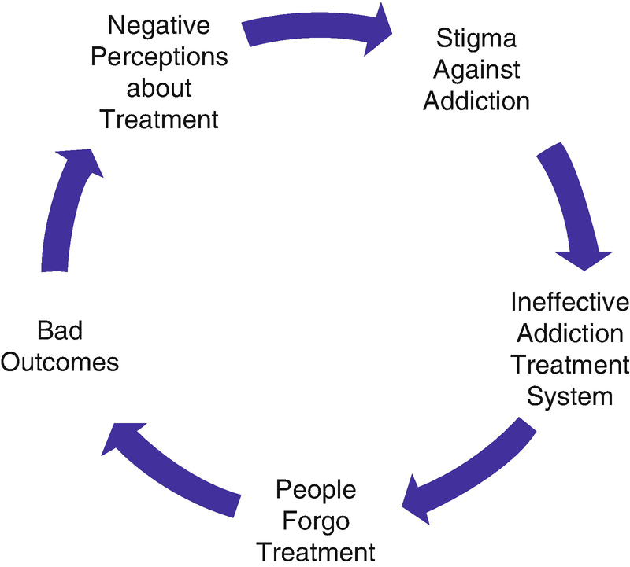
The behavioral health problem/health disparity:
Stigma is the largest barrier to MAT (Snyder, 2019).
Despite studies that continue to demonstrate MAT superiority over abstinence-based models, stigma & misinformation continue to drown-out the life-saving, gold standard treatment of MAT for OUD.
Treatment settings such as Narcotics Anonymous have adopted personal philosophies stigmatizing MAT as a part of recovery.
Providing a one-stop-shop via integrated outpatient primary care settings that connects patients with primary care services, mental health services, social determinants of health screenings and resources, as well as MAT groups and services can highly increase the likelihood that MAT patients will receive a holistic range of needed services.

Slide 5
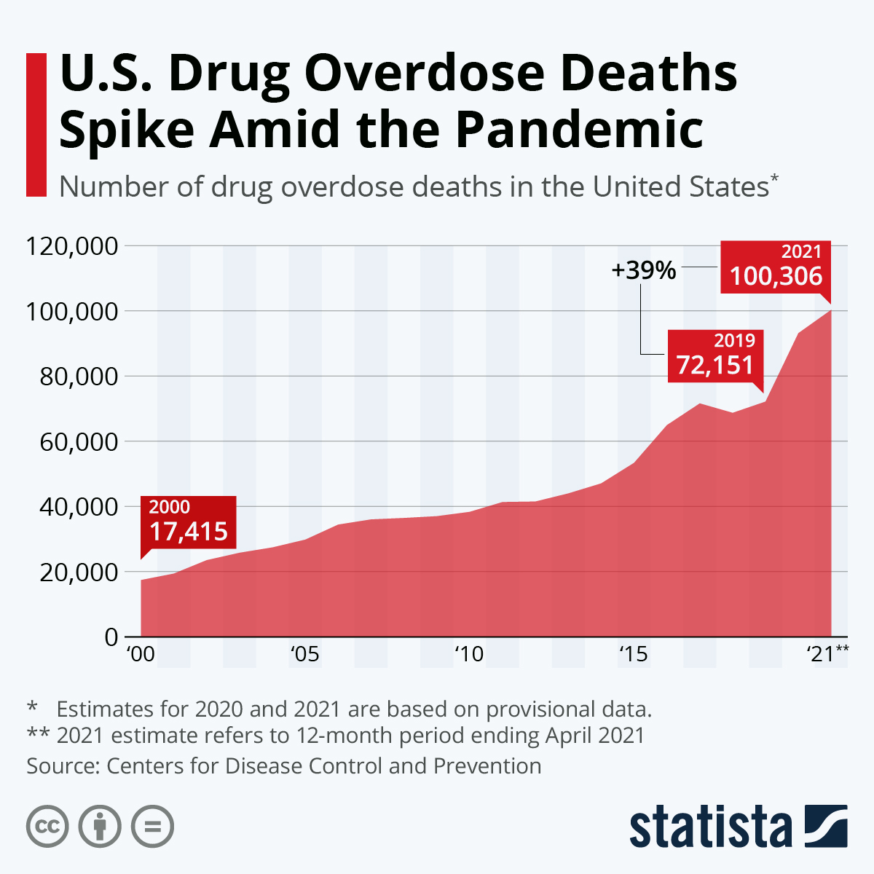
Prevalence of the problem AND WHO IS AFFECTED: The United States

Slide 6
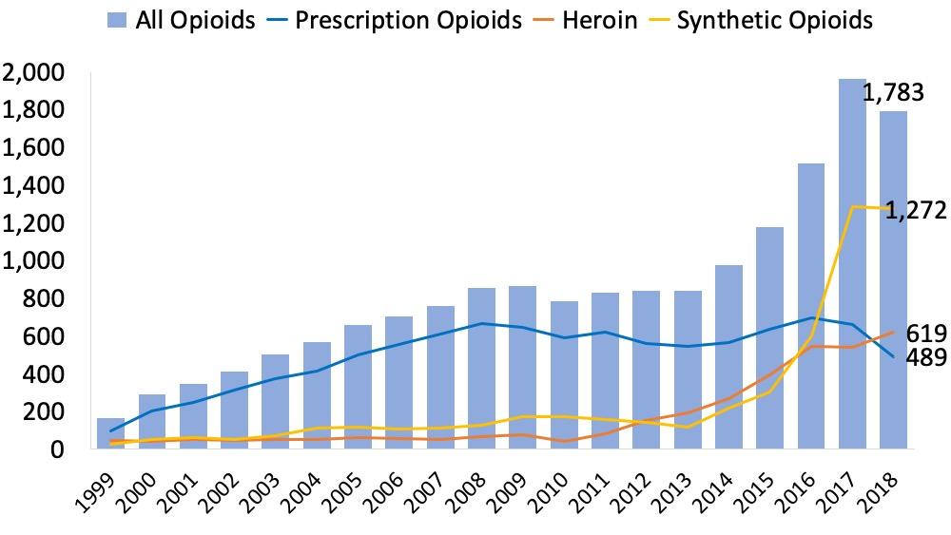
Prevalence of the problem AND WHO IS AFFECTED: north Carolina
In North Carolina, an estimated 79% of drug overdose deaths involved opioids in 2018; a total of 1,783 fatalities and a rate of 17.9 (NIDA, 2020)
From 2000-2020, more than 28,000 North Carolinians lost their lives to drug overdose. (NCDHHS, n.d.)
In 2020, over 8 North Carolinians died each day from a drug overdose. (NCDHHS, n.d.)
Notes:
Figure: https://nida.nih.gov/drug-topics/opioids/opioid-summaries-by-state/north-carolina-opioid-involved-deaths-related-harms
(https://www.ncdhhs.gov/about/department-initiatives/overdose-epidemic)

Slide 7
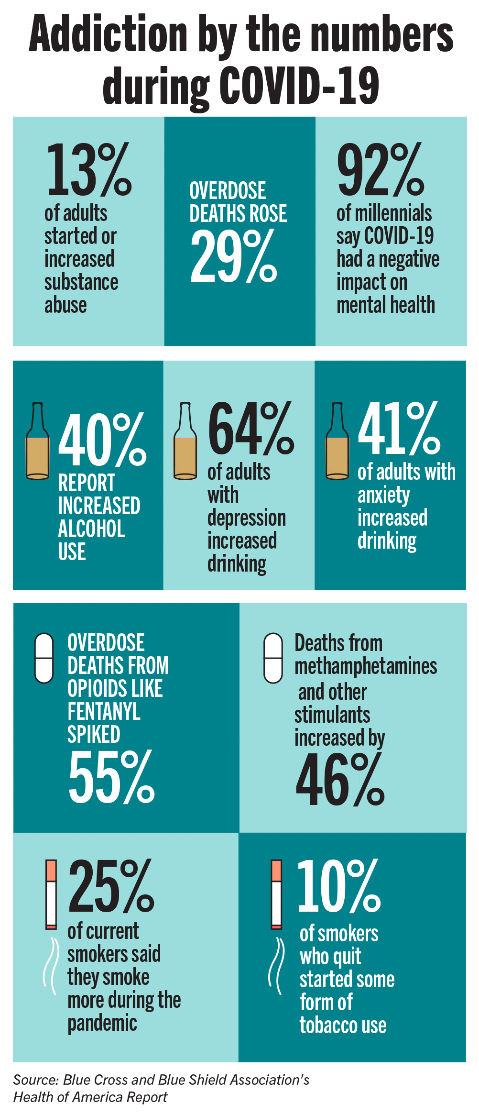
Pandemic Impact on Addiction
2019-2020: 23% increase of overdose-related emergency room visits (Green Hill Recovery, n.d.)
2020: 30% of Wake County residents survived an overdose and were referred to substance use treatment (Green Hill Recovery, n.d.)
The pandemic has led to an
Increase in feelings of isolation
Increase in life stressors like homelessness and job loss fueling an increase in drug use and overdose
Increase in fentanyl being cut into all street drugs
Decrease in access to substance use disorder treatment due to gathering restrictions and treatment centers shutting down
Increase in virtual counseling and support groups which might pose as a barrier to active and engaged participation
Decrease in readily available treatment resources due to a decrease and reallocation in funding that was previously intended for treatment programs
Notes:
https://greenhillrecovery.com/opioid-overdose-spikes-north-carolina/

Slide 8
current guidelines and evidence-based practices
According to Zerden, et al., (2021), there has been an increase in physical and behavioral health services in addition to the treatment of OUD in primary care settings, aka office-based opioid treatments (OBOT).
MAT Model of Care for OUD in Primary Care OBOT Practice-Base Models:
Pharmacologic: medication (primarily buprenorphine-naloxone aka Suboxone) prescribed by primary care providers who complete DATA2000 waiver training
2) Psychosocial Support: physician or other onsite/offsite counseling (at least monthly)
3) Coordination/Integration of care: non-physician clinic staff member sometimes used to coordinate MAT prescribing and integration with primary and mental health care
Of note, the above model of care applies for both rural and other underserved settings.
Notes:
I would recommend creating teams of inter-professional individuals, such as the prescribing physician and non-physician clinic staff member to collaborate and have at least monthly meetings to communicate patient progress in order to best serve the patient in this integrated care model.

Slide 9
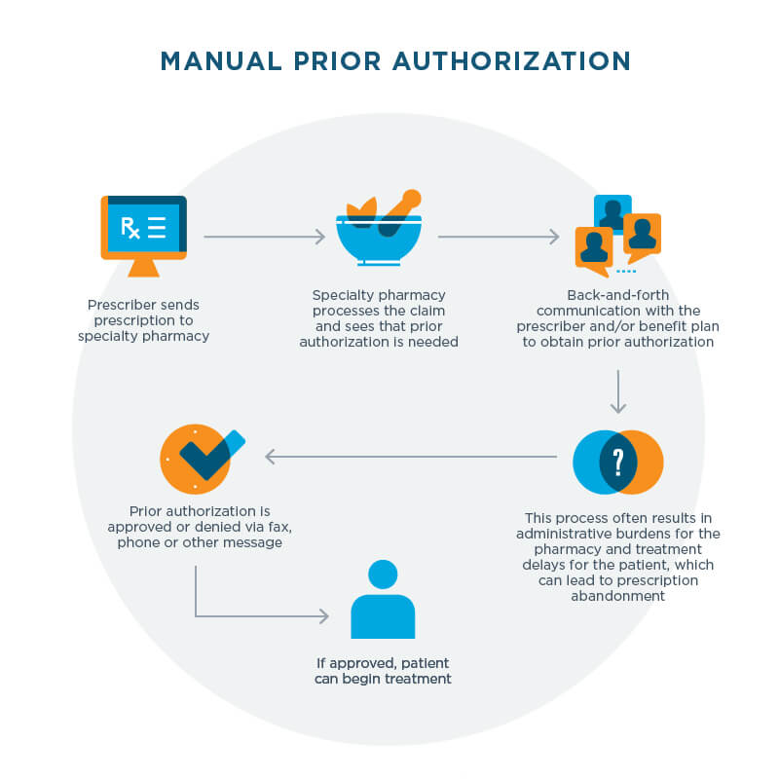
Recommendations based On Current guidelines and evidence-based practices:
Eliminating prior-authorization requirements for medications for opioid use disorder:
Due to regulations governing the provision of methadone, buprenorphine and naltrexone are the only FDA-approved medications for opioid use disorder potentially subject to prior authorization requirements.
Prior authorizations may take up to several days to process with insurance providers:
Processing time creates an immediate barrier to a patient’s initiation onto treatment.
Delay forces patients to leave their provider’s office without receiving potentially life-saving medication
During that time, treatment can be derailed:
A patient may lose interest, lose access to their doctor, lose transportation, suffer an injury, or even die from an overdose

Slide 10
MAT at UNC Family Medicine (An integrated care facility)
How many MAT patients are there? Estimated 190 patients
Eligibility: Cautious and strategic about people who are accepted; must be intrinsically motivated with no intense psychiatric history or existing comorbidities
Appointment Schedule: patients are scheduled at intervals depending on their circumstances (how long on MAT, how stable, recent relapse, etc.) - it could be weekly, biweekly, monthly, or every other month)
MAT certified physicians: Started in 2011 with only 2 physicians waivered, now have 30 waivered physicians
Supporting psychosocial resources: Monthly support groups (financial literacy presentation at meeting), refer out to community resources (UNC ASAP, community therapists in network, etc.)
Accessibility: Covered under UNC Charity Care Program (only legal and affordable option for a lot of patients); can get Narcan for free from UNC pharmacies

Slide 11
limited mat program options
UNC Family Medicine is the only primary practice within the UNC system to offer MAT, as it is not as common for primary care providers to offer MAT.
Limited MAT options in the area:
Eleanor Health: Mental Health and Addiction Treatment Center (accept insurance)
Different day programs (cash payment)
Some private practice providers
New Hope Urgent Care
Notes:
-there is a small program at UNC internal medicine

Slide 12
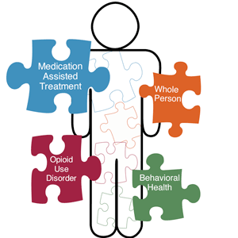
gap between recommendations in the literature and what is occurring in practice?
Zerden, et al., (2021) states that to provide needed psychosocial support and coordination/integration of care, a workforce trained in addiction psychosocial components as well as biological and neurological addiction interventions is needed.
Despite this notion, not all OBOTs are required to have licensed clinical addiction specialists (LCAS) in their workforce.
Treatment is best when individualized (Connery, 2015), which means offering:
Multiple options for psychosocial support:
Individual counseling
Group support
Personalized coordination of care
Treatment that considers patient barriers to care (Wolfe et al., 2010):
Availability for virtual psychosocial support sessions for patients with transportation barriers
Availability for in-person psychosocial support for those without internet access or those who prefer in-person

Slide 13
Health Care Disparities and mat patients
What contributes to healthcare disparities at the systems and provider levels?
Clinician bias (both explicit and implicit) --> misperception that African Americans experience less pain and have a greater addiction tendency
People of color having a lower probability of receiving buprenorphine treatment than non-Hispanic white counterparts or those with a higher income
Misperceptions that patients with a decreased health literacy or limited English language proficiency may be less compliant with medication use, leading to ascription of noncompliance
Lack of culturally specific services and non-implementation of culturally specific trainings and resources
(American Psychological Association, 2018)

Slide 14
Health Care Disparities and mat patients
What contributes of healthcare disparities at the patient level?
Hesitation to report opioid use due to fear of criminal prosecution or removal of parental rights as people of color are more likely to experience corrective criminal justice outcomes
Hesitation to seek out and accept clinician services due to worries regarding misdiagnosis and cultural mistrust
Hesitation to accept services due to fear that intervention goes against cultural norms
(American Psychological Association, 2018)
Notes:
https://www.apa.org/advocacy/substance-use/opioids/resources/cultural-competency.pdf
-example of last bullet: (e.g., self-reliance, beliefs that pain is inevitable and can be managed without prescription medication, fear of substance use disorders, and use of complementary or alternative treatments).

Slide 15
Importance of access, screening, and culturally sensitive care for Mat patients
Culturally competent care is extremely important in the delivery of substance use treatment care and services
Massachusetts Department of Public Health research found that: "people of color don’t access our system services and treatment at the same rate as White people, in part, I believe, because of their perception that the system isn’t responsive to their unique needs" (Koppelman, 2021)
Notes:
https://www.pewtrusts.org/en/research-and-analysis/articles/2021/08/02/cultural-competency-a-key-component-of-substance-use-treatment-services

Slide 16
Improving culturally Sensitive Care to MAT Patients
Offer personalized care and services for each patient that is reflective of their individual needs and culture
Respect patient beliefs, language of choice, and different communication needs
Develop a knowledge and understanding of possible treatment barriers among racial/ethnic minorities, with consideration to the different contributing factors to the health disparity by the health-care system, provider, and patient factors.
Ensure the workforce providing MAT services is representative of the patients being served, proficiently trained in serving diverse communities, and well-supported in seeking out and sustaining future diversity training and resources
Notes:
https://www.pewtrusts.org/en/research-and-analysis/articles/2021/08/02/cultural-competency-a-key-component-of-substance-use-treatment-services

Slide 17
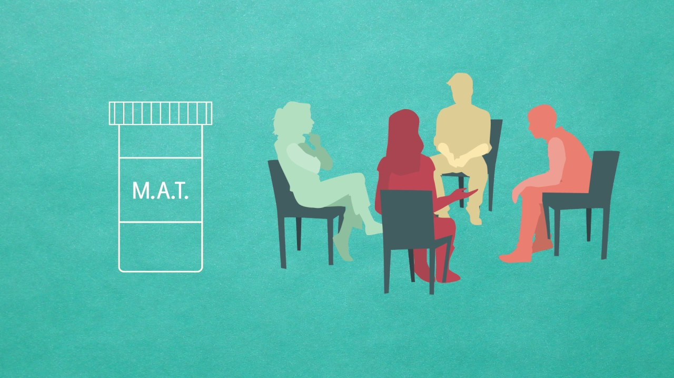
Closing: Brief summary with future recommendations
Policy Changes: Advocate for policy maker and health care provider collaboration with insurance companies and state Medicaid programs to eliminate prior-authorization requirements for medications for OUD.
Create more psychoeducational opportunities informing medical residents and current physicians of the importance of MAT in integrated primary care settings – encouraging DATA2000 waiver training.
Community-based partnerships to expand public awareness on effectiveness of MAT to help reduce stigma and increase treatment availability.
LCAS social workers required for outpatient primary care offices that offer MAT

Slide 18
Further Resources
https://www.safeproject.us/
https://www.cdc.gov/drugoverdose/pdf/pubs/2018-evidence-based-strategies.pdf
https://www.samhsa.gov/medication-assisted-treatment

Slide 19
This project was supported by the Health Resources and Services Administration (HRSA) of the U.S. Department of Health and Human Services (HHS), Behavioral Health Workforce Education and Training (BHWET) Program under M01HP31370, UNC-PrimeCare, $1,920,000.00, or the Opioid Workforce Expansion Program -- Professional, under T98HP33425, UNC-PrimeCare-OUD, $1,350,000. Both programs are 100% financed with governmental sources. This information or content and conclusions are those of the author/s and should not be construed as the official position or policy of, nor should any endorsements be inferred by HRSA, HHS or the U.S. Government.

Slide 20
resources
American Psychological Association. (2018). Cultural competency in assessing and treating opioid use disorder. https://www.apa.org/advocacy/substance-use/opioids/resources/cultural- c
ompetency.pdf
Ayanga D, Shorter D, Kosten TR. Update on pharmacotherapy for treatment of opioid use disorder.
Expert Opin Pharmacother. 2016;17(17):2307-2318. doi:10.1080/14656566.2016.1244529.
Carroll, J., Green, T., & Noonan, R. (2018). Evidence-based strategies for preventing opioid overdose: what’s working in the united states. Centers for Disease Control and Prevention. Retrieved March 31, 2022, from https://www.cdc.gov/drugoverdose/pdf/pubs/2018-evidence-based-strategies.pdf
Centers for Disease Control and Prevention. (2021, March 17). Understanding the opioid overdose epidemic. CDC. https://www.cdc.gov/opioids/basics/epidemic.html
Chou, R. (n.d.). Table 2, overview of MAT models of care for oud in primary care (including rural or other
underserved settings) - medication-assisted treatment models of care for opioid use disorder in primary care settings - NCBI bookshelf. National Center for Biotechnology Information. Retrieved March 20, 2022, from https://www.ncbi.nlm.nih.gov/books/NBK402343/table/findings.t1/? report=objectonly
Connery HS. Medication-assisted treatment of opioid use disorder: review of the evidence and future
directions. Harv Rev Psychiatry. 2015;23(2):63-75. doi:10.1097/HRP.0000000000000075
Dole VP, Nyswander ME. The use of methadone for narcotic blockade. Br J Addict Alcohol Other
Drugs. 1968;63(1):55-57.
Green Hill Recovery. (n.d.). North carolina opioid overdose spikes during the pandemic.
https://greenhillrecovery.com/opioid-overdose-spikes-north-carolina/

Slide 21
Resources (cont.)
Koppelman, J. (2021, August 2). Cultural competency a key component of substance use treatment services. The Pew Charitable Trusts. https://www.pewtrusts.org/en/research-and-
analysis/articles/2021/08/02/cultural-competency-a-key-component-of-substance-use-
treatment-services
Leukefeld CG, Tims FM. Compulsory treatment: a review of findings. NIDA Res Monogr. 1988;86:236- 251.
Connery HS. Medication-assisted treatment of opioid use disorder: review of the evidence and
future directions. Harv Rev Psychiatry. 2015;23(2):63-75. doi:10.1097/HRP.0000000000000075
Mattick RP, Breen C, Kimber J, Davoli M. Methadone Maintenance Therapy Versus No Opioid Replacement Therapy for Opioid Dependence. In: Cochrane Database of Systematic Reviews. John Wiley & Sons, Ltd; 2009. http://onlinelibrary.wiley.com/doi/10.1002/14651858.CD002209.pub2/abstract.
National Institute on Drug Abuse. (2020, April 3). North carolina: opioid-involved deaths and related harms. https://nida.nih.gov/drug-topics/opioids/opioid-summaries-by-state/north-carolina-opioid- involved-deaths-related-harms
NC Department of Health and Human Services. (n.d.). Overdose epidemic.
NCDHHS. https://www.ncdhhs.gov/about/department-initiatives/overdose-epidemic
SafeProject. (n.d.). Medication assisted treatment (MAT) explained. SafeProject.
https://www.safeproject.us/resource/medication-assisted-treatment-explained/

Slide 22
Resources (cont.)
Snyder, J. (2019, March 19). Stigma: the greatest barrier to medication assisted treatment. Pinnacle
Treatment Centers. https://pinnacletreatment.com/blog/stigma-the-biggest-barrier-to-
medication-assisted-treatment/
Wolfe D, Carrieri MP, Shepard D. Treatment and care for injecting drug users with HIV infection: a review of barriers and ways forward. The Lancet. 2010;376(9738):355-366. doi:10.1016/S0140
-6736(10)60832-X
Zerden, L. D. S., Cooper, Z., & Sanii, H. (2021). The primary care behavioral health model (PCBH) and
medication for opioid use disorder (MOUD): integrated models for primary care. Social Work in Mental Health, 19(2), 186-195.

