Slide 1
Treatment Consideration for Vietnamese Americans ________ Brian Nguyen, MSW Candidate ‘21

Slide 2
Who are Vietnamese Americans?
Vietnam
Southeast Asia
Immigrants
People
2.2 Million Vietnamese Americans (US Census Bureau, 2018)
5th Most spoken language in the United States (US Census Bureau, 2017)
Notes:
Language – English, Spanish, Chinese, Tagalog, Vietnamese

Slide 3
Immigration to the United States
Recent Immigration
Fall of Saigon (April 30, 1975)
According to a 1975 poll, only 36% of US Americans favored Vietnamese immigration (Gall & Natividad, 1996)
Re-education camps

Slide 4
Large Vietnamese Population in United States
Top 5 largest Vietnamese metropolitan areas (Batalova & Alperin, 2018)
Los Angeles, CA | San jose, CA | Houston, TX | San Francisco, CA | Dallas, TX
~242,000 | ~102,000 | ~81,000 | ~61,000 | ~56,000

Slide 5
Health Disparity
Language and Communication Barriers
Cultural Barriers
Low SES
Notes:
https://unsplash.com/photos/5pYUt2gEZaA
Naing & Phyo, 2017)
(UMD School of Public Health, 2007)

Slide 6
Language
Negative Consequences
Privacy
Translation
Not asking questions
Notes:
(Naing & Phyo, 2017)

Slide 7
Cultural Barriers
Cultural insensitivity
Negative attitude
Families and friends care
Cạo gió
Coin rubbing
Notes:
(Naing & Phyo, 2017)

Slide 8
Low SES
Income inequality (Budiman, Cilluffo, & Ruiz, 2020)
Lack of health insurance
Self-employed ineligible for medicaid
Notes:
(Naing & Phyo, 2017)

Slide 9
Women’s Health
Cervical Cancer
Vietnamese-American Women – 50%-70%
General USA Women Population – 90%
Highest rate of invasive cervical cancer among all ethnic group in USA (Tung, Nguyen, & Tran, 2008)
Notes:
https://unsplash.com/photos/RT1_5NEXspU
(Tung, Nguyen, & Tran, 2008)

Slide 10
Transtheoretical Model (TTM)
TTM acknowledges that people differ in their readiness to adopt new behaviors. Readiness can be better understood in terms of the following key construct:
Stages of change
Self-efficacy
Decisional balance (perceived benefits and barriers)
Notes:
Tung, Nguyen, & Tran, 2008)

Slide 11
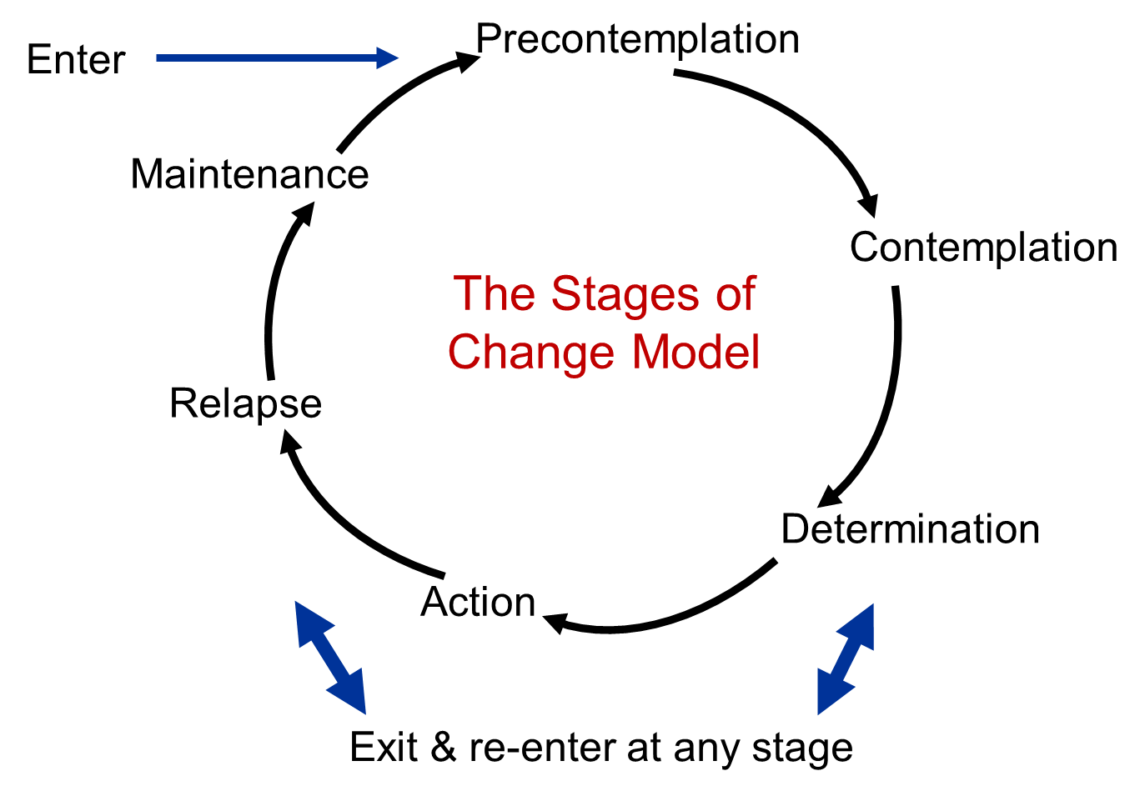
Notes:
Tung, Nguyen, & Tran, 2008)

Slide 12
Mental Illness
Notes:
(UMD School of Public Health, 2007)

Slide 13
Cultural Barriers
Vietnamese Cultural Beliefs about medication:
Western medications effectiveness
Harmful
Tolerance
Notes:
(Fancher, Ton, Meyer, Ho, & Paterniti, 2009)

Slide 14
Adolescents and Youth
Significant academic pressure
Learning two cultures at once
Need more resources in Vietnamese for parents to understand
Notes:
https://unsplash.com/photos/AEaTUnvneik

Slide 15
Seniors
Isolation
Language Barriers
Transportation Barriers
Vietnam War Trauma
Notes:
https://unsplash.com/photos/xFZzwOnt0qU

Slide 16
In the literature (Fancher, Ton, Meyer, Ho, & Paterniti, 2009)
Strategies to Improve communication with Vietnamese American patients:
To minimize stigma and help patients find face-saving communication strategies
To address social functioning and family roles
Ask the patient about their role in the family, the ways their illness affects life as experienced by the family and to identify key family decision makers.
To incorporate traditional beliefs into the treatment plan
To optimize language concordance and cultural understanding • Explore local or telehealth sources of bilingual and bicultural staff.

Slide 17
Suggestions
Trauma Informed Care
Pan Asian Clinics
Pan Asian inter-professional team
MORE research is needed
Notes:
So, some quick suggestions. As mentioned earlier in the presentation, many Vietnamese immigrants have endured trauma from either the war, post-war, or immigration. Even though many Vietnamese Americans did not personally experienced these traumas, second hand trauma is plausible. As a country, we need more Pan Asian Clinics or at the minimum, Pan Asian inter-professional teams. This will allow patients to feel more comfortable which could lead to positive healthcare relations. Last one, more research is needed. The lack of research on Vietnamese Americans is saddening. As the Vietnamese population in the United States grows to a more substantial percentage of the country’s population, researchers should aim to investigate the health of the Vietnamese Americans.
Thank you for following along and I wish you have a great rest of your day

Slide 18
References
Batalova, J., & Alperin, E. (2018, September 13). Vietnamese immigrants in the United States. migrationpolicy.org. https://www.migrationpolicy.org/article/vietnamese-immigrants-united-states-2017
Budiman, A., Cilluffo, A., & Ruiz, N. (2020, May 30). Key facts about Asian origin groups in the U.S. Pew Research Center. https://www.pewresearch.org/fact-tank/2019/05/22/key-facts-about-asian-origin-groups-in-the-u-s/
Fancher, T. L., Ton, H., Le Meyer, O., Ho, T., & Paterniti, D. A. (2009). Discussing depression with Vietnamese American patients. Journal of Immigrant and Minority Health, 12(2), 263-266. https://doi.org/10.1007/s10903-009-9234-y
Gall, S. B., & Natividad, I. (1996). Asian American almanac. In undefined. UXL.

Slide 19
References
Naing, K., & Phyo, T. Z. (2017). Disparities in healthcare among Vietnamese immigrants in the United States. 5th Annual Worldwide Nursing Conference.
Tung, W., Nguyen, D., & Tran, D. (2008). Applying the transtheoretical model to cervical cancer screening in Vietnamese-American women. International Nursing Review, 55(1), 73-80. https://doi.org/10.1111/j.1466-7657.2007.00602.x
UMD School of Public Health. (2007). Vietnamese Community Needs Assessment Summary Report. https://sph.umd.edu/sites/default/files/files/AAHI_FocusG_M_Vietnamese.pdf
US Census Bureau. (2017). http://factfinder.census.gov/faces/tableservices/jsf/pages/productview.xhtml?pid=ACS_12_1YR_S0201&prodType=table
US Census Bureau. (2018). https://factfinder.census.gov/bkmk/table/1.0/en/ACS/17_1YR/S0201//popgroup~048

Slide 20
This project was supported by the Health Resources and Services Administration (HRSA) of the U.S. Department of Health and Human Services (HHS), Behavioral Health Workforce Education and Training (BHWET) Program under M01HP31370, UNC-PrimeCare, $1,920,000.00, or the Opioid Workforce Expansion Program -- Professional, (OWEP) under T98HP33425, UNC-PrimeCare-OUD, $1,350,000. Both programs are 100% financed with governmental sources. This information or content and conclusions are those of the author/s and should not be construed as the official position or policy of, nor should any endorsements be inferred by HRSA, HHS or the U.S. Government.

