Slide 1

Somatic Psychotherapy in substance use treatment
Elle Townsend

Slide 2
What is Somatic Psychotherapy?
Centers the role of the body in processing trauma, developing insight, establishing a sense of safety, and managing stress
Interventions may focus on developing interoception, proprioception, or general body awareness; using movement; or attention to bodily signs to indicate the appropriate pace of treatment
Interventions may work with nervous system regulation, and the general approach takes into account and honors the body not only in interventions but scheduling, environment, etc.
Embodied knowing : “Bottom-up”

Slide 3
What is somatic psychotherapy?
Many somatic approaches address physiological responses to trauma or stress
Treatment may include psychoeducation, expanding capacity for activation and ability to connect with the body, identification of these responses, and working through stuck patterns of response

Slide 4
Similarities and differences with other approaches
Mindfulness
Mindfulness is essential to much of somatic work, and there is overlap with many mindfulness practices that are body-oriented
Curiosity is essential to both
Focus on present moment, nonjudgmental awareness, and/or acceptance
Somatics also involves tuning into bodily wisdom, building trust with body, and processing experiences (not just present moment awareness)
Focus in mindfulness on nonjudgmental awareness or acceptance while shifting experience may be a goal of somatics

Slide 5
Similarities and differences with other approaches
Trauma-informed practice
Can be understood as a general approach (not just specific interventions or protocols)
Awareness of apparently “dysfunctional” responses as resulting from and even adaptive to past experiences
Attention to building a sense of safety and autonomy
Attention to environment and pacing

Slide 6
Somatic Psychotherapy In current Practice
Typical recommendations for substance-use treatment modalities include MAT, CBT, MI, CM, and sometimes mindfulness
It is recommended that MAT and a psychosocial treatment be used in conjunction, though there is not evidence that any particular combination of medication and modality is preferable to another.
Somatic modalities are becoming more researched and widespread but are not yet commonly taught in graduate programs or used specifically for substance use treatment. There have been studies showing the feasibility and benefit of somatic work in conjunction with MAT or other substance treatments, in a group context, and for trauma.

Slide 7
Why Somatics For Problematic Substance Use?
Trauma
People with PTSD diagnosis are up to 14 times more likely to have a substance use disorder diagnosis
Pacing of integrated treatment
Treatment dropout for people with both PTSD and SUD diagnoses is high. Integrated treatment is recommended, and attention to pacing in somatic approaches could be useful

Slide 8
Why Somatics For Problematic Substance Use?
Experiential processing
The most-often recommended substance use treatments focus on behavioral change.

Slide 9
Why Somatics For Problematic Substance Use?
Neuroscience
Substance use can be coded as a survival behavior in the brain, and somatics addresses survival behaviors
Role of the body in substance use
Substances are processed in the body and typically sought for the shift in perception or sensation they facilitate. Somatics develops awareness and capacity to work with sensation.

Slide 10
Practical suggestions for implementation in substance use treatment
Arriving/orienting
Normalizing survival responses
Co-regulation
Working with the vagus nerve
Titration and pacing
Attention to body

Slide 11
Arriving/Orienting
Allowing the time necessary to fully transition into the task at hand , taking in information from the environment, noticing body sensations
Enable nervous system to settle, prevents overwhelm, develops mindfulness, body awareness, and connection with self, provides opportunity to check in with self for cues about safety, emotional state, and boundaries
Demonstration

Slide 12
Arriving/orienting
Concept is applicable to nearly any setting
  Formally guided process (like the demo)
  Taking a breath before beginning your appointment
  Making explicit when transitions are happening
  Inviting people to pause and check in with themselves before engaging
Example of a super quick invitation to orient to a transition

Slide 13
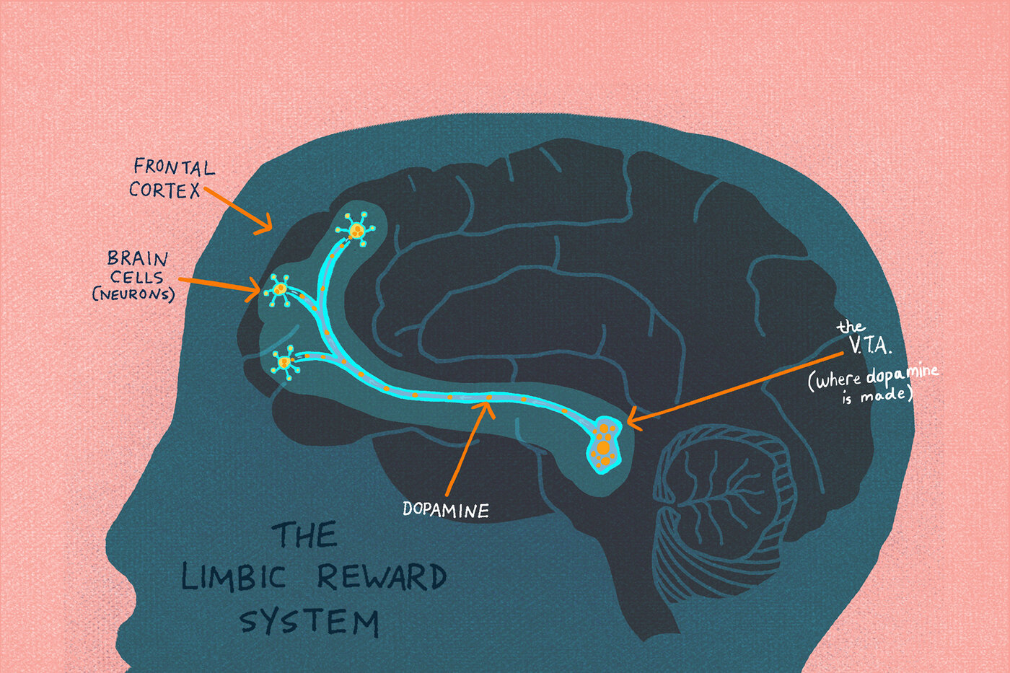
Survival Responses
Acknowledge and normalize survival responses
Psychoeducation around survival responses may fit well with psychoeducation on the neuroscience of addiction

Slide 14
Co-Regulation
Your own settled nervous system can be a huge support. As social beings we respond to cues from others (both to activate and settle)
  Checking into your own level of activation
  Practicing ways of settling your own nervous system
  Attunement

Slide 15
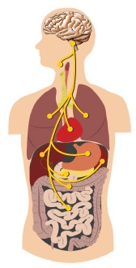
Working with the vagus nerve
Two-part informational post on activating the parasympathetic nervous system (with exercises)
Brief introduction to and list of ways to engage vagus nerve, including:
  Splashing cold water on your face or using a cold pack
  Deep belly laughing
  Breathing (exhaling longer than inhaling)
  Humming, singing, chanting, or “voo breath”
  Self-massage
  Gargling
  Movement

Slide 16
Titration and Pacing
Titration: working with manageable levels of activation
Working at a respectful pace
  Slowing down can be activating for some folks
  Note the challenge with the duration of common treatment programs
Particularly crucial when we think about how mental health symptoms can increase with abstinence
Give space for both you and your client to check in and track whether activation is within a manageable range. This usually involves proceeding s l o w l y.

Slide 17
Attending to the body
Just a handful of somatically-focused considerations:
Environment: how does lighting, seating, spacing, noise, temperature, and décor contribute to settling or activation?
Schedule: is there time for people to move their bodies where they need to go? Is there time for nourishment, bathroom breaks, rest?
Accessibility: what kinds of bodies can access and thrive in the space and schedule?
Potential: how is the body a resource? How can movement, self-touch, or the language of sensation move things forward?

Slide 18
Somatic interventions during Covid-19
Most somatic work is still possible through teletherapy
Many folks’ experiences during this time highlight the importance of the skills developed in this work, i.e. the body itself as a resource
Some research highlights the relative ease with which individuals can begin to use this independently

Slide 19
References
Briggs PC, Hayes S and Changaris M (2018) Somatic Experiencing® Informed Therapeutic Group for the Care and Treatment of Biopsychosocial Effects upon a Gender Diverse Identity. Front. Psychiatry 9:53. doi: 10.3389/fpsyt.2018.00053
Brom, D., Stokar, Y., Lawi, C., Nuriel‐Porat, V., Ziv, Y., Lerner, K. and Ross, G. (2017), Somatic Experiencing for Posttraumatic Stress Disorder: A Randomized Controlled Outcome Study. JOURNAL OF TRAUMATIC STRESS, 30: 304-312. https://doi.org/10.1002/jts.22189
Dugosh, Karen PhD; Abraham, Amanda PhD; Seymour, Brittany BA; McLoyd, Keli JD; Chalk, Mady PhD; Festinger, David PhD A Systematic Review on the Use of Psychosocial Interventions in Conjunction With Medications for the Treatment of Opioid Addiction, Journal of Addiction Medicine: March/April 2016 - Volume 10 - Issue 2 - p 93-103
Gerritsen, R., & Band, G. (2018). Breath of Life: The Respiratory Vagal Stimulation Model of Contemplative Activity. Frontiers in human neuroscience, 12, 397. https://doi.org/10.3389/fnhum.2018.00397
Jia, T., Ogawa, Y., Miura, M., Ito, O., & Kohzuki, M. (2016). Music Attenuated a Decrease in Parasympathetic Nervous System Activity after Exercise. PloS one, 11(2), e0148648. https://doi.org/10.1371/journal.pone.0148648
Leigh, J., Bowen, S., & Marlatt, G.A. (2005). Spirituality, mindfulness, and substance abuse. Addictive Behaviors, 30, 1335-1341. DOI: 10.1016/j.addbeh.2005.01.010

Slide 20
McCauley, J. L., Killeen, T., Gros, D. F., Brady, K. T., & Back, S. E. (2012). Posttraumatic Stress Disorder and Co-Occurring Substance Use Disorders: Advances in Assessment and Treatment. Clinical psychology : a publication of the Division of Clinical Psychology of the American Psychological Association, 19(3), 10.1111/cpsp.12006. https://doi.org/10.1111/cpsp.12006
Nakamura, Y., Lipschitz, D. L., Kanarowski, E., McCormick, T., Sutherland, D., & Melow-Murchie, M. (2015). Investigating Impacts of Incorporating an Adjuvant Mind–Body Intervention Method Into Treatment as Usual at a Community-Based Substance Abuse Treatment Facility: A Pilot Randomized Controlled Study. SAGE Open. https://doi.org/10.1177/2158244015572489
Norman, S. and Hien, D. (2020). Behavioral Interventions for Comorbid PTSD and Substance Use Disorder. RQ Vol. 31(2)
Payne P, Levine PA and Crane-Godreau MA (2015) Somatic experiencing: using interoception and proprioception as core elements of trauma therapy. Front. Psychol. 6:93. doi: 10.3389/fpsyg.2015.00093
Peter J. Taylor Ph.D., SEP, CGP, FAGPA, & Roger Saint-Laurent Psy.D., SEP, CGP (2017). Group Psychotherapy Informed by the Principles of Somatic Experiencing: Moving Beyond Trauma to Embodied Relationship, International Journal of Group Psychotherapy, 67:sup1, S171-S181.
Price, C. J., Merrill, J. O., McCarty, R. L., Pike, K. C., & Tsui, J. I. (2020). A pilot study of mindful body awareness training as an adjunct to office-based medication treatment of opioid use disorder. Journal of substance abuse treatment, 108, 123–128. https://doi.org/10.1016/j.jsat.2019.05.013
Price CJ, Thompson EA, Crowell SE, Pike K, Cheng SC, Parent S, Hooven C. Immediate effects of interoceptive awareness training through Mindful Awareness in Body-oriented Therapy (MABT) for women in substance use disorder treatment. Subst Abus. 2019;40(1):102-115. doi: 10.1080/08897077.2018.1488335. Epub 2018 Sep 20. PMID: 29949455; PMCID: PMC6775765.

Slide 21
Price CJ, Thompson EA, Crowell S, Pike K. Longitudinal effects of interoceptive awareness training through mindful awareness in body-oriented therapy (MABT) as an adjunct to women's substance use disorder treatment: A randomized controlled trial. Drug Alcohol Depend. 2019 May 1;198:140-149. doi: 10.1016/j.drugalcdep.2019.02.012. Epub 2019 Mar 23. PMID: 30928884; PMCID: PMC6467707.
Price, C. J., Wells, E. A., Donovan, D. M., & Rue, T. (2012). Mindful awareness in body-oriented therapy as an adjunct to women's substance use disorder treatment: a pilot feasibility study. Journal of substance abuse treatment, 43(1), 94–107. https://doi.org/10.1016/j.jsat.2011.09.016
Substance Abuse and Mental Health Services Administration. SAMHSA’s Concept of Trauma and Guidance for a Trauma-Informed Approach. HHS Publication No. (SMA) 14-4884. Rockville, MD: Substance Abuse and Mental Health Services Administration, 2014.
Shimojo, G., Joseph, B., Shah, R., Consolim-Colombo, F. M., De Angelis, K., & Ulloa, L. (2019). Exercise activates vagal induction of dopamine and attenuates systemic inflammation. Brain, behavior, and immunity, 75, 181–191. https://doi.org/10.1016/j.bbi.2018.10.005
Winerman, L. (2013, June). Breaking free from addiction. Monitor on Psychology, 44(6). http://www.apa.org/monitor/2013/06/addiction

