Slide 1
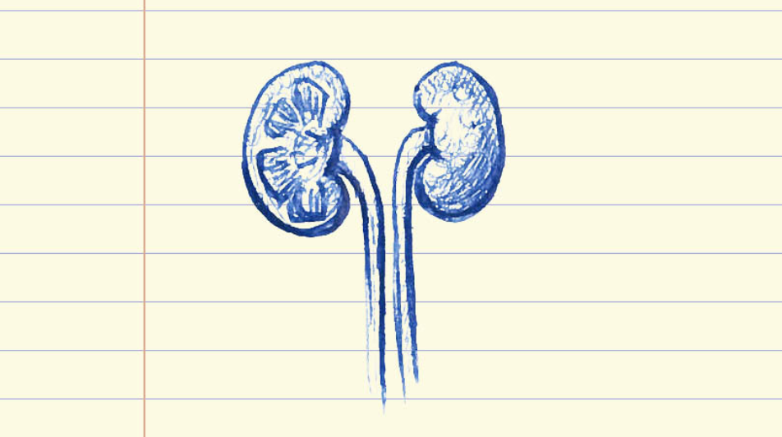
Social Work Assessment & Intervention with Kidney Transplant Patients
Kristi Bickford
MSW Candidate, Class of 2021
UNC School of Social Work
Notes:
Hello, my name is Kristi Bickford. I am a third-year triangle distance education student in the MSW program at the UNC School of Social Work. My PrimeCare placement for 2020-2021 was with the UNC Center for Transplant Care. I worked primarily with the kidney transplant and living donor populations.
In this presentation, I will discuss the implications of kidney disease, failure, transplant and donation on behavioral health as well as the utilization of social work assessment and intervention on an integrated health care team.

Slide 2
Kidney Disease/Failure Statistics
Kidney disease is the 10th leading cause of death in the US (Ahmad & Anderson, 2021)
Prior to 2020/COVID-19, it was #9 (Kidney Disease, 2021)
More than 37 million people affected but only ~10% are aware (Kidney Disease, 2021)
Kidney disease is a progressive, chronic condition that has 5 stages. Kidney failure is the 5th stage hence why it is often called “end stage kidney disease” (ESKD) or “end stage renal disease” (ESRD).
~768,000 people in the US have kidney failure (CDCP, 2021)
Only medical condition covered by Medicare without age requirement or waiting period
US total expenditure for kidney failure in 2018 was $49.2 billion (Kidney Disease, 2021)
Accounts for ~7% of the Medicare budget
Notes:
Kidney disease is an under-recognized public health crisis in the United States. It is currently the 10th leading cause of death and kills more people than breast or prostate cancer. It affects more than 37 million people in our country, which is about 15% of the adult population. It is estimated that about 90% of those with kidney disease don’t know they have it.
Kidney disease is a progressive, chronic health condition and is often called “the silent killer” because symptoms occur slowly and may not emerge until the kidneys begin to fail. About 768,000 people in the US have kidney failure. Kidney failure is the only medical condition that is entitled to Medicare coverage without an age requirement or waiting period. It is a very costly disease with a total expenditure of $49.2 billion in 2018.

Slide 3
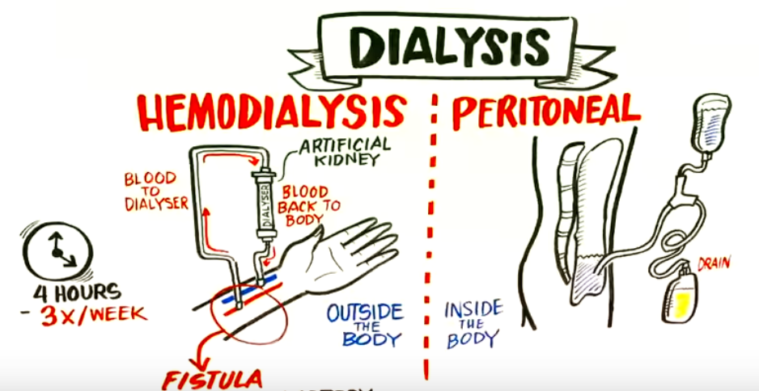
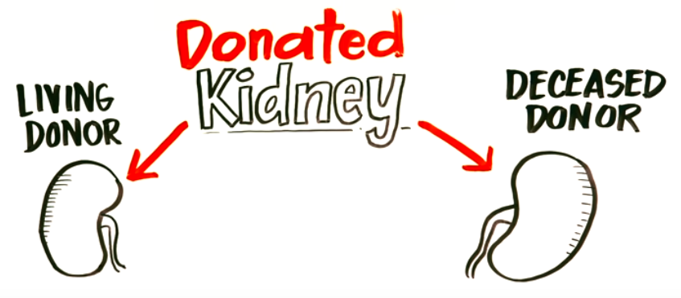
Kidney Failure Treatment
DIALYSIS
in-center hemodialysis, home hemodialysis, or home peritoneal dialysis
~86% of all dialysis patients receive in-center hemodialysis (USRDS, 2020)
~OR~
TRANSPLANT
living donor or deceased donor
~two-thirds of all transplants are from a deceased donor (Mayo Foundation, 2020)
Notes:
Patients who have kidney failure have 2 options for treatment: dialysis or transplant.
Dialysis removes wastes and extra fluid from the blood. Depending on the modality type, dialysis is either completed at a dialysis unit or at a patient’s home. Most patients receive dialysis at a unit.
Transplant is a surgical procedure that places a healthy kidney into the body. The new kidney can come from a deceased donor or from a living donor. Most people receive transplants from deceased donors. It is important to remember that transplant is a treatment, not a cure.

Slide 4
Kidney Transplant Statistics
United States:
23,644 kidney transplants performed in 2020 (UNOS, 2021)
91,063 patients on national waitlist as of 3/30/2021 (OPTN, 2021)
~13 people die every day waiting for a kidney transplant in the US (UNOS, 2017)
UNC Chapel Hill Center for Transplant:
157 kidney transplants performed in 2020 – most ever! (UNC Center for Transplant)
788 patients on waitlist as of 3/30/2021 (UNC Center for Transplant)
Notes:
23,644 kidney transplants were performed in the US in 2020. As of March 30th, 2021, there were 91,063 patients on the national kidney transplant waitlist. Even though kidneys are the most commonly transplanted organ, ~13 people die every day waiting for one.
At the UNC Chapel Hill Center for Transplant Care, 157 kidney transplants were performed last year. This was the center’s largest number of kidney transplants ever performed in 1 year. As of March 30th, 2021, 788 patients were on the waitlist.
The average national wait time for a deceased donor kidney is between 3-7 years depending on blood type.

Slide 5
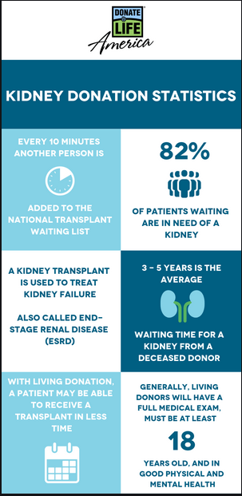
Kidney Donation
Deceased Donor
Last 10-15 years average
Longer wait time
Living Donor
Related (biological relative)
Unrelated (nonbiological relative, friend, stranger)
Last 15-20 years average
Shorter wait time
Paired Exchange
Another form of living donation
Patients with incompatible donors swap kidneys to receive a compatible kidney
(Types of transplants, n.d.)
Notes:
A deceased donor kidney comes from a person who has just died. This person or their family members decided to donate their healthy organs at the time of death in order to benefit people who need transplants. No matter how the person died, his or her kidney will only be used if it is healthy. On average, deceased donor transplants last 10-15 years. The wait time for receiving a deceased donor kidney is much longer than that of a living donor.
A living donor kidney comes from someone who is still alive. The donor can be someone who is related or unrelated to the recipient as long as the blood types are compatible. On average living donor kidney transplants last 15-20 years.
Paired kidney exchange is when kidney transplant recipients swap donors. It is another form of living donation.

Slide 6
Kidney Transplant Behavioral Health Concerns
Guilt
Recipients:
Receiving a kidney from a living or deceased donor
Leaving other dialysis patients ‘behind’ once you get your transplant
Having to depend on someone for the first few weeks after surgery
Donors:
The donated kidney doesn’t work
The recipient experiences complications or dies
You experience complications that impact others
Notes:
I am now going to talk about behavioral health concerns in regards to kidney transplantation and donation. Getting a transplant is usually an exciting event, but it also involves a major life change. Because of this, recipients and donors are both susceptible to experiencing changes in their moods or emotions.
An example of this is feelings of guilt before or after transplant or donation. Guilt can be stressful, cause emotional and psychological pain, and increase one’s risk for developing depression and/or anxiety. There are different reasons why someone may experience feelings of guilt in regards to transplant. For the recipient, receiving a kidney from someone whose life ended short or getting called for a transplant before other patients at their dialysis unit may produce feelings of guilt. For donors, any negative outcomes for their recipients or themselves can cause feelings of guilt.

Slide 7
Kidney Transplant Behavioral Health Concerns
Depression
Donors:
Pain
Body image
Recovery complications
Recipients:
Having a chronic health condition
Taking medicines for the rest of one’s life
Medication side effects
Recovery complications
Body image
Anxiety
Donors:
Pain
Body image
Surgical/recovery complications or death
Insurance coverage (pre-existing condition)
Kidney may not work in recipient
Recipients:
Having a chronic health condition
Taking medicines for the rest of one’s life
Medication side effects
Surgical/recovery complications or death
Body image
New kidney could reject/fail
Increased risk of infection due to immunosuppression
Lifestyle changes (remembering to take meds, drinking enough water, short-term weight bearing/physical activity restrictions, etc)
Insurance and medication coverage (pre-existing condition)
Notes:
Although guilt is important to recognize and address, depression and anxiety are the two behavioral health concerns most commonly experienced in the kidney transplant and donor populations.
Depression and anxiety can interfere with one’s mental, emotional and physical well-being, especially in regards to self-care responsibilities that are necessary after surgery. Pain, surgical scars, medication side effects, and recovery complications are examples of factors that may contribute to experiencing depression or anxiety before or after surgery.
As visually represented on this slide, recipients tend to be more affected by depression and anxiety than donors. This may be attributed to the fact that donors are volunteers, pursuing donation out of altruistic choice and desire. Although recipients also pursue transplant out of choice and desire, their motivation is heavily entwined with necessity.
I will discuss the prevalence of depression and anxiety in this population on the next slide.

Slide 8
Prevalence
Anxiety and depression are the most common disorders in kidney transplant recipients that may affect disease process and graft survival (De Pasquale, 2020)
Presence of depression associated with a 65% increased risk of post-transplant mortality (Dew, 2015)
Up to 63% of transplant recipients experience depression or anxiety during the first several years post-transplant (Dew, 2015)
A study of 825 living donors found 5.5% screened positive for anxiety and 4.2% for depression using 2-item GAD-2 and PHQ-2 scales (Holscher, 2018)
Notes:
Although both recipients and donors are susceptible to transplant-related behavioral health concerns, recipients experience depression and anxiety at elevated rates when compared with the general population and with other chronic illnesses. This may arise from stressors associated with the recovery process, the need to follow a complex medical regimen, or adjustment to the prospect of new health threats including transplant rejection, infections, and other malignancies.
Since depression prevalence is 3 to 4 times higher in patients with kidney disease and kidney failure compared with the general population, and 2 to 3 times higher compared to individuals with other chronic illnesses, it is not a surprise that transplant recipients have higher rates of depression.
Even though the prevalence of depression and anxiety is significantly lower among living donors, it is still important to screen for and identify those that may need support, intervention, and/or treatment.

Slide 9
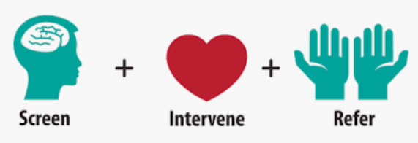
Behavioral Health Screening during Social Work Evaluation
The following standardized tools are used to screen for present/historical mental health, psychiatric, substance use, health behavior, and/or support system issues:
SIPAT (Stanford Integrated Psychosocial Assessment for Transplant)
Readiness level, Social support system, Psychological Stability and Psychopathology, Lifestyle and Effect of Substance Use
PHQ-2 (Patient Health Questionnaire – first 2 questions)
Depressive symptoms over past 2 weeks
GAD-2 (Generalized Anxiety Disorder scale – first 2 questions)
Anxiety symptoms over past 2 weeks
Notes:
Due to the increased risk for depression and anxiety among transplant recipients and donors, it is important and necessary for both populations to undergo screening. At UNC, clinical social workers are responsible for completing psychosocial evaluations with both recipients and donors.
The SIPAT is designed to predict psychosocial and medical outcomes of transplant candidates. It collects information about present or historical mental health, psychiatric, substance use, health behavior, and support system issues. Results can be used to identify risk for negative outcomes so that interventions may be applied prior to listing or donation approval.
The PHQ is used to screen for recent depressive symptoms and the GAD is used to screen for recent anxiety symptoms.
Transplant social workers combine all of this information to form a recommendation on one’s appropriateness for transplantation or donation and to make appropriate referrals for intervention.

Slide 10
1. Nurse coordinator receives referral for recipient or donor
2. If accepted, recipient/donor undergo evaluations
Medical (transplant nephrologist and surgeon)
Psychosocial (social worker)
3. Needs/concerns identified during evaluations are referred for appropriate intervention
Psychological evaluation/treatment (psychologist)
Additional medical testing/treatment (nephrologist, nurse coord.)
Future follow up re: care giving plan (social worker)
Financial assistance (social worker, financial coordinator)
Education (nephrologist, surgeon, nurse coord., social worker, financial coord., dietitian, pharmacist, psychologist, ILDA)
4. Teams decide if recipient/donor are approved for listing
Surgery scheduled for living donation
Recipients w/out a living donor are put on national transplant waitlist
5. Process ends when transplantation/donation completed
Transplant Recipient and Donor Process
Referral
Evaluation
Intervention
Listing
Transplant!
*Recipients and donors have separate care teams and do not share providers.
Notes:
The transplant process is outlined by the Centers for Medicare and Medicaid Services. In order to be considered for transplant, a patient must be referred to a transplant center by a nephrologist or dialysis unit. Donors refer themselves. If accepted, both candidates and donors must undergo specific medical testing and psychosocial evaluation. Recommendations for interventions, such as referral to psychology, applying for financial assistance, or losing weight, are made based on the medical and social work assessments. The recipient team and the donor team meet weekly to review the status and needs of each patient and decide whether listing for transplant or approval for donation is appropriate. This process ends when the recipient receives a transplant and a donor completes donation.

Slide 11
Interprofessional Kidney Transplant Team
Transplant programs model their teams after policies created by the Centers for Medicare and Medicaid Services (CMS). At UNC Chapel Hill, the following team members provide direct patient care:
Nephrologist*
Surgeon*
Nurse Coordinator*
Case Manager/Licensed Clinical Social Worker*
Financial Coordinator*
Registered Dietitian*
Pharmacist*
Clinical Psychologist
Independent Living Donor Advocate (ILDA)
(*) indicates position required by CMS and/or the Organ Procurement and Transplantation Network (OPTN)
Notes:
As described on the previous slide, the transplant process requires an interprofessional approach. Transplant centers are federally mandated to provide specific services and require certain licensed or registered positions to be members of the transplant team. Each kidney transplant team must have a nephrologist, surgeon, nurse coordinator, clinical social worker, financial coordinator, dietitian, and pharmacist.
The UNC kidney transplant team also includes clinical psychologists and an independent living donor advocate.
To ensure confidentiality and minimize bias or discrimination, donors and recipients have separate teams and do not share providers.

Slide 12
Interprofessional Collaboration at UNC
Separate weekly treatment team meetings for donor and recipient teams
Review recipient/donor lists
Provide status updates
Voice concerns/needs
Each team agrees to plan for transplant listing / donation approval
All notes documented/shared in EPIC (electronic health record)
Each team member able to review notes
Notes:
Interprofessional collaboration is a necessary means to meet the complex health and psychosocial needs of kidney transplant patients. Having multiple health care professionals work together with patients, families, and caregivers provides an opportunity for the delivery of the highest quality care. To maintain confidentiality and ensure communication between team members, separate treatment team meetings for donors and recipients are held weekly. The meetings are led by a nurse coordinator and a member from each discipline is required to attend. Each transplant and donor candidate is reviewed and recommendations from each discipline are heard. The team then agrees with listing or donation approval or makes a plan in regards to next steps.
Another form of interprofessional collaboration that occurs is in the form of medical record documentation. Team members are able to access and review each other’s notes as well as send messages to each other using Epic, UNC’s electronic health record.

Slide 13
Racial/Ethnic Disparities in Kidney Failure
BIPOC are disproportionately affected by kidney failure …
African Americans
Almost four times as likely as Whites to develop kidney failure
Account for 35 percent of the people with kidney failure, but only make up ~13 percent of the US population
Diabetes and high blood pressure are the leading causes of kidney failure among African Americans
Hispanics
Almost 1.3 times more likely than non-Hispanics to be diagnosed with kidney failure
The number of Hispanics with kidney failure has increased by more than 70 percent since 2000
Diabetes and high blood pressure are the leading causes of kidney failure among Hispanics
American Indians and Alaska Natives
Almost 1.2 times more likely than Whites to be diagnosed with kidney failure
Diabetes is the leading cause of kidney failure among American Indians
Hispanics and Kidney Disease, 2021; USDHHS, 2014
Notes:
Although strong interprofessional collaborative efforts are being made to provide the best care possible for those with kidney disease, failure and transplant, racial and ethnic disparities within this population continue to exist.
Black, Indigenous, and People of Color are disproportionately affected by kidney failure as evidenced by the following statistics…
African Americans are almost 4 times as likely as whites to develop kidney failure. They account for 35% of the kidney failure population but only make up approximately 13% of the US population.
Hispanics are almost 1.3 times more likely than non-Hispanics to be diagnosed with kidney failure. Over the past two decades, the number of Hispanics with kidney failure has increased by more than 70%.
As for American Indians and Alaska Natives, they are almost 1.2 times more likely than whites to be diagnosed with kidney failure.
In all 3 groups, diabetes is a leading cause of kidney failure while high blood pressure is also a main cause for African Americans and Hispanics.

Slide 14
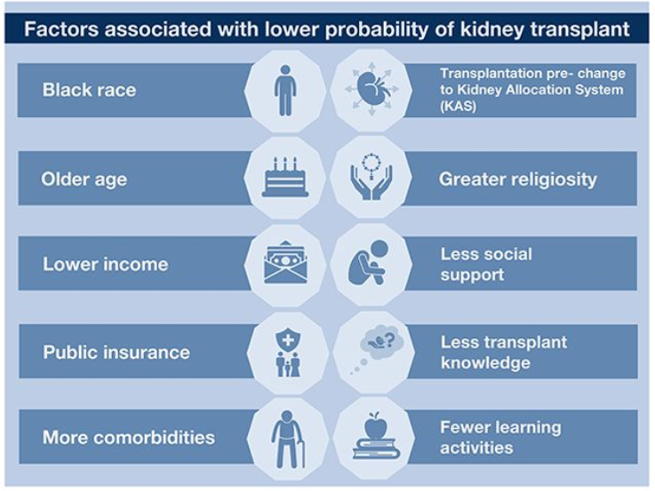
Social Determinants of Health and Disparities in Kidney Transplant
Race, age, SES, culture/faith, and education are powerful influencers in regards to receiving a kidney transplant (Wesselman et al, 2020)
Transplantation rate among all dialysis patients remains higher for Whites than Blacks (USRDS, 2020)
Disparity in access to deceased donor transplants has been completely eliminated for the last 3-4 years (USRDS, 2020)
Blacks receive living donor transplants at rates ~60% lower than Whites (USRDS, 2020)
Transplant waiting times substantially longer for Black vs White recipients (USRDS, 2020)
Notes:
I would be remiss if I did not address the influence social determinants of health have on the disparities presented on the previous slide. A study just published this year in the Clinical Journal of the American Society of Nephrology focused on social determinants of health and disparities in kidney transplant. The results were not surprising but rather confirmed what we thought we knew. Race, age, socioeconomic status, religious beliefs, insurance and education are all factors associated with a lower probability of receiving a kidney transplant. Blacks wait longer for and receive transplants at lower rates than whites. Although the disparity in access to deceased donor transplants has been eliminated thanks to changes in the kidney allocation system, Blacks have a significantly lower rate of receiving one from a living donor. Transplant social workers are in a unique position to identify areas of patient deficit or need, make recommendations on how to appropriately and effectively address them, and advocate for equitable access to transplantation.

Slide 15
Addressing Disparities: Recommendations for Medical Social Workers
Advocate for equitable health care access policies at the institutional/ state/ national levels
One-third of Hispanics or Latinos, 20% of Blacks or African Americans, and nearly 1 out of 3 American Indians and Alaska Natives are uninsured (Kidney Disease, 2021)
Engage in and advocate for culturally sensitive care within the health care system
Physician workforce: 67% White, 20% Asian, 6% Hispanic, 5% Black
Psychologists: 84% White, 6% Hispanic, 5% Black, 3% Asian
Registered Nurses: 74% White, 10% Black, 8% Asian, 6% Hispanic
Social Workers: 61% White, 22% Black, 12% Hispanic, 3% Asian (USDHHS, 2017)
Notes:
The study I talked about on the previous slide identified public insurance as a factor associated with lower probability for transplant. For those that are uninsured, the probability for transplant does not exist. It is estimated that one-third of Hispanics, 20% of Blacks, and nearly 1 out of 3 American Indians and Alaska Natives do not have health insurance. While it is important for transplant social workers to specifically focus on advocacy for equitable access to transplantation, advocating for equitable health care access policies at every level should be a priority for all medical social workers.
Culturally sensitive care is another area medical social workers can prioritize to help address health care disparities. National statistics show that minorities are significantly underrepresented in health occupations across the board. With our population becoming increasingly diverse, it is crucial for all providers in the health care field to engage in culturally sensitive care. Medical social workers are uniquely positioned to guide conversations about, implement trainings on and advocate for culturally sensitive care improvements within the health care setting.

Slide 16
Culturally Sensitive Care involves …
Being aware of religious, cultural, and ethnic differences
Respecting one’s values, customs, traditions, and preferences
Using an interpreter to ensure information/education is translated appropriately
Asking if there are any spiritual/religious/cultural beliefs that may impact care received in hospital setting
Avoiding assumptions
Withholding judgment
Building trust/rapport
Educating oneself
Respect
The principal standard of the National Standards for Culturally and Linguistically Appropriate Services in Health and Health Care is “to provide effective, equitable, understandable and respectful quality care and services that are responsive to diverse cultural health beliefs and practices, preferred languages, health literacy and other communication needs”. (Office of Minority Health, 2018)
Education
Translation
Trust/Rapport
Communication
Awareness
Acknowledgment
Notes:
Culturally sensitive care is patient-centered. It involves awareness, respect, appropriate and effective communication, the acknowledgement of differences and lack of cultural experience and/or knowledge, the building of trust and rapport, and the education of oneself in regards to diverse cultural health beliefs and practices. Cultural sensitivity avoids assumptions and withholds judgement to create a safe space for all patients.
The US Department of Health and Human Services Office of Minority Health has developed National Standards for Culturally and Linguistically Appropriate Services in Health and Health Care to improve health care quality and advance health equity among our nation's increasingly diverse communities.
Its principal standard is to provide effective, equitable, understandable and respectful quality care and services that are responsive to diverse cultural health beliefs and practices, preferred languages, health literacy and other communication needs.

Slide 17
Social Work Interventions in Transplant Setting
Provide education in oral and written form
Translate complex medical information/instructions for patients
Review care giving expectations and responsibilities with patients/care givers
Send resource information to patients through mail or UNC My Chart
Make referral/resource recommendations
Engage patients in teach-back method
Acknowledge, normalize, and validate feelings of depression, anxiety and guilt
Be available for questions, concerns, and/or support throughout process
Notes:
Social work interventions in the transplant setting are focused on education and support. Transplant social workers educate patients on the transplant process, psychosocial, medical, and surgical risks associated with transplant, patient and care giver responsibilities after transplant, and resources available for financial or mental health needs. These interventions aim to prepare and empower transplant candidates, donors, and their supports to manage transplant related care successfully. Transplant social workers are skilled at providing emotional support for patients and caregivers throughout the transplant process by being available by phone or secure message through the electronic medical record. Acknowledging, normalizing and validating feelings of depression, anxiety, and/or guilt and connecting patients with mental health based services are unique interventions transplant social workers offer to their patients.

Slide 18
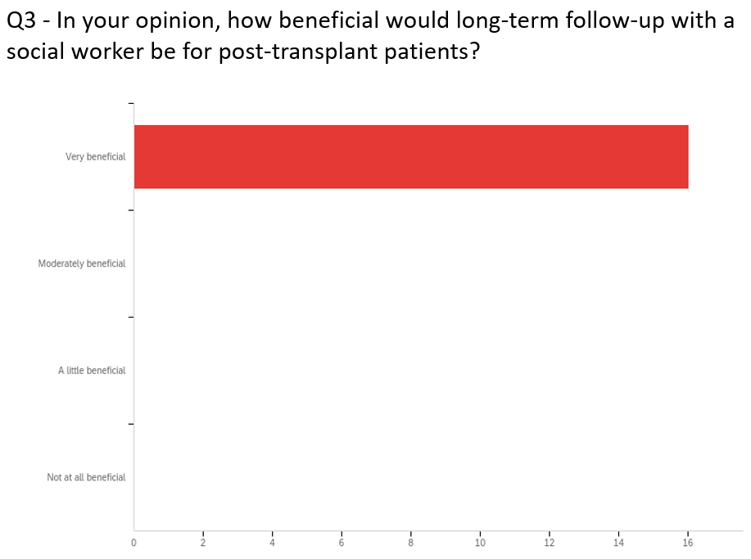
Service Gap/Recommendation
Designated post-transplant social work position
Provide longitudinal follow-up
Address SDOH risk factors that occur post-transplant
Contribute to preventive care efforts in regards to behavioral health
Notes:
I will end my presentation with an area that I believe deserves future attention and support: a post-transplant social work position.
Unfortunately, most social work assessment and intervention occurs during the pre-transplant period. The Center for Medicare and Medicaid Services does not currently provide guidelines or mandates for post-transplant social work care. As we know, health care is ultimately a business and kidney transplant is a very lucrative event for hospitals. All services provided on the front end are billed as bundled care and aimed at preparing patients for transplant. Since social work is not a revenue producing service on the transplant team by itself, designating social workers to post-transplant care positions may be viewed as cost inefficient. However, from both my professional and field placement experiences, efforts after transplant would prove invaluable to address social determinants of health risk factors as well as behavioral health issues that arise post-transplant and contribute to rejection and failure.
Investing in social workers who are assigned to post-transplant care would be beneficial to patients, their families, and transplant medical providers by ultimately helping to improve health outcomes and reduce preventable transplant rejection and failure.
In a survey I conducted with UNC kidney transplant team members, all responders agreed that long-term follow-up with a social worker for post-transplant patients would be “very beneficial”. It is clear that this position is highly desired by team members.

Slide 19
References
Ahmad FB, Anderson RN. The Leading Causes of Death in the US for 2020. JAMA. Published online March 31, 2021. doi:10.1001/jama.2021.5469
Centers for Disease Control and Prevention. (2021). Chronic Kidney Disease in the United States, 2021. US Department of Health and Human Services. https://www.cdc.gov/kidneydisease/pdf/Chronic-Kidney-Disease-in-the-US-2021-h.pdf
De Pasquale, C., Pistorio, M. L., Veroux, M., Indelicato, L., Biffa, G., Bennardi, N., … Veroux, P. (2020). Psychological and Psychopathological Aspects of Kidney Transplantation: A Systematic Review. Frontiers in Psychiatry, 11(106).
Hispanics and Kidney Disease. National Kidney Foundation. (2021, February 25). https://www.kidney.org/atoz/content/hispanics-kd.
Holscher, C. M., Leanza, J., Thomas, A. G., Waldram, M. M., Haugen, C. E., Jackson, K. R., Bae, S., Massie, A. B., & Segev, D. L. (2018). Anxiety, depression, and regret of donation in living kidney donors. BMC nephrology, 19(1), 218.
Kidney Disease: The Basics. National Kidney Foundation. (2021, March 23). https://www.kidney.org/news/newsroom/factsheets/KidneyDiseaseBasics.
Mayo Foundation for Medical Education and Research. (2020, February 25). Kidney transplant. Mayo Clinic. https://www.mayoclinic.org/tests-procedures/living-donor-kidney-transplant/pyc-20384838.
Office of Minority Health. National CLAS Standards - The Office of Minority Health. (2018, October 2). https://minorityhealth.hhs.gov/omh/browse.aspx?lvl=2&lvlid=53.

Slide 20
References
Organ Procurement and Transplantation Network. (2021, March 30). https://optn.transplant.hrsa.gov/data/view-data-reports/national-data/#.
Organ transplant trends: More transplants than ever. UNOS. (2021, February 9). https://unos.org/data/transplant-trends/.
Types of transplants. living and deceased - American Kidney Fund (AKF). (n.d.). https://www.kidneyfund.org/kidney-disease/kidney-failure/treatment-of-kidney-failure/kidney-transplant/types-of-transplants/.
United States Renal Data System. (2020). USRDS Annual Data Report: Epidemiology of kidney disease in the United States. National Institutes of Health, National Institute of Diabetes and Digestive and Kidney Diseases, Bethesda, MD.
UNOS. (2017, December 15). The kidney transplant waitlist. Transplant Living. https://transplantliving.org/kidney/the-kidney-transplant-waitlist/.
U.S. Department of Health and Human Services. (2014, March 1). Race, Ethnicity, & Kidney Disease. National Institute of Diabetes and Digestive and Kidney Diseases. https://www.niddk.nih.gov/health-information/kidney-disease/race-ethnicity.
U.S. Department of Health and Human Services. (2017). Sex, Race, and Ethnic Diversity of U.S, Health Occupations (2011-2015). Health Resources and Services Administration, National Center for Health Workforce Analysis, Rockville, Maryland.
Wesselman, H., Ford, C. G., Leyva, Y., Li, X., Chang, C. H., Dew, M. A., Kendall, K., Croswell, E., Pleis, J. R., Ng, Y. H., Unruh, M. L., Shapiro, R., & Myaskovsky, L. (2021). Social Determinants of Health and Race Disparities in Kidney Transplant. Clinical journal of the American Society of Nephrology : CJASN, 16(2), 262–274.

