Slide 1
Treatments for veterans with Post traumatic stress disorder (PTSD)
Presentation by Adrienne emery-ramirez

Slide 2
PTSD Diagnostic criteria and treatments

Slide 3
Incidence of ptsd in veterans and non-veterans
PTSD in Veterans
PTSD in Non-Veterans
Operations Iraqi Freedom & Enduring Freedom: Between 11 and 20% of veterans who served in these tours will develop PTSD in a given year
Gulf War (Desert Storm): About 12% of veterans have PTSD in any given year
Vietnam War: About 15% were diagnosed with PTSD at the time of the most recent study completed in the 1980’s. About 30% of Vietnam Veterans have had PTSD in their lifetime.
Another source of PTSD in the military is sexual trauma. Among veterans, 23% of women reported sexual assault while in the military. 55% of women and 38% of men have experienced sexual harassment while in the military
About 7 to 8 % of the population will have PTSD at some point in their lives
About 8 million adults have PTSD each year
About 10% of women develop PTSD in their lives
About 4% of men develop PTSD in their lives

Slide 4
Modes of treatment
Trauma focused therapies
Other therapies/treatments
Prolonged Exposure
Cognitive Processing Therapy (CPT)
Eye Movement Desensitization and Reprocessing (EMDR)
Other psychotherapies
Antidepressants
Anxiolytics
Complementary Alternative Medicine (CAM)

Slide 5
Treatment 1: Prolonged exposure

Slide 6
Treatment 1: Prolonged exposure
This treatment teaches veterans with PTSD to gain control by facing negative feelings
Incorporates talking about the event/trauma and potential activities that have been avoided due to the trauma and fears about certain situations/events/circumstances
Prolonged Exposure is actually one type of Cognitive Behavioral Therapy (CBT)
Prolonged exposure works under the premise that by talking about what happened, as well as addressing one’s memories and feelings regarding the event (s), one may be able to decrease their PTSD symptoms

Slide 7
Treatment 2: Cognitive processing therapy
Theory behind CPT:
Traumatic events can drastically change a persons beliefs about the world, themselves, and other people.
CPT focuses on how trauma survivors integrate traumatic events into their cognition/belief systems through assimilation or accommodation
This CPT is NOT incompatible with information/emotional processing therapies

Slide 8
Treatment 2: Cognitive processing therapy
Teaches veterans with PTSD how to reframe their negative thoughts regarding the traumatic event
It often involves writing assignments around the negative thinking
It is a 12-session psychotherapy for PTSD
CPT teaches one how to evaluate and change the upsetting thoughts which changes the way the individual feels
The logic behind CPT involves re-evaluating the thoughts and deciding whether it makes sense to take a new and different perspective

Slide 9
Treatment 3: Eye movement desensitization and reprocessing
This is a form of therapy for PTSD
This helps individuals process their trauma and make sense of it
The therapy calls the trauma to the mind while some other activity occurs (finger waving side to side, a tone, or something similar)
The result is that there are shifts in the way one experiences that memory and the trauma becomes “processed”

Slide 10
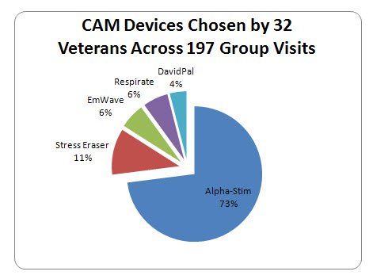
Complementary and alternative medicine (CAM)
CES: Cranial Electrotherapy stimulation uses an alpha stimulator medical device (alpha-stim)
Biofeedback device 1: Stress eraser
Biofeedback device 2: EmWave
Biofeedback device 3: Respirate
Audiovisual entertainment device called Davidpal
These interventions demonstrate improved sleep, group attendance and engagement, decreased pain and anxiety, and an increased sense of emotional well-being.
There are numerous CAM’s, the most common in addition to the above are massage, acupuncture, yoga, mindfulness training, chiropractics, energy therapy

Slide 11
Cranial electrotherapy sTimulation
https://youtu.be/d-patvoAGkI
Link to a video that provides information about the Alpha Stim device** May need to cut and paste link to browser

Slide 12
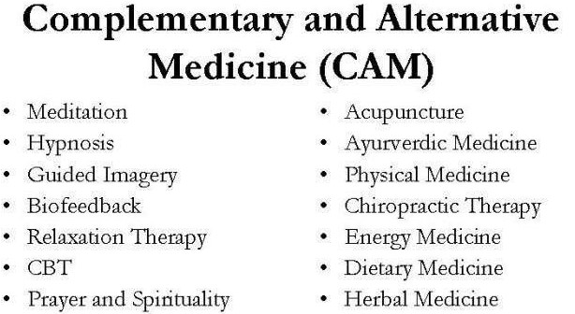
Statistics about cam use in those with Ptsd
Veterans with PTSD
Non-Veteran PTSD or Mixture of Veterans and Civilians
Veterans who were diagnosed with PTSD were 25% more likely than veterans not diagnosed with PTSD to utilize CAM
In research considering older veterans, PTSD diagnosis was more common in CAM users
Results from the National Comorbidity Survey Replication study indicated that 12.6% of individuals with PTSD utilized provider administered CAM in the past year (chiropractics, groups, acupuncture).
In a nationally recognized sample, 39% of those diagnosed with PTSD stated that they had used CAM within the last year to address emotional and mental health issues.

Slide 13
MEDICATION monotherapy for the treatment of ptsd by recommendation and strength of evidence
Level of Evidence | Recommended For | Suggest For | Suggest Against | Recommend Against | No Recommendations For or Against
MODERATE | Sertraline Paroxetine Fluoxetine Venlafaxine |  | Prazosin (except in PTSD related nightmares) |  | Prazosin for the treatment of PTSD associated nightmares
LOW |  | Nefazodone (serious potential toxicity) | Quetiapine Olanzipine Citalopram Amitriptyline | Divalproex Tiagabine Guanficine | Eszopiclone
VERY LOW |  | Imipramine Phenelzine (serious potential toxicity) | Lamotrigine Topiramate | Resperidone Benzodiazepines D-cycloserine Hydrocortizone Ketamine | Buproprion Desipramine D-serine Escitalopram Mirtazapine
No Data/ No recommendation for or against:
Doxepin
Duloxetine
Desvenlafaxine
Fluvoxamine
Levomilnacipran
Nortriptyline
Trazodone
Vilazodone
Vortioxetine
Buspirone
Cyproheptadine
Hydroxizine
Zaleplon
Zolpidem
U.S. Dept. of Veterans Affairs, 2018

Slide 14
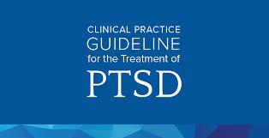
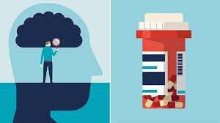
Trauma Focused Therapies
Trauma-focused psychotherapy over other pharmacologic and non-pharmacologic interventions are most effective primary treatments of PTSD. The best evidence is for Prolonged Exposure (PE), Cognitive Processing Therapy (CPT), and Eye Movement Desensitization and Reprocessing (EMDR).
Non-Trauma Focused Therapies
Pharmacotherapy or individual non-trauma-focused psychotherapy, are effective if/when trauma focused therapies are unavailable or patient is not ready for them.
 |  | Recommended Medications Sertraline – strong evidence Paroxetine- strong evidence Fluoxetine- strong evidence Venlaflaxine- strong evidence Nefazodone- low evidence Imipramine- very low evidence Phenelzine- very low evidence

Slide 15
What to look for:

Slide 16
Conclusions: What to do (1)
Have person seen by a trained professional where screening and assessment can take place some emergent medication may need to be started to help with mood dysregulation, hypervigilance, and/or sleep
Initiate Trauma focused psychotherapies such as Prolonged Exposure, Cognitive Processing Therapy, or Eye Movement Desensitization Reprocessing

Slide 17
Conclusions: What to do (2)
Assess changes that may occur with the trauma focused psychotherapy and medications.
Have provider titrate medications appropriately until desired result or change regimen
Adjunctively add CAM treatments (e.g. biofeedback, acupuncture, cranial electrotherapy stimulation)

Slide 18
Other recommendations
The VA/DoD strongly recommends against the use of benzodiazepines in the treatment of PTSD.
Based on two placebo-controlled RCT’s, both had negative findings regarding the use of benzodiazepines in treating PTSD
In these studies, Xanax had no benefit in alleviating PTSD symptoms, and Klonopin had no benefit for improving sleep secondary to PTSD-related sleep disruption.
Due to the risk and sometimes comorbid substance use disorder, a recent meta-analysis of 18 studies found benzodiazepines to be ineffective in the treatment of PTSD and the risks outweigh the short-term benefits.
Per current treatment guidelines CAM’s should be use adjunctively with the primary trauma focused forms of psychotherapy and medications.

Slide 19
SUMMARY
Most effective treatments are the trauma focused therapies which include Prolonged Exposure, Cognitive Processing Therapy, & Eye Movement Desensitization and Reprocessing
Other modalities include Complementary and Alternative Medicine (Biofeedback devices, Alpha Stimulator), mindfulness training and antidepressant/pharmacological treatment options
The three aforementioned trauma focused therapies lead to successful outcomes in about half of all cases
Pharmacotherapy: The most evidence-based medications for treatment of PTSD include:
Sertraline – strong evidence
Paroxetine- strong evidence
Fluoxetine- strong evidence
Venlaflaxine- strong evidence
https://www.ptsd.va.gov/professional/treat/txessentials/enhance_ptsdtx.asp

Slide 20
references
Buckland, Stephanie. (2018). What are the best treatments and therapies for PTSD? Retrieved from https://www.everydayhealth.com/ptsd/guide/treatment/
The American Institute of Stress. (2019). Incorporating complementary and alternative medicine (CAM) therapies to expand psychological services to veterans suffering from chronic pain. Retrieved from https://www.stress.org/incorporating-complementary-and-alternative-medicine-cam-therapies-to-expand-psychological-services-to-veterans-suffering-from-chronic-pain
Tull, Matthew. (2019). How PTSD is treated. Retrieved from https://www.verywellmind.com/ptsd-treatment-2797659
U.S. Department of Veterans Affairs. (2020). PTSD: National center for PTSD. Retrieved from https://www.ptsd.va.gov/understand_tx/tx_basics.asp

Slide 21
references
U.S. Department of Veterans Affairs and Department of Defense. (2018). VA/Dod Clinical practice guidelines for PTSD. Retrieved from https://www.ptsd.va.gov/professional/treat/docs/mhp_veterans_effective_tx.pdf
U.S. Department of Veterans Affairs and Department of Defense. (2018).VA/Dod clinical practice guideline for the management of Posttraumatic Stress Disorder – clinician summary. Retrieved from https://www.healthquality.va.gov/guidelines/MH/ptsd/VADoDPTSDCPGClinicianSummaryFinal.pdf
Veterans Health Administration. (n.d.) Prescribing for PTSD: Knowing your options. Retrieved from https://www.bing.com/images/search?view=detailV2&id=A501EA3BFED19BE2221578C847BB9301844CBC23&thid=OIP.1Iwgq11P9nJ6GbAn-XpR0gHaEK&exph=720&expw=1280&q=PTSD+treatment+options&selectedindex=6&ajaxhist=0&vt=0&eim=0,1,2,3,4,6,8,10

