Slide 1
Treatment for Pregnant Women Using Opioids in an Integrated Care Setting
Alina Mason, CADC
Ashley Esry
Notes:
Treatment for Pregnant Women using Opioids in an Integrated Care Setting is a PowerPoint designed to help providers working within an integrated behavioral health care team to better understand the unique concerns and considerations when delivering care to pregnant and parenting mothers who use opiates.

Slide 2
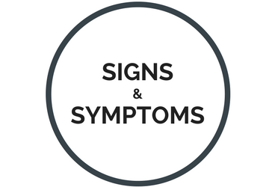
Opioid Use Disorder
For a substance use disorder diagnosis, problematic substance use leading to clinically significant impairment or distress must have happened within a twelve-month period, as exhibited through at least two diagnostic criteria.​
Criterion Groupings:​
Criterion A: Impaired control
Criterion B: Social Impairment
Criterion C: Risky substance use
Criterion D: Pharmacological criteria – tolerance and withdrawal
https://www.recoveryanswers.org/resource/signs-symptoms/
Notes:
So what exactly is opioid use disorder? Opioid use disorder is a DSM-5 diagnosis characterized by problematic substance use that has led to clinically important impairment or distress. At least two of the eleven diagnostic criteria must be met within a twelve-month period to receive the diagnosis. The criteria are grouped into four sections: impaired control, social impairment, risky substance use, and pharmacological criteria. Impaired control relates to symptoms such as using opioids in larger quantities or for longer periods than planned; continuously wanting and/or being unsuccessful at reducing or managing one’s substance use; significant time spent getting, using, and recovering from the effects of opioids; and having an intense desire or compulsion to use (also known as cravings). Social impairment indicates disruption to work, school, or home responsibilities; worsened interpersonal problems; and decreased engagement in enjoyable activities due to opioid use. Risky substance use is associated with using opioids in physically dangerous situations or continued use despite physical and mental health problems arising from their effects. Lastly, pharmacological criteria is met through gaining tolerance to opioid use or experiencing withdrawals in the absence of opioid use.

Slide 3
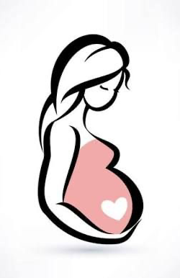
Opioid Use Disorder in Pregnancy
The etiology for women developing an opioid use disorder is nuanced and involves multiple factors.
Women experience substance use disorders differently than men
Hormonal differences, especially during pregnancy
Faster onset and progression of substance use disorders
Less likely to engage in treatment
May have increased difficulty limiting or quitting substances.
Can be a motivation for treatment
https://www.pinterest.com/pin/673499319249236013/
Notes:
The etiology of substance use disorders cannot be traced to one specific cause, though there are some identifiable risk factors, especially those specific to women. These include physical, psychological, social, societal factors as well as time, substance, and pattern of use. Often substance use is a coping mechanism for grief, trauma, mental illness, or stress that becomes problematic. Some risk factors for substance use that are often specific to women are domestic or intimate partner violence, sexual assault, loss of child custody or death of a child, and co-occurring eating disorders.
Women also develop and experience substance use disorders differently than men. While men are more likely to use illicit drugs and have higher rates of dependence than women, On average, women exhibit a faster onset and progression of SUD than men after first exposure to substances. Women experience greater impairments in social functioning, such as relationships and employment, than men. It is also important to note the hormonal differences in women, especially during pregnancy, may cause more drug cravings, risk of relapse, and be more sensitive to the effects of drugs (drugabuse.gov).
Women are also less likely than men to engage in SUD treatment. One reason for pregnant women may be the fear of child welfare involvement or criminal charges due to substance use while pregnant. 15 As a result of these differences, women with SUD benefit from gender-responsive treatment programs – programs that are tailored to the unique needs of women.16
Women are also more likely to use many substances, rather than just one, like alcohol. Women are more likely to be in a relationship with a partner who uses drugs and alcohol too. This can cause additional barriers when seeking treatment if their partner is unable to care for the children, or is unsupportive of her receiving treatment. Women who use during pregnancy are also likely to have higher levels of shame and guilt about their addiction, which can continue the cycle of addiction.
However it is important to note that pregnancy can also be a motivator for women to get help. Therefore it is vital to have resources and support available for pregnant women using opioids.

Slide 4
Prevalence
The national prevalence of opioid use disorder in the United States among pregnant women at hospital delivery is estimated to have increased more than fourfold from 1999 through 2014.
The prevalence increased from 1.5 to 6.5 cases per 1000 delivery hospitalizations.
https://www.drugabuse.gov/opioid-summaries-by-state/north-carolina-opioid-summary
Notes:
According to the National Survey on Drug Use and Health (2017), 2.1 million people had an opioid use disorder in 2016, and opioid overdoses accounted for more than 42,000 deaths. These numbers are only increasing, leading the Department of Health and Human Services to declare the opioid crisis as a public health emergency in 2017.
The national prevalence of opioid use disorder in the United States among pregnant women at hospital delivery is estimated to have increased more than fourfold from 1999 through 2014 [9]. The prevalence increased from 1.5 to 6.5 cases per 1000 delivery hospitalizations.
A recent national study revealed a fivefold increase in the incidence of NAS/NOWS between 2004 and 2014, from 1.5 cases per 1,000 hospital births to 8.0 cases per 1,000 hospital births. This is the equivalent of one baby born with symptoms of NAS/NOWS every 15 minutes in the United States. During the same period, hospital costs for NAS/NOWS births increased from $91 million to $563 million, after adjusting for inflation
Not only does opioid use in pregnancy cause significant health risks for mother and baby, but affects hospital and communitites. With the increasing number of cases, it is vital to improve affordable healthcare, accessibility to services, and treatment available to address opioid use disorder in pregnancy.

Slide 5
Social Determinants of Health
Pregnant women who use opiates may experience:
Lack of positive social support and isolation
Homelessness or unsafe living environments
Employment/financial concerns
Intimate partner violence
Sexual violence
Co-occurring mental health diagnoses
Inadequate healthcare and nutrition
Societal stigma
https://hitconsultant.net/2019/03/18/social-determinants-of-health-sdoh-collection/#.XnAJ3y2ZNbU
Notes:
Pregnant women with an opioid use disorder diagnosis have increased risk in many social determinant of health domains. They can often have fractured relationships, which can lead to a lack of positive social support. The distance from a support system combined with potential financial concerns from difficulty obtaining or maintaining employment can lead pregnant women who use opiates to experience problems with homelessness. Sometimes their only alternative is to be in unsafe living environments where drug use may be in the home. They may find themselves in romantic relationships where intimate partner violence, including verbal, emotional, physical, or sexual abuse, is present. Engagement in survival sex work can also lead to dangerous situations where sexual violence can be experienced. These traumas can contribute to continued opiate use as a way to cope. Many women who use opiates also have co-occurring mental and physical health diagnoses. It can be difficult for them to receive adequate care to address their overall health concerns. Societal stigma related to pregnant women experiencing problematic opioid use can make it difficult for them to access resources. Addressing these social determinants of health in integrated care is a vital aspect of treatment for these women.

Slide 6
Common Myths
Myth #1: Babies that are exposed to opiates in utero are born addicted.
Myth #2: Pregnant women would just simply stop using opiates if they cared about the wellbeing of their child.
Myth #3: It is unsafe for pregnant women to use medication-assisted treatment.
Myth #4: Women who use opiates are unfit to take care of their children after birth.
Notes:
Here we debunk some of the most common myths about mothers who use opiates:
- Myth #1: Babies that are exposed to opiates in utero are born addicted. Fact: Babies are not born addicted to substances, as they do not experience the DSM-5 criteria previously discussed, such as risky substance use or social problems related to use. They can experience dependency symptoms, such as withdrawals, but they can be safely attended to by medical professionals.
- Myth #2: Pregnant women would just simply stop using opiates if they cared about the wellbeing of their child. Fact: Ceasing opioid use cold turkey can be dangerous for the baby, as withdrawals during pregnancy could lead to miscarriage or preterm labor. It is actually in the best interest of the child for the mother to seek professional help rather than to quit abruptly.
- Myth #3: It is unsafe for pregnant women to use medication-assisted treatment. Fact: Methadone and buprenorphine are safe and effective options for addressing problematic opiate use during pregnancy.
- Myth #4: Women who use opiates are unfit to take care of their children after birth. Fact: Opiate use, in and of itself, does not make someone unfit to parent. Neglect or abuse can happen in any home. Mothers who use opiates can provide the same love and care for their children as those who do not use substances.

Slide 7
Effects
Breathing Problems
Low Birthweight
Feeding Problems
Maternal Mortality
Preterm Birth
https://www.cdc.gov/reproductivehealth/maternalinfanthealth/substance-abuse/opioid-use-disorder-pregnancy/index.html
Notes:
Opioid use disorder during pregnancy has been linked to: Preterm birth, breathing and feeding problems, low birthweight, maternal mortality. Another significant risk factor is neonatal abstinence syndrome or NAS. This is ____________
These risk factors make access to treatment incredibly important for the health of mother and baby. Not only are these serious and potentially fatal consequences of untreated substance use when pregnant for mother and baby, but opioid use disorders during pregnancy also affects families and communities.

Slide 8
Case Study
Jennifer is a 28 year old, Caucasian, cisgender female from rural North Carolina who has been using opioids for the past six years, intravenously for three. She realized she was pregnant 5 weeks prior and does not know how far along she is. After not being able to stop using drugs on her own, Jennifer goes to the closest primary care clinic to check on the health of the fetus and get help addressing her substance use. After a long wait she receives a pregnancy test, blood tests, drug screen, and the physician takes a medical and reproductive history. When discussing lifestyle changes and finding out about her usage history, the physician lets her know that they cannot offer her prenatal care due to the risks and recommends she go to a specialized prenatal clinic. They explain how dangerous drug use is for her and the fetus and tell her to make some calls to see what offices will work with her and to make an appointment as soon as possible. She leaves with some pamphlet information, feeling unhelped and rejected. After confirming a positive test for opioids, the office calls the Department of Social Services to report her for prenatal drug use.
Notes:
This is something that is unfortantely common in primary care settings. Often the medical risks and liabilities feel to significant and these settings will simply refer out. However, women using substances during pregnancy face multiple barriers before entering those doors, including transportation issues, inability to take off work, and fear of not being helped or being reported to DSS. Therefore it is important to capitalize on the patient seeking help, for not only the health of the mother, but that the earlier prenatal care begins the better for the health of the fetus. With the increasing number of women using opioids, it is important that health care settings adopt an integrated health model as much as possible, and have a screening, assessment, and referral process for pregnant women using substances.

Slide 9
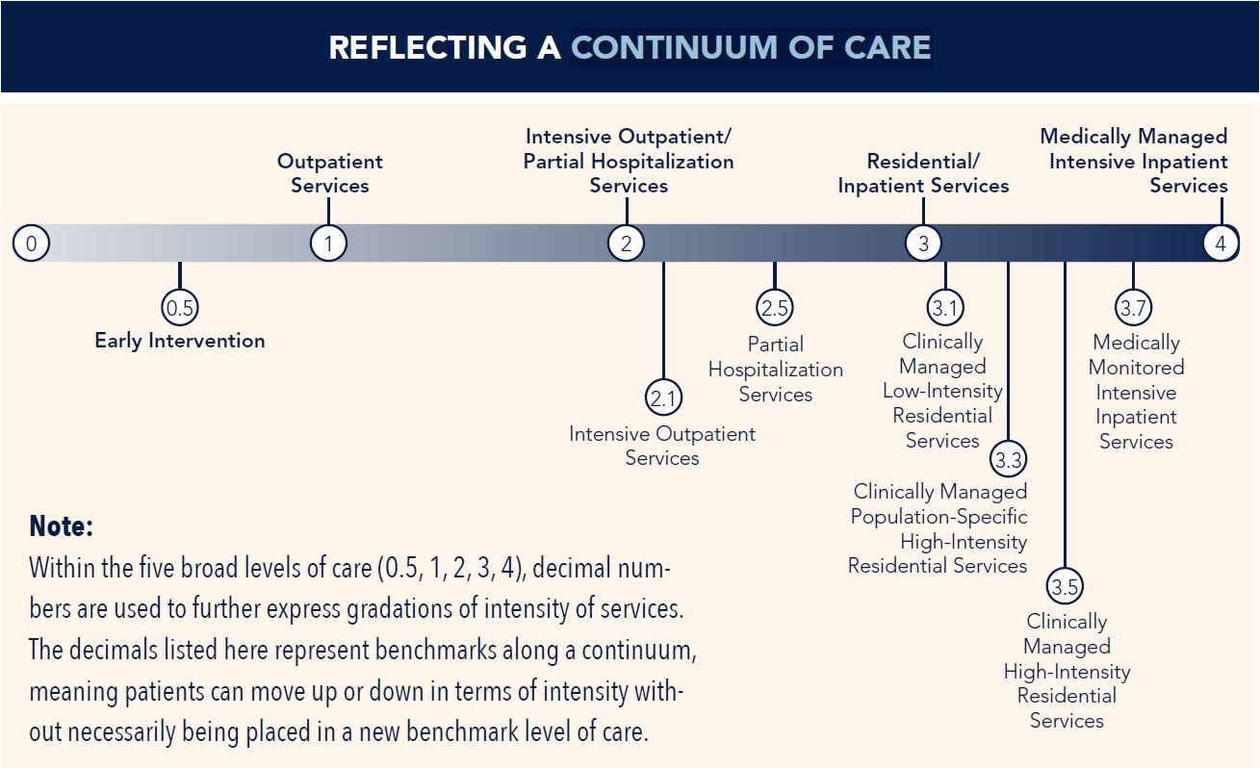
ASAM/Levels of Care
https://www.asam.org/asam-criteria/level-of-care-certification
Notes:
There are various types of care that mothers can find themselves in depending on the intensity of treatment needed. This image includes the continuum of care as designated by the American Society of Addiction Medicine. Level 0.5 or early intervention is for those at risk of developing a substance use disorder. Level 1 includes outpatient services such as medication-assisted treatment. Level 2 includes SAIOP (or substance abuse intensive outpatient program), which generally consists of at least three hours of service per day for three days per week, and SACOT (substance abuse comprehensive outpatient treatment), which entails no less than four hours of service per day for five days per week. Level 3 consists of varying degrees of residential and inpatient treatment, while Level 4 indicates hospitalization. Pregnant women with problematic opioid use can find themselves receiving one or more of these treatment modalities.

Slide 10
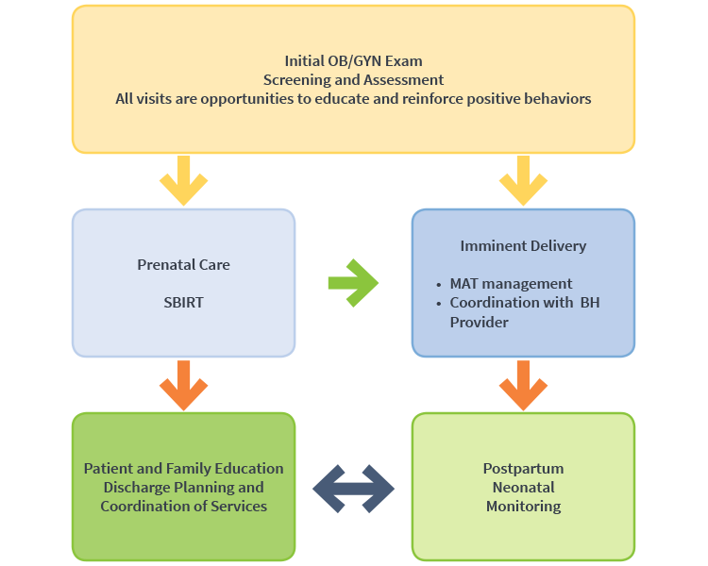
Current Treatment Guidelines
http://www.healthrecovery.org/maternal-opioid-use/
Notes:
Info from: https://www.acog.org/clinical/clinical-guidance/committee-opinion/articles/2017/08/opioid-use-and-opioid-use-disorder-in-pregnancy
According to the American College of Obstetricians and Gynecologists, all pregnant women should be screened for problematic substance use. Substance use disorders affect every demographic, making it imperative to screen everyone at their first prenatal visit. A positive screening should be followed by brief intervention and referral to treatment (also known as SBIRT). This is an opportunity to provide psychoeducation to the patient and help coordinate services with appropriate treatment providers. Medication-assisted treatment is recommended to address the patient’s continued use and withdrawal potential. Depending on the symptom severity and the need for recovery support, pregnant women could be referred to outpatient individual or group therapy to more restrictive residential treatment programs. Should the patient already be receiving medication-assisted treatment and/or behavioral interventions with another provider, coordination of care should occur. After delivery, postpartum neonatal monitoring will occur to detect signs of neonatal abstinence syndrome or any other health complications that require medical attention.

Slide 11
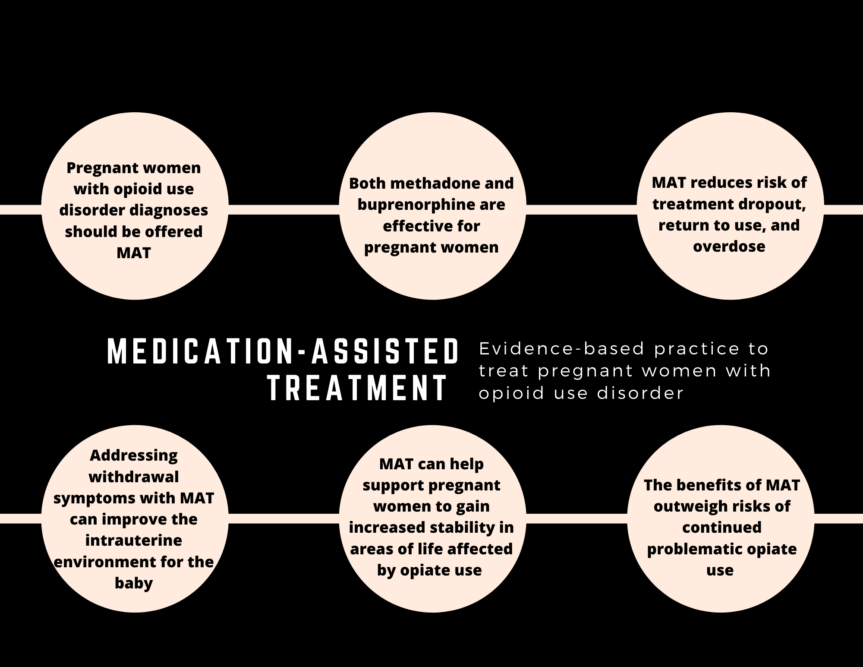
EBP – Medication-Assisted Treatment
Notes:
According to SAMHSA, pregnant women with opioid use disorder diagnoses should be offered medication-assisted treatment consisting of methadone or buprenorphine combined with behavioral interventions. Both methadone and buprenorphine have been found to be appropriate medication options to start or continue in pregnancy. MAT reduces the risk of treatment dropout, return to use, and overdose, as withdrawal symptoms are managed, resulting in an increased likelihood that the mother can abstain from illicit opiate use. Addressing withdrawals has benefits for the baby, as SAMHSA reports that it stabilizes the intrauterine environment of the baby since the mother’s experiences of withdrawal symptoms can be harmful for the baby. Being able to abstain from use through the stabilization of physical symptoms of addiction (such as withdrawals and cravings) allows a chance for the mother to regain a sense of normalcy in other areas of life, such as resuming engagement in role obligations negatively affected by substance use. Overall, pregnant women should be informed that the benefits of MAT outweigh the risks of continued illicit opiate use.
Substance Abuse and Mental Health Services Administration. Clinical Guidance for Treating Pregnant and Parenting Women With Opioid Use Disorder and Their Infants. HHS Publication No. (SMA) 18-5054. Rockville, MD: Substance Abuse and Mental Health Services Administration, 2018.

Slide 12
EBP – Residential Substance Use Treatment
Specific to Pregnant Women May Also Include:
Housing
OBGYN and prenatal treatment including MAT
Case management
Assistance with employment and/or education
Childcare and pediatric services
Evidence-based substance use treatment specific to pregnant and parenting women
https://www.voa.org/family-focused-treatment
Notes:
In a national effort to address the opioid epidemic, 19 states have either created or funded drug treatment programs specifically targeted to pregnant women. North Carolina being one of these states, it has developed the North Carolina Perinatal and Maternal Substance Abuse and CASAWORKS for Families Initiatives as a state-wide initiatve to address substance use with women and their families. It is comprised of 28 programs using evidence-based treatment models located in 13 counties across the state. Residential programs offer a structured and supervised environment for mother and children and includes:
https://search.proquest.com/docview/213809534?pq-origsite=gscholar

Slide 13
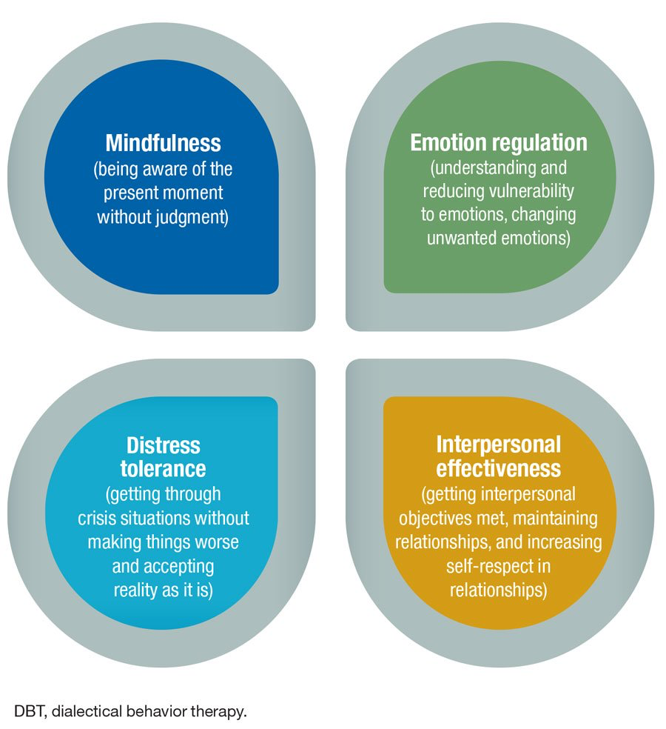
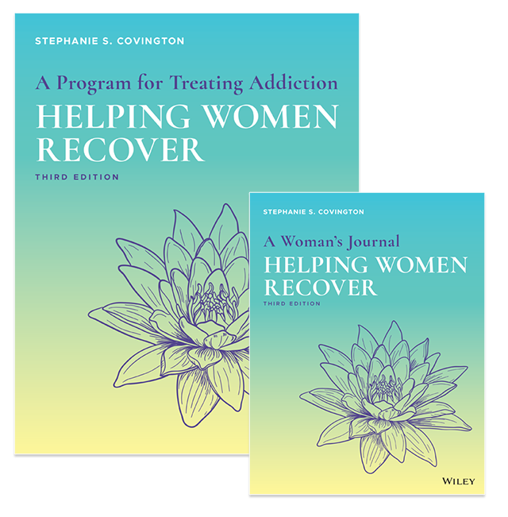
Evidence Based Practices for Substance Use Treatment
https://www.psychiatrictimes.com/special-reports/dialectical-behavior-therapy-skills-training-effective-intervention
https://www.stephaniecovington.com/books-and-curricula.php
Notes:
Evidence Based Practices that are researched and approved by the Substance Abuse and Mental Health Services Administration. These can be utilized in multiple levels of care
Dialectical Behavioral Therapy (DBT) is a form of cognitive behavioral therapy developed by Dr. Marsha Linehan originally developed for those with borderline personality disorder. Over time there has been adaptations to work with those with substance use disorders including skills groups, additional manuals, and integrating DBT into the 12 Steps. DBT covers ____.
It is also important to include treatment that is Gender-Specific and gender-responsive when working with pregnant women
Dr. Stephanie Covington is a leading clinician and researcher an expert on developing curriculum specific to the needs of women and men. Some of her treatment specific to women includes
Beyond Trauma - includes education on neuroscience and trauma and the connection between trauma, addiction, and interpersonal relationships.
Beyond Anger and Violence - for women struggling with anger as well as trauma experienced personally as well as in communities.
A Woman’s Way Through the 12 Steps - designed to be used in a residential or outpatient setting. This program explains each step from the 12 step program and describes women’s experiences
Helping Women Recover - an EBP that integrates women’s development, trauma and addiction. It discusses the Self, Relationships, Sexuality and Spirituality.

Slide 14
Considerations for Integrated Care
Integrated Care Teams should:
Be aware of personal biases and societal stigma
Provide patient-centered care that supports the autonomy of the mother and positive clinical outcomes for mother and baby.
Engage in advocacy for treatment/service and against the criminalization of addiction
Adopt the perspective that addiction is a chronic disease rather than a moral failure
Notes:
To provide effective integrated care to pregnant women who use opiates, it is important for the treatment team to be aware of the intricate ethical and legal implications that can arise. It is important to be mindful of the personal biases we may hold and to do work to combat our part in perpetuating the stigma against these mothers. This will support the provision of empathetic and nondiscriminatory care to ensure that mothers are being offered the appropriate care such as medication-assisted treatment. Patient-centered care should be provided to support the autonomy of the mother and positive clinical outcomes for the mother and baby to help mothers feel comfortable seeking and utilizing medical care during pregnancy. Providers should make sure to avoid having an “us versus them” mindset or trying to persuade mothers to engage in care through the use of negative judgment. Integrated teams should advocate in favor of access to appropriate treatment and services and against the criminalization of addiction in pregnancy. Lastly, providers should act from the perspective that addiction is a chronic, relapsing disease rather than a moral failure. Providers need to remember that mothers who use opiates are not looking to harm their children, as their continued use is a symptom of their opioid use disorder diagnoses.

Slide 15
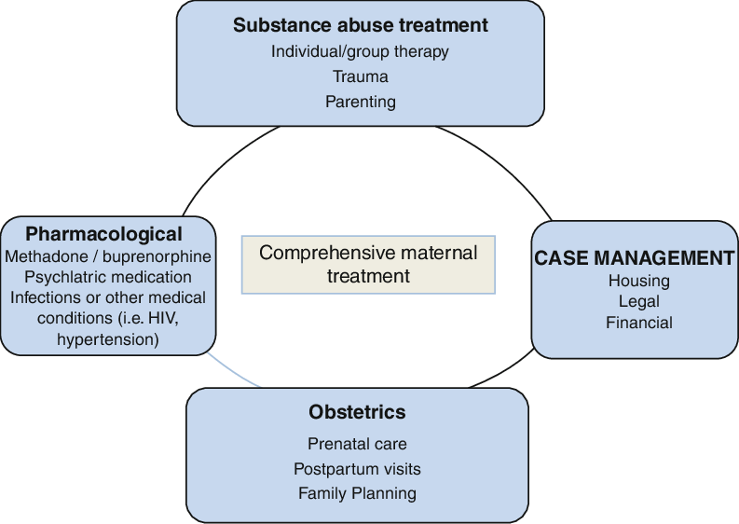
Considerations for Integrated Care
https://www.researchgate.net/figure/Comprehensive-treatment-of-the-substance-dependent-pregnant-woman-Treatment-of-the_fig3_300184533
Notes:
Integrated behavioral health care providers should address opioid use disorder among pregnant women with comprehensive maternal treatment that integrates obstetric care, pharmacological needs, substance use and mental health treatment, and case management. Integrated care has been shown to contribute to improved birth outcomes and sustained recovery for the mother. Obstetric care should consist of prenatal and postpartum care, as well as family planning options such as contraceptives after birth. Prenatal visits are often required more frequently, which allows for increased opportunities to have positive contacts to support the progression of the pregnancy and provide recovery support. Prenatal care providers should collaborate with substance use treatment providers, mental health professionals, and MAT/psychiatric medication prescribers, whether they are co-located or not. Additionally, the case management needs of the mothers need to be addressed, which can often be done by social workers on the integrated team. This includes helping mothers with housing, employment, financial, legal, transportation, food security, and other social service needs. All of these components should be conducted from a trauma-informed perspective, as many of the mothers with opioid use disorder have experienced various types of trauma that can affect their engagement with social services and medical, substance use, and mental health treatment.

Slide 16
Gaps Between Research and Practice in Integrated Care
Stigmatization among health care professionals
Lack of substance use training among all staff on integrated health care teams
Lack of provider comfort in treating opioid use in pregnancy
Not all staff are trauma-informed
https://www.educationnext.org/connecting-to-practice-put-education-research-to-work/
Notes:
While there are several clear recommendations and guidelines for treating pregnant women with opioid use disorder, there are gaps between the research and actual practice realities. Research has explained that addiction is a chronic disease, which should reduce stigma among providers; however, pregnant women continue to face stigma in the health care setting. Viewing pregnant women negatively can lead to providers giving them substandard care. Even if integrated health care providers do not have negative perceptions of this group, they may lack knowledge about substance use disorders. It is imperative that all members on an integrated team, from physicians to office staff, have an understanding of problematic substance use in pregnancy, which is not always the case. Many providers lack comfort in treating substance use disorders in pregnant women despite having clinical guidelines from organizations such as SAMHSA, ASAM, and ACOG. For example, while medication-assisted treatment is regarded as an evidence-based practice for addressing problematic opioid use among pregnant women, it is common for providers in obstetrics and gynecology to have not completed the waiver process to receive buprenorphine prescribing privileges. Lastly, research indicates the importance of trauma-informed care, as 50-80% of women with substance use disorders are thought to have experienced trauma (Johnson, 2019. However, many providers do not work from a sensitive, compassionate, and empathetic framework that would be indicative of trauma-informed care, which is concerning as it can continue to stigmatize pregnant women and make them feel unable to trust their medical team.

Slide 17
Case Study: Ideal
Jennifer is a 28 year old, Caucasian, cisgender female from rural North Carolina who has been using opioids for the past six years, intravenously for three. She realized she was pregnant 5 weeks prior and does not know how far along she is. After not being able to stop using drugs on her own, Jennifer goes to an integrated care clinic to check on the health of the fetus and get help addressing her substance use. She receives a pregnancy test, blood tests, drug screen, and the physician takes a medical and reproductive history. The physician introduces her to the behavioral social worker. The social worker discusses lifestyle, screens for safety and social needs, and does a brief substance use assessment as is standard protocol for all prenatal patients. Based on the screening, the social worker determines she is high risk and discusses with Jennifer that residential substance use treatment would be the best option. The social worker addresses Jennifer’s questions and concerns,, and they call a residential substance use center together to begin to admissions process. The social worker provides some psychoeducation about addiction, and MAT. The social worker lets her know that she will fax this information to the residential treatment center, and lets her know that she would like to follow up with her by next week to check in on the process of admitting to residential treatment and make sure she is okay. Jennifer feels like her concerns have been addressed, and that she is taking the next steps to better the health for her and her baby.

Slide 18
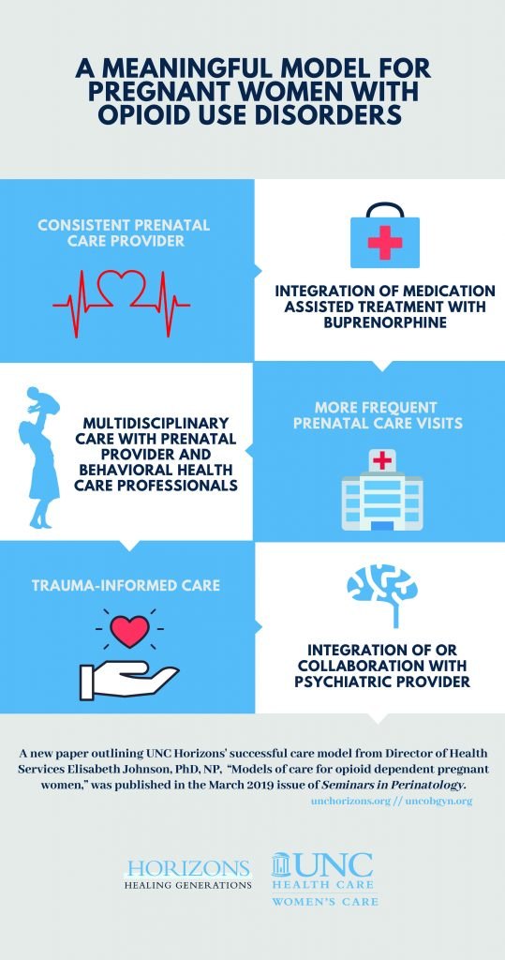
EXAMPLE OF effective INTEGRATED CARE: UNC HORIZONS
Continuum of Care
Interdisciplinary team of professionals
Prenatal care, MAT, coordination for pediatric and additional medical services
5-star daycare
Notes:
MD, Psychiatrist, Nurse Practioner, Nurses
Psychologist, Licensed Clinical Social Workers, Case Managers, Peer Support Specialist

Slide 19
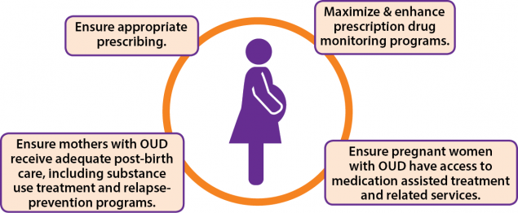
Recommendations for Improving Access
https://www.cdc.gov/reproductivehealth/maternalinfanthealth/substance-abuse/opioid-use-disorder-pregnancy/index.html
Notes:
Pregnant women and mothers using opioids may encounter additional barriers trying to access treatment.
Women may have childcare in order to attend treatment and need to bring children with them
Interpersonal relationships / financial dependence
Accessibility of MAT programs that will work with pregnant women
The CDC is currently implementing strategies to: For practices, if having a MAT provider or prenatal care is not feasible, accessibility can be improved by building partnerships with various agencies on the continuum of care to be able to make intentional referrals based upon their individual needs. By having awareness of evidence based treatment for women with opioid use disorders, practitioners can explain what options are available to their patients and help conenct them with the best treatment.

Slide 20
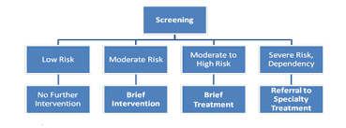
Recommendations for Improving Screening
https://youth.gov/collaboration-profiles/youth-substance-use/about-youthbuild-and-sbirt
Notes:
It is recommended that all prenatal clinics and health settings offering OB services should incorporate screenings for substance use. This should be done at every first prenatal visit and be universal.
SBIRT - include standardized screening (ie.
Benefits: reduces emergency room visits, preventative

Slide 21
Recommendations for Improving
Culturally Sensitive Care
Harm-Reduction Model
Universal Screenings
Addressing Stigma
Spreading Awareness and Education
Notes:
The stigma associated with SUD during pregnancy can serve as a significant barrier to providing care for a woman and her infant. Pregnant and parenting women may be reluctant to seek SUD treatment or seek prenatal and postpartum care, which are linked with improved maternal and infant health outcomes,98 due to the fear of criminal justice or child welfare involvement. The stigma among the provider community can lead to discrimination and further discourage women from receiving care. There is also a persistent stigma against MAT for pregnant women despite evidence that MAT improves maternal and infant outcomes.99
Universal screeening can reduce bias or stereotyping

Slide 22
Online Resources
Find the LME-LMO for your county. They provide telephone screenings, triage, and referral to treatment: http://www.ncdhhs.gov/mhddsas/lmeonblue.htm
NC Perinatal Substance Use Specialist at the Alcohol Drug Council of NC: 1-800-688-4232
Filter needs including Labor and Delivery Hospital, Prenatal Care, Opioid Treatment, etc. to find what treatment options are available in the area: https://ncpoep.org/services

Slide 23
References
Haight, S. C., Ko, J. Y., Tong, V. T., Bohm, M. K., &amp; Callaghan, W. M. (2018). Opioid Use Disorder Documented at Delivery Hospitalization — United States, 1999–2014. MMWR. Morbidity and Mortality Weekly Report, 67(31), 845-849.
Johnson, E. (2019). Models of care for opioid dependent pregnant women. Seminars in Perinatology, 43(3), 132-140.
Kremer, M. E. & Arora, K. S. (2015). Clinical, Ethical, and Legal Considerations in Pregnant Women With Opioid Abuse. Obstetrics & Gynecology, 126(3), 474–478. doi: 10.1097/AOG.0000000000000991.
Saunders, J. B., Jarlenski M. P., Levy, R., & Kozhimannil, K. B. (2018). Federal and state policy efforts to address maternal opioid misuse: Gaps and challenges. Women’s Health Issues, 28(2), 130-136.
Winkelman, T. N. A., Villapiano, N., Kozhimannil K. B., Davis, M. M., & Patrick, S. W., (2018). Incidence and costs of neonatal abstinence syndrome among infants with Medicaid: 2004-2014. Pediatrics, 141(4),. doi: 10.1542/peds.2017-3520.

Slide 24
References
The American College of Obstetricians and Gynecologists: https://www.acog.org/clinical/clinical-guidance/committee-opinion/articles/2017/08/opioid-use-and-opioid-use-disorder-in-pregnancy
American Society of Addiction Medicine: https://www.asam.org/asam-criteria/level-of-care-certification; https://www.asamcontinuum.org/knowledgebase/what-are-the-asam-levels-of-care/; https://www.asam.org/advocacy/find-a-policy-statement/view-policy-statement/public-policy-statements/2017/01/19/substance-use-misuse-and-use-disorders-during-and-following-pregnancy-with-an-emphasis-on-opioids
Centers for Disease Control and Prevention: https://www.cdc.gov/pregnancy/opioids/basics.html
Harvard Medical School: https://leanforward.hms.harvard.edu/2019/03/21/dispelling-common-myths-about-opioid-use-disorder-in-pregnancy/

Slide 25
References
National Institute on Drug Abuse: https://www.drugabuse.gov/publications/drugfacts/substance-use-in-women
Substance Abuse and Mental Health Services Adminstration: https://www.samhsa.gov/data/sites/default/files/NSDUH-DetTabs-2016/NSDUH-DetTabs-2016.pdf
National Academy for State Health Policy: https://nashp.org/wp-content/uploads/2018/10/NOSLO-Opioids-and-Women-Final.pdf
UNC Department of Obstetrics & Gynecology: https://www.med.unc.edu/obgyn/treating-women-with-opioid-use-disorders-during-pregnancy-requires-integrated-collaborative-care/

