Slide 1
Conversations about Cannabis Use with Patients Who Experience Anxiety and Depression
Martha Carter
Courtney Cheek
Anne Olivar
Leah Wolff
2019-2020 UNC PrimeCare-OUD
UNC School of Social Work

Slide 2
Etiology of Anxiety
Anxiety disorders vary from occasional anxiety in that the symptoms do not go away and can get worse over time, interfering with job performance, daily activities, and mental well being.
Some symptoms of generalized anxiety, which must be present almost everyday for at least 6 months for diagnosis, include:
Feelings of restlessness or being on-edge
Fatigue
Difficulty concentrating
Irritability
Muscle tension
Uncontrollable worry
Issues with sleep
Risk factors for anxiety include genetic and environmental factors such as:
Exposure to trauma, stressful or negative life events in childhood or adulthood
Family history of anxiety or other mental illnesses
Physical health conditions such as heart arrhythmias and thyroid issues
Substances such as caffeine or medication
Some examples of anxiety disorders include generalized anxiety disorder, panic disorder, and phobia-related disorders.
The National Institute of Mental Health Information Resource Center (2018). Anxiety Disorders. Retrieved from: https://www.nimh.nih.gov/health/topics/anxiety-disorders/index.shtml

Slide 3
Anxiety and Cannabis Use
Cannabis use disorder is highly comorbid with anxiety disorders
Evidence and findings vary, however mounting literature suggests:
Cannabis use is frequently associated with increased occurrence of anxiety disorders
Heavy cannabis use in particular may be linked to higher risk for anxiety disorders
Cannabis use and cannabis use disorders may be associated with clinically significant symptoms of anxiety
Individuals who regularly use cannabis and have an anxiety disorder reported more frequent mental-health related functional problems such as accomplishing less due to emotional problems and increased interference in social activities due to emotional problems
Social anxiety, in particular, may be linked to cannabis issues, and men with social anxiety are especially vulnerable to problematic cannabis use.
Shalit, & Lev-Ran, 2020; Kedzior, & Laeber, 2014; Buckner, Zvolensky, & Schmidt, 2012

Slide 4
Anxiety and Cannabis Use
Cannabis use disorder is highly comorbid with anxiety disorders
Use is associated with increased occurrence of anxiety disorder, but findings are not sustained when controlled for confounding variables
Some inconclusive evidence suggests heavy cannabis use leads to higher risk for anxiety disorders, but there is no clear, direct effect of use on treatment or outcomes of anxiety disorder.
Social anxiety is particularly linked to cannabis issues, but the association is still unclear
Data exists to suggest that men with social anxiety might be especially vulnerable to problematic cannabis use
Meta-analysis suggests association between cannabis use/use disorders and clinically significant symptoms of anxiety, however causation and causal direction is unclear
Shalit, & Lev-Ran, 2020; Kedzior, & Laeber, 2014; Buckner, Zvolensky, & Schmidt, 2012

Slide 5
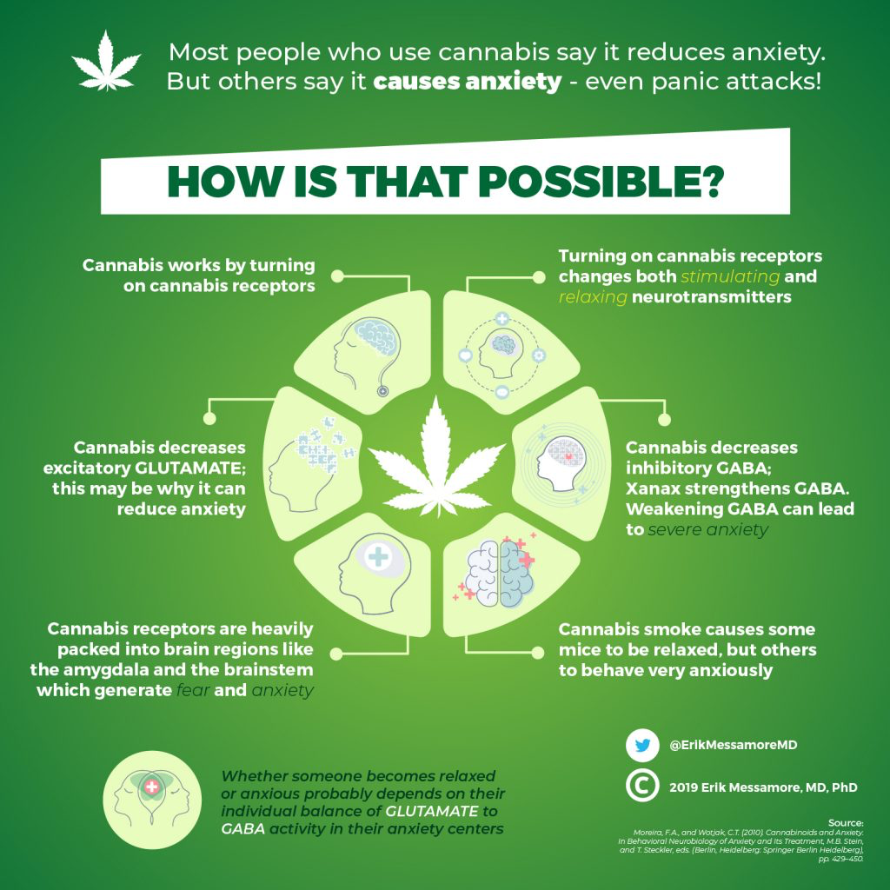
So does Cannabis cause or relieve Anxiety?
Can it be Both?
Cannabis has a paradoxical effect on patients.
Some people experience lowered levels of anxiety while using cannabis, while others report increase in anxiety
This is attributed to the activity of brain chemicals glutamate (stimulating brain chemical) and GABA (inhibitory brain chemical).
THC from cannabis affects both chemicals, and depending on whether the emotion center of the brain (the amygdala) is under control of glutamate or GABA results in reduction or increase of anxiety.
Messamore, E. (2020). Cannabis and anxiety. Retrieved from: https://erikmessamore.com/cannabis-and-anxiety/

Slide 6
Etiology of Depression
Fairly common but serious mood disorder affecting how one thinks, feels, and functions in daily activities such as sleeping, eating, and working.
For diagnosis, symptoms must be present nearly every day for at least 2 weeks.
Common symptoms include:
Persistent sad, empty mood
Hopelessness or pessimism
Irritability
Feelings of guilt or worthlessness
Loss of interest or pleasure in usual activities
Fatigue or decrease in energy
Difficulty concentrating or remembering
Changes in sleep
Changes in appetite
Thoughts of hurting oneself
Risk factors of depression include genetic, biological, environmental, and psychological factors.
Personal or family history
Major life changes, trauma, or stress
Physical illnesses
Medications
Various examples of depression disorders include major depressive disorder, persistent depressive disorder, postpartum depression, psychotic depression, and seasonal affective disorder.
The National Institute of Mental Health Information Resource Center (2018). Depression. Retrieved from: https://www.nimh.nih.gov/health/topics/depression/index.shtml

Slide 7
Depression and Cannabis Use
Cannabis use may lead to worsening of depression symptoms
There is evidence of a significant linear association between frequency of cannabis use and severity of depression, even after adjustment for confounding non-observed fixed factors
The strength of the adjusted association between cannabis use and depression varied with age
associations were strongest in mid-adolescence, and decrease to weak/negligible effects in mature adulthood
There may be a difference in gender experience of depression and cannabis use as women reported poorer mental health and quality of life outcomes in comparison to men
Aspis, I., Feingold, D., Weiser, M., Rehm, J., Shoval, G., & Lev-Ran, S. 2015; Bahorik, Leibowitz, Sterling, Travis, Weisner, & Satre, 2017, Hordwood, Fergusson, Coffey, Patton, Tait, Smart, Letcher, Silins, & Hutchinson, 2012

Slide 8
Prevalence & Patterns of Use
1-in-6 people who start using marijuana before the age of 18 can become addicted.
v e r s u s
1-in-10 adults who use marijuana can become addicted.
~9% of people who smoke marijuana will develop an addiction
NIDA. (2019, Dec 24). Marijuana. Retrieved from www.drugabuse.gov.publications/research-reports/marijuana
Lopez-Quintero, C., et al., Probability and predictors of transition from first use to dependence on nicotine, alcohol, cannabis, and cocaine: results of the National Epidemiologic Survey on Alcohol and Related Conditions (NESARC). Drug Alcohol Depend, 2011. 115(1-2): p. 120-30.; Hall, W. and L. Degenhardt, Adverse health effects of non-medical cannabis use. Lancet, 2009. 374(9698): p. 1383-91.

Slide 9
Entering Adulthood: Link between Mental & Substance Use Disorders?
8.8 million young adults reported having a mental illness
42% of those with mental illness went untreated
5.1 million young adults reported having a substance use disorder
87% of those with substance use disorders went untreated
While marijuana use has also been linked to depression and anxiety, and suicide among teens, it is not known whether this is a causal relationship or simply an association.
SAMHSA. https://www.samhsa.gov/young-adults; National Academies of Sciences, Engineering and Medicine, 2017.

Slide 10
Medicine or Recreation?
Cannabis as medicine can be inherently problematic due to the common method of delivery (largely smoking), no standardized dosage, and the well documented side effects of increased risk of psychosis and dependency.
Additionally, if cannabis is to be used as medication, it must reach higher standard of positive therapeutic effect (compared to lower bar set for recreational use), avoid serious side effects, and pass double blind clinical trial.
Alcohol and tobacco use can be viewed in similar category as recreational cannabis, with the creation of euphoric, pleasant intoxicating effect, and no immediate serious health issues in majority of users.
Newton-Howes & McBride, 2016.

Slide 11
Why do patients seek medical use of marijuana?
In a meta-analysis and systematic review of available research in 2019, the majority of patients reported seeking medical cannabis for pain (63%)
However, a large portion of individuals also sought prescriptions for their depressive (35%) and anxiety (52%) symptoms
Seeking cannabis prescriptions for depressive and anxiety symptoms could be problematic given that there is limited evidence available that points to marijuana having a positive long-term influence on mood symptoms or disorders
Van Ameringen, Zhang, Patterson, & Turna. 2020, Kosiba, Maisto, & Ditre, 2019

Slide 12
Disparities in access/Impact of criminalization
Who is benefiting from legalization?
Less than 1% of legal dispensaries are owned by people of color
Drug laws, that have historically targeted populations of color, have branded many people in these communities with criminal records
In some states where legalization has opened up cannabis industry as a viable business venture, licenses to start these businesses are barred from individuals with cannabis convictions or felony records.
Gandhi & Macrae, 2019
https://www.nbcnews.com/news/nbcblk/black-entrepreneurs-struggle-join-legal-weed-industry-n1132351

Slide 13
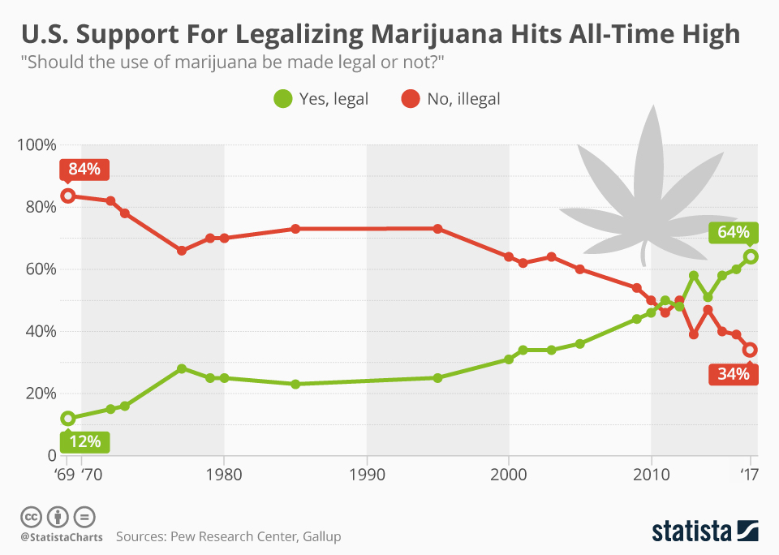
Current Opinions on Legalization in the US
More Americans than ever support legalization of marijuana.
The trajectory is similar to the support shown for legalization of same-sex marriage.
McCarthy, J. (2017). Record-high support for legalizing marijuana use in US. Gallup. Retrieved from: https://news.gallup.com/poll/221018/record-high-support-legalizing-marijuana.aspx
Graphic from https://www.statista.com/chart/6242/us-support-for-legalizing-marijuana-hits-all-time-high/

Slide 14
State of Current Practice/Provider Biases
“It is not as bad as some of the stuff you could be taking…”
Don’t Ask, Don’t Tell
”If we were in another state it would be legal…”
”Well I smoke so I don’t want to be a hypocrite…”

Slide 15
Is it My Business?
As a clinical social worker, YES!
As a provider, it is important to have the full picture and understanding of the client’s experience.
It is important to have an idea of how cannabis use might be affecting the client’s health, both physical and mental, as well as other aspects of their life, including legal, professional, and social implications.
Maintain unconditional positive regard and nonjudgmental stance, but also overcome provider discomfort to ask questions about cannabis and other substance use.
Provider will be missing an important factor in client’s life if neglectful or too uncomfortable to ask.

Slide 16
Things to Consider in an Integrated Care Setting:
Are you screening for cannabis use with all clients, no matter age, identity, religion etc?
Is your staff comfortable having ongoing conversations about cannabis use outside of initial assessment?
Can your staff identify cannabis use dependence and withdrawal symptoms?
Does your staff have the needed information to speak with their clients about recreational and habitual use?
What is your referral process/resources for SUDs, particularly cannabis use?
Lack of Standardization for THC levels...Rising potency of marijuana
https://www.cdc.gov/marijuana/fact-sheets.htm

Slide 17
Suggestions for Decreasing Cannabis Use Risks
Avoid daily or near daily use of cannabis, if possible limit use to once per week
This may not be achievable for all, but a reduction in use may decrease adverse effects for patients
Postpone onset of use of cannabis, particularly frequent and intensive use, as use before 18 is associated with increased for dependence and later problem outcomes including depressive symptoms
Use products with lower THC content as higher THC content is associated with higher risks
This may be harder to achieve in states that have no legal access to cannabis products
Consider individual genetic predisposition and/or current condition
A first-degree family history of psychosis and/or substance disorder increases risk associated with use
Cannabis use while pregnant is connected to adverse birth outcomes (eg: anemia and decreased birth weight)
Fischer et al., 2017

Slide 18
Recommendations/Guidelines
-Allow space for conversations about habitual and recreational use of cannabis (outside of screening and assessment)
-Clinicians should assess for cannabis use especially when working with individuals with anxiety disorders and co-occurring mood disorders
-Frequency of use important to assess, as some evidence points to regular cannabis use (as opposed to occasional use) lead to poorer mental health outcomes on quality of life measurements
-Know some facts:
CDC Fact Sheets- In English/Spanish:
What You Need to Know About Marijuana Use and Pregnancy
What You Need to Know About Marijuana Use and Driving
What You Need to Know About Marijuana Use and Teens
Ottawa Public Health Fact Sheet:
Cannabis: Information for Older Adults and Caregivers

Slide 19
References
Aspis, I., Feingold, D., Weiser, M., Rehm, J., Shoval, G., & Lev-Ran, S. (2015). Cannabis use and mental health-related quality of life among individuals with depressive disorders. Psychiatry Research, 230(2), 341–349. doi: 10.1016/j.psychres.2015.09.014
Bahorik, A. L., Leibowitz, A., Sterling, S. A., Travis, A., Weisner, C., & Satre, D. D. (2017). Patterns of marijuana use among psychiatry patients with depression and its impact on recovery. Journal of Affective Disorders, 213, 168–171. doi: 10.1016/j.jad.2017.02.016
Buckner, J. D., Zvolensky, M. J., & Schmidt, N. B. (2012). Cannabis-related impairment and social anxiety: The roles of gender and cannabis use motives. Addictive Behaviors, 37(11), 1294-1297. doi: https://doi.org/10.1016/j.addbeh.2012.06.013
Charles, N. (2020, February 11). Black entrepreneurs struggle to join legal weed industry. NBC News. Retrieved from: https://www.nbcnews.com/news/nbcblk/black-entrepreneurs-struggle-join-legal-weed-industry-n1132351
Fischer, B., Russell, C., Sabioni, P., Brink, W. V. D., Foll, B. L., Hall, W., … Room, R. (2017). Lower-Risk Cannabis Use Guidelines: A Comprehensive Update of Evidence and Recommendations. American Journal of Public Health, 107(8), 1277–1277. doi: 10.2105/ajph.2017.303818a
Gandhi, V., Macrae, A. (Producers), & Fab 5 Freddy (Director). (2019). Grass is Greener [Documentary]. United States: Netflix.
Hall, W. and L. Degenhardt. (2009). Adverse health effects of non-medical cannabis use. Lancet . 374(9698): p. 1383-91.
Hordwood, J. L., Fergusson, D. M., Coffey, C., Patton, G. C., Tait, R., Smart, D., Letcher, P., Silins, E., Hutchinson, D. M. (2012). Cannabis and depression: An integrative data analysis of four Australasian cohorts. Drug and Alcohol Dependence, 126 (3), 369-378. doi: https://doi.org/10.1016/j.drugalcdep.2012.06.002
Kedzior, K.K., Laeber, L.T.(2014) A positive association between anxiety disorders and cannabis use or cannabis use disorders in the general population- a meta-analysis of 31 studies. BMC Psychiatry 14, 136 . https://doi-org.libproxy.lib.unc.edu/10.1186/1471-244X-14-136

Slide 20
References
Kosiba, J. D., Maisto, S. A., & Ditre, J. W. (2019). Patient-reported use of medical cannabis for pain, anxiety, and depression symptoms: Systematic review and meta-analysis. Social Science & Medicine, 233, 181–192. doi: 10.1016/j.socscimed.2019.06.005
Lev-Ran, S., Roerecke, M., Foll, B. L., George, T. P., Mckenzie, K., & Rehm, J. (2013). The association between cannabis use and depression: a systematic review and meta-analysis of longitudinal studies. Psychological Medicine, 44(4), 797–810. doi: 10.1017/s0033291713001438
Lopez-Quintero, C., et al. (2011). Probability and predictors of transition from first use to dependence on nicotine, alcohol, cannabis, and cocaine: results of the National Epidemiologic Survey on Alcohol and Related Conditions (NESARC). Drug Alcohol Depend. 115(1-2): p. 120-30.
McCarthy, J. (2017). Record-high support for legalizing marijuana use in US. Gallup. Retrieved from: https://news.gallup.com/poll/221018/record-high-support-legalizing-marijuana.aspx
Messamore, E. (2020). Cannabis and anxiety. Retrieved from: https://erikmessamore.com/cannabis-and-anxiety/
Newton-Howes, G., & McBride, S. (2016). Medicinal cannabis: Moving the debate forward. The New Zealand Medical Journal (Online), 129(1445), 103-109,7. Retrieved from http://libproxy.lib.unc.edu/login?url=https://search-proquest-com.libproxy.lib.unc.edu/docview/1844659618?accountid=14244
National Academies of Sciences E, and Medicine. (2017). The health effects of cannabis and cannabinoids: Current state of evidence and recommendations for research. Washington, D.C.
NIDA. (2019, December 24). Marijuana. Retrieved from https://www.drugabuse.gov/publications/research-reports/marijuana on 2020, March 25

Slide 21
References
Ottawa Public Health. (n.d.). Cannabis: Information for Older Adults and Caregivers. [Fact Sheet]. Retreived from https://www.ottawapublichealth.ca/en/professionals-and-partners/resources/Documents/EN-Factsheet-Cannabis-Info-for-Older-Adults--Caregivers-.pdf
Shalit, N. & Lev-Ran, S. (2020). Does cannabis use increase anxiety disorders? A literature review. Current Opinion in Psychiatry, 33(1), 8–13. doi: 10.1097/YCO.0000000000000560.
The National Institute of Mental Health Information Resource Center (2018). Depression. Retrieved from: https://www.nimh.nih.gov/health/topics/depression/index.shtml
Van Ameringen, M. , Zhang, J. , Patterson, B. & Turna, J. (2020). The role of cannabis in treating anxiety. Current Opinion in Psychiatry, 33(1), 1–7. doi: 10.1097/YCO.0000000000000566.
Volkow ND, Swanson JM, Evins AE, et al. (2016). Effects of cannabis use on human behavior, including cognition, motivation, and psychosis: a review. JAMA Psychiatry. 73(3):292-297. doi:10.1001/jamapsychiatry.2015.3278.

Slide 22
This project was supported by the Health Resources and Services Administration (HRSA) of the U.S. Department of Health and Human Services (HHS), Behavioral Health Workforce Education and Training (BHWET) Program under M01HP31370, UNC-PrimeCare, $1,920,000.00, or the Opioid Workforce Expansion Program -- Professional, under T98HP33425, UNC-PrimeCare-OUD, $1,350,000. Both programs are 100% financed with governmental sources. This information or content and conclusions are those of the author/s and should not be construed as the official position or policy of, nor should any endorsements be inferred by HRSA, HHS or the U.S. Government.
Notes:
***Thank you script? Other capstones seem to have it on this slide***

