Slide 1
More Than Just Baby Blues: Postpartum Depression
Essence Hairston & Johanna Contreras

Slide 2
According to the Diagnostic Statistical Manual-5 (DSM-5), postpartum depression is when depressive episodes start within four weeks surrounding birth.
Notes:
There is no separate diagnosis for postpartum depression in the DSM-5. The diagnosis of depression during the postpartum period uses the “with peripartum onset,” which is defined as the most recent episode occurring within four weeks following delivery.

Slide 3
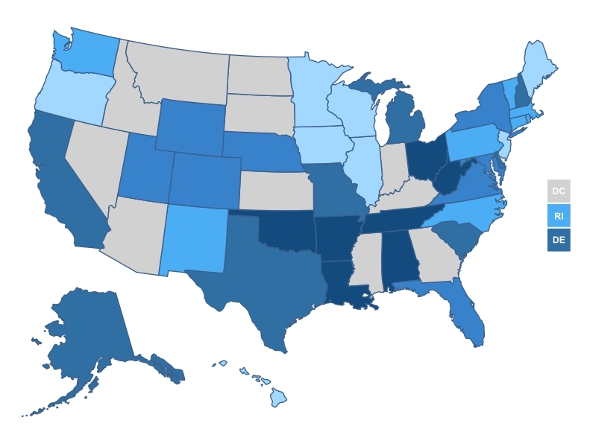
Prevalence
Percentage of Women with a Recent Live Birth who Reported Experiencing Postpartum Depression Symptoms in the U.S. in 2018
<= 9.9%
10.0% - 11.4%
11.5% - 12.4%
12.5% - 14.7%
>= 14.8%
No Data
Notes:
1 in 9 women experience symptoms of postpartum depression. Symptoms can begin at birth or anytime within the first year of giving birth. The states with the highest rates of women with a recent live birth who reported postpartum depression symptoms in 2018 include Ohio, West Virginia, Tennessee, Alabama, Oklahoma, Arkansas, and Louisiana.

Slide 4
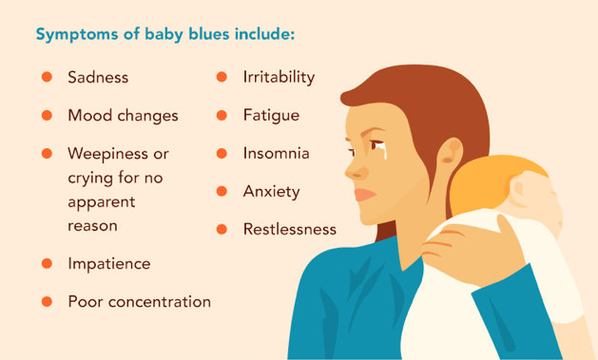
Signs & Symptoms of Baby Blues
Notes:
The postpartum blues, which affects up to 80% of mothers, usually get better within a few days or within 1-2 weeks without any treatment and do not cause any major impairment in daily functioning. Babies require a lot of care, so it is common and normal for a mother to feel worried about providing that care or tired from providing that care.

Slide 5
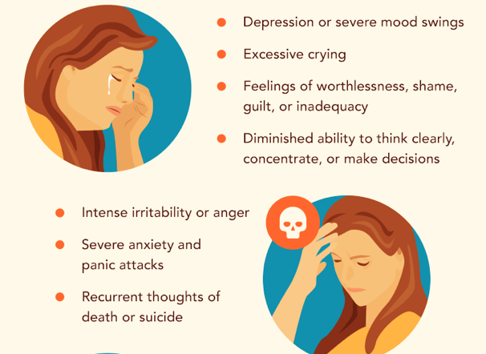
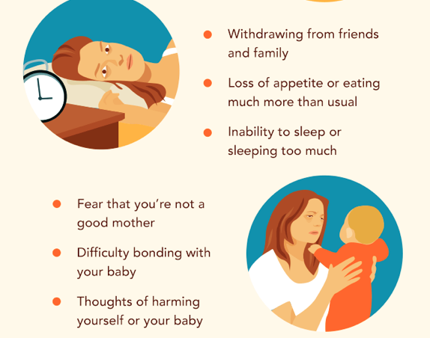
Signs & Symptoms of Postpartum Depression
Notes:
With postpartum depression, symptoms can be severe and interfere with a mother’s daily functioning and ability to care for herself and her child.

Slide 6
How to Know Clinically When Symptoms are More than Just the Baby Blues
There are two evidence-based measurement tools that can screen, monitor, and assess for postpartum depression:
The Edinburgh Postnatal Depression Screen (EPDS)
Patient Health Questionnaire - 9 (PHQ-9)
Notes:
It is not uncommon for individuals to confuse baby blues with postpartum depression. This is why it is important for health care providers to administer screenings and provide ongoing assessment of behavioral and emotional changes.

Slide 7
Screening: Edinburgh Postnatal Depression Scale
It is a self-report questionnaire
Includes specific questions for depressive symptoms during the perinatal period.
It is also being used to screen for depression at any time during pregnancy.
The tool can only be used in a setting that is equipped with providers, psychosocial support staff, and trained professionals that can assist the individual with managing the test scores.

Slide 8
Screening: Patient Healthcare Questionnaire - 9
The PHQ-9 is a self-administered tool that incorporates the criteria of depression in the Diagnostic and Statistic Manual (DSM-5) and used to screen for postnatal depression
It is a reliable and valid measurement tool for assessing the severity of depression
There are ten statements specific for depressive symptoms.
The tool monitors the duration and frequency of suicidal ideation within the last two weeks.

Slide 9
Risk Factors
History of mood disorder prior to pregnancy or in a previous pregnancy
Alcohol or substance misuse
Stressful life events
Low income
Single marital status
Lack of social supports
Unwanted or unplanned pregnancy
Notes:
There is not sufficient evidence in research that demonstrates differences in race/ethnicity among women who have PPD. However studies show that there are racial/ethnic disparities in quality of treatment and in initiation and continuation of treatment. Although we know that postpartum depression does not discriminate against individuals and any woman can develop it, we do know that individuals that are exposed to environmental stress, medicaid-insured women, individuals residing in rural communities, and women with social and economic disadvantages are at greater risk for developing postpartum depression.

Slide 10
Postpartum Depression can have adverse impacts on the family:
Increase marital stress
Insecure attachment and bonding
Feelings of hopelessness
Disconnection from older children and loved ones
Notes:
Postpartum depression impacts the individual, their loved ones, and friends. It can increase tension and frustration that can lead to adverse effects on the family unit.

Slide 11
Effects of Postpartum Depression on the Baby
The literature shows that maternal depression can negatively impact an infant’s development. Studies show that maternal depression can contribute to:
Irritability
Excessive crying
Difficulty soothing the infant
Notes:
Research states that the mother-child dyad is connected. The literature posits that babies are able to feel love and comfort from their mother; similarly babies can also sense worry and sadness and inherent discomfort from the mother as well.

Slide 12
Can Men develop Postpartum Depression?
Yes!
“Every day, over 1,000 new dads in the United States become depressed. And according to some studies, that number is as high 2,700. That’s 1 in 10 to as many 1 in 4 new dads who have postpartum depression.”
-PostpartumMen
Notes:
Recently, doctors have started to screen fathers as well using this same Edinburgh postnatal depression scale (EPDS) questionnaire. Early identification of depressed fathers helps in accessing support and treatment so that they can remain present and positively involved with their family.
New demands and responsibilities during pregnancy and the postpartum period often cause major changes in a father's life, too. It's important to understand what risk factors can affect the development of depression.
Difficulty developing an attachment with the baby
Lack of a good male role model
Lack of social support or help from family and friends
Changes in marital relationship, such as a partner's lack of intimacy
Feeling excluded and jealous over mother-child bonding
Lack of rewards in parenting
Maternal depression
Financial and work stress
Low testosterone

Slide 13
Notes:
Mental Health Matters! According to Health Resources and Services Administration (HRSA), one or two in 1000 individuals suffer from postpartum psychosis due to untreated postpartum depression.
Women who have a bipolar disorder or other psychiatric problem may have a higher risk for developing this form of Perinatal Depression. Symptoms of Postpartum Psychosis may include:
• Extreme confusion
• Hopelessness
• Cannot sleep (even when exhausted)
• Refusing to eat
• Distrusting other people
• Seeing things or hearing voices that are not there
• Thoughts of hurting themselves, their baby, or others

Slide 14
Treatment: Psychotherapy
Three of the most common types of psychotherapy treatment for managing depression symptoms are:
Cognitive Behavioral Therapy
Interpersonal Therapy
Psychodynamic Therapy

Slide 15
Treatment: Pharmacotherapy
Studies have shown that antidepressant medications like serotonin-reuptake inhibitors (SSRIs) are effective for treating postpartum depression:
Fluoxetine
Sertraline
Also, serotonin-norepinephrine reuptake inhibitor (SNRI) medications have shown promising outcomes:
Venlafaxine
“When my doctor suggested taking medicine, I wasn’t sure. But it turned out to be the best decision for me. I feel so much better now.”
Notes:
Research has shown that medication can assist with managing postpartum depression symptoms. Also, medications like Fluoxetine, Sertraline, and Venlafaxine have also been prescribed during breastfeeding

Slide 16
United States Legislation
The Melanie Blocker Stokes MOTHERS Act of 2009
The MOTHERS Act and the Affordable Care Act of 2010
Bringing Postpartum Depression out of the Shadows Act of 2015
Notes:
Unfortunately, little progress has been made to address postpartum depression in the United States. In 2009, the HOR passed the Melanie Blocker Stokes MOTHERS Act which provided funds for research, screening, and support services for those suffering with PPD. In 2010, the Affordable Care Act adopted the MOTHERS Act and it extended and mandated that ongoing research takes place to fully understand and address postpartum depression amongst racial and ethnic groups and implement culturally-aware evidence-based interventions and programs. However, congress has failed to disperse the funds. In 2015, Bringing Postpartum Depression out of the Shadows Act was introduced. The bill is intended to build on current interventions by issuing federal funds to develop programs. As of today, the bill is currently still in review status.

Slide 17
Implications Moving Forward
Screen and assess both parents for postpartum depression symptoms.
Provide psychoeducation and treatment resources to individuals at-risk for developing postpartum depression.
Implement culturally-sensitive treatment models.
Recognize the cultural aspects of racial and ethnic groups that may prevent individuals to seek care.
Bridge the gap of literature on postpartum depression amongst racial and ethnic groups and communities.
Advocate for healthcare reform that supports the management of postpartum depression symptoms.
Notes:
Postpartum Depression is a family illness and screening and assessments must be applied to both parents.

Slide 18
References
American College of Obstetricians and Gynecologists. (2013). FAQ’s postpartum depression. Washington, DC: American College of Obstetricians and Gynecologists. Retrieved from: https://www.acog.org/Patients/FAQs/Postpartum-Depression?IsMobileSet=false
America's Health Rankings analysis of CDC, Pregnancy Risk Assessment Monitoring System; California Department of Public Health, Maternal and Infant Health Assessment, United Health Foundation, AmericasHealthRankings.org, Accessed 2019. Retrieved from: https://www.americashealthrankings.org/explore/health-of-women-and-children/measure/postpartum_depression/state/ALL
H.R.3235 - Bringing Postpartum out of the Shadows Act of 2015, 114th congr., 1st session. (2015 - 2016).
Kim, D. R., Epperson, C. N., Weiss, A. R., & Wisner, K. L. (2014). Pharmacotherapy of postpartum depression: an update. Expert opinion on pharmacotherapy, 15(9), 1223–1234. doi:10.1517/14656566.2014.911842
Kozhimannil, K. B., Trinacty, C. M., Busch, A. B., Huskamp, H. A., & Adams, A. S. (2011). Racial and ethnic disparities in postpartum depression care among low-income women. Psychiatric services (Washington, D.C.), 62(6), 619–625. doi:10.1176/ps.62.6.pss6206_0619
Kroenke, K., Spitzer, R. L., & Williams, J. B. (2001). The PHQ-9: validity of a brief depression severity measure. Journal of general internal medicine, 16(9), 606–613. doi:10.1046/j.1525-1497.2001.016009606.x
Musser, Anna K., MS, RN, CPNP, Ahmed, Azza H., DNS, RN, IBCLC, PNP, Foli, Karen J., MSN, PhD, RN, & Coddington, Jennifer A., DNP, MSN, RN, CPNP. (2013). Paternal postpartum depression: What health care providers should know.Journal of Pediatric Health Care, 27(6), 479-485. doi:10.1016/j.pedhc.2012.10.001
PostpartumMen. Retrieved from: http://postpartummen.com

Slide 19
References
Nicole Lyn Letourneau, Cindy-Lee Dennis, Karen Benzies, Linda Duffett-Leger, Miriam Stewart, Panagiota D. Tryphonopoulos, Dave Este & William Watson (2012) Postpartum Depression is a Family Affair: Addressing the Impact on Mothers, Fathers, and Children, Issues in Mental Health Nursing, 33:7, 445-457, DOI: 10.3109/01612840.2012.673054
Oberlander TF, Rotem-Kohavi N. Post-Partum Depression and Infant Crying Behaviour. In: Tremblay RE, Boivin M, Peters RDeV, eds. Encyclopedia on Early Childhood Development[online]. http://www.child-encyclopedia.com/crying-behaviour/according-experts/post-partum-depression-and-infant-crying-behaviour. Updated March 2017. Accessed April 4, 2019.
Postpartum Support International. (copyright 2019). U.S national legislative action. Retrieved from: https://www.postpartum.net/professionals/legislation/
Schuetze P, Zeskind PS. Relations between women’s depressive symptoms and perceptions of infant distress signals varying in pitch. Infancy.2001;2(4):483-499. doi:10.1207/S15327078IN0204_06
U.S Department of Health and Human Services-HRSA. (2006, November). Depression during and after pregnancy. Rockville, MD. Retrieved from:https://mchb.hrsa.gov/sites/default/files/mchb/MaternalChildHealthTopics/maternal-womens-health/Depression_During_and_After_Pregnancy_ENGLISH.pdf
World Health Organization. (copyright 2019). Maternal mental health. Retrieved from: https://www.who.int/mental_health/maternal-child/maternal_mental_health/en/

