Slide 1
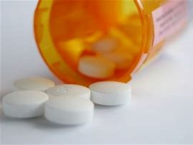
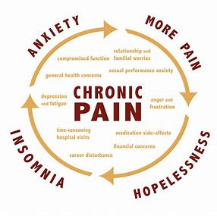
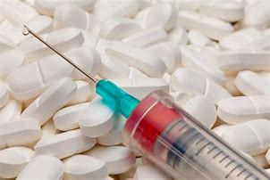
Integrated Care for the Treatment of Chronic Pain and Opioid Use Disorder
Notes:
This presentation will focus on the import role of integrated care in the treatment of chronic pain and opioid use disorder. We will discuss the challenges and guidelines for treating chronic pain, criteria for the diagnosis of opioid use disorder, and treatment options available in our nation and in the state of North Carolina.

Slide 2
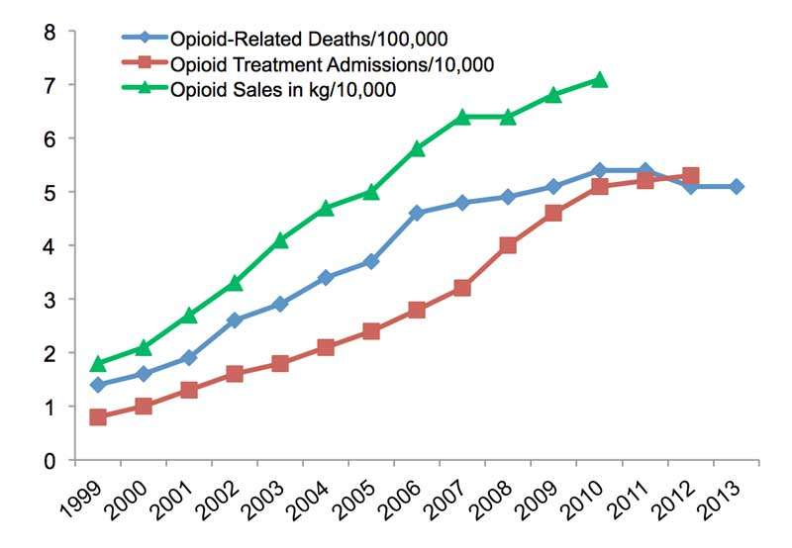
DEFINING THE PROBLEM – THE OPIOID EPIDEMIC
From 1999 to 2017, nearly 400,000 people have died from an opioid related death.
In 2016, more than 11.5 million people reported misuse of prescription opioid pain medicine.
Source: National Institute on Drug Abuse, 2017
Notes:
The opioid epidemic is believed to be a pharmacologically driven crisis stemming from a sharp increase in opioid prescriptions beginning in 1990s and continuing to this day. From 1999 to 2017, nearly 400,000 Americans have died from an opioid related deaths. While opioid prescriptions began to level off in 2012, we still see a higher than normal rate of opioid prescriptions. In 2016, more than 11 and a half million people in the United States reported misuse of prescription opioid pain medication.

Slide 3
Source: Centers for Disease Control, 2018
Notes:
The first wave began with increased prescribing of opioids in the 1990s ³, with overdose deaths involving prescription opioids (natural and semi-synthetic opioids and methadone) increasing since at least 1999.
The second wave began in 2010, with rapid increases in overdose deaths involving heroin.
The third wave began in 2013, with significant increases in overdose deaths involving synthetic opioids – particularly those involving illicitly-manufactured fentanyl (IMF). The IMF market continues to change, and IMF can be found in combination with heroin, counterfeit pills, and cocaine. ^{2,4}

Slide 4
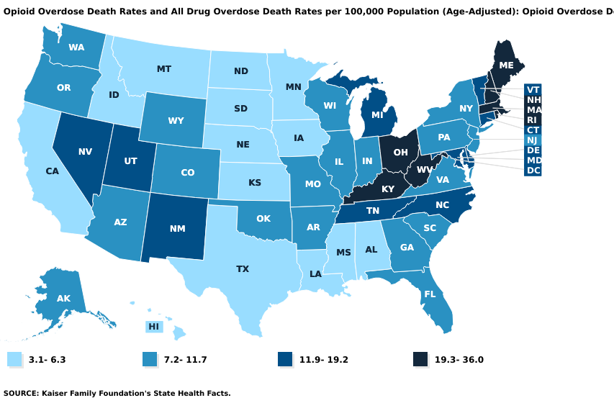
Notes:
In 2015, states with the highest drug overdose death rates include: West Virginia, Kentucky, Ohio, New Hampshire, Massachusetts and Rhode Island. But many other states have been challenged with the growing number of opioid related deaths.

Slide 5
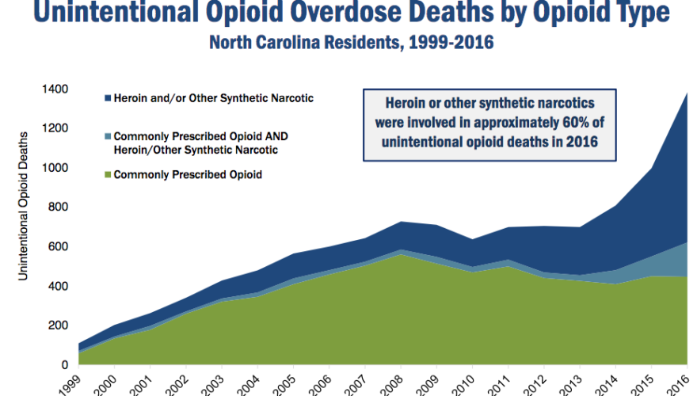
Source: North Carolina Department of Health and Human Services, 2018
Notes:
From 1999 to 2016, more than 12,000 North Carolinians died from opioid-related deaths. • the CDC estimates, the cost of unintentional opioid-related overdose deaths in N.C. totaled $1.3 billion in 2015. •

Slide 6
Source: North Carolina Department of Health and Human Services, 2017
Notes:
Many of the counties impacted are in rural areas where rising rates of unemployment, have contributed to increasing risk factors of poverty, financial stress, and depression. Industrial restructuring, or loss of manufacturing jobs can be especially difficult in working class families where work is an important aspect of identity.

Slide 7
GUIDELINES FOR TREATING PAIN IN PRIMARY CARE
Source: Centers for Disease Control, 2018
Notes:
In 2018, the Centers for Disease Control issued guidelines for providers in primary care settings on how to address the continuing crisis. These guidelines are not intended for patients in active treatment for cancer, palliative care, or end of life care. The first recommendation is that opioids should not be the first line of therapy.
Studies have found that patients are at risk of dependence if opioid prescriptions last more than 3 to 5 days.. #3 Discuss Risk and Benefits
Before starting and periodically during opioid therapy, clinicians should discuss with patients known risks and realistic benefits of opioid therapy and patient and clinician responsibilities for managing therapy.

Slide 8
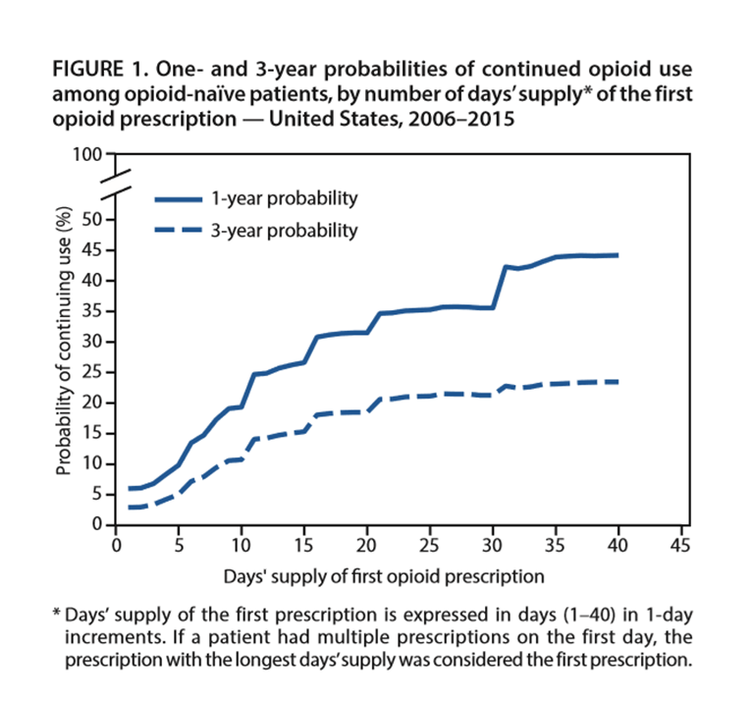
GUIDELINES FOR TREATING PAIN IN PRIMARY CARE
Source: Centers for Disease Control, 2018
Notes:
Other clinical reminders are to avoid using extended-release or long acting opioids as studies have shown an increased risk of dependence on those medications. Physicians are advised to prescribe the lowest effective dosage and carefully reassess evidence of individual benefits and risks; Physicians should prescribe no greater quantity than needed for expected duration. Three days or less should be sufficient for acute pain. Studies have shown a that patients who use prescription opioids for more than three days are more likely to become long-term users and that a sharp increase in probability occurs after the fifth and 31st day of therapy.
Clinicians should also evaluate benefits and harms of continued therapy within 1 to 4 weeks of starting opioid theraphy

Slide 9
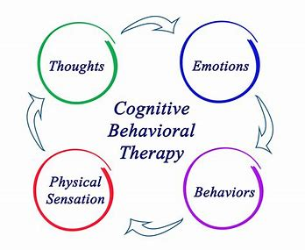
NON-OPIOID THERAPIES
Non-opioid medications (NSAIDS, TCAs, SNRIs, anti-convulsants, )
Physical therapy (exercise, weight loss)
Behavioral treatment (CBT, mindfulness, etc.)
Procedures (intra-articular corticosteroids, acupuncture)
Source: Centers for Disease Control, 2018
Notes:
It is recommended that physicians use non-opioid therapies for pain when possible. Non-opioid medications such as ibuprofen and naproxen as well as, anti-depressants, and anti-convulsants have been shown to be particularly effective in treating pain. Other therapies include Physical therapy, behavioral treatment and steroidal injections and acupuncture. There is evidence that Cognitive Behavioral Therapy (CBT) works better than taking pain medication long-term for chronic pain treatment. Cognitive Behavioral Therapy (CBT) is a form of psychotherapy that addresses the ways our thoughts contribute to our feelings and awareness of external forces such as chronic pain. Cognitive Behavioral Therapy (CBT) therapists believe that by changing the way you think, you can change how you feel and act.

Slide 10
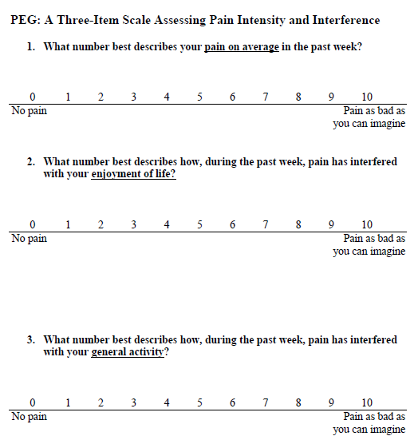
CDC CHECKLIST: ASSESSMENT FOR PAIN
The PEG score, like most other screening instruments, is most useful in tracking changes over time. The PEG score should decrease over time after therapy has begun.
PEG Scale
Sources: Centers for Disease Control, 2018
Notes:
Other suggestions for primary care physicians are to assess for pain and function. If the score does not decrease over time, physicians should help patients determine alternative therapies. The video includes a dramatization of how physicians should use the scale to assess for pain. To download a copy of the scale, click on the link below the video.

Slide 11
EVALUATING RISK OF HARM
Known risk factors:
Illegal drug use; using prescription drugs for nonmedical reasons;
History of substance use disorder or overdose
Mental health conditions (eg, depression, anxiety)
Sleep-disordered breathing
Benzodiazepine use
Urine drug testing: Check to confirm presence of prescribed substances and illicit substance use.
Prescription drug monitoring Program (PDMP): check for opioids or benzodiazepines
Source: Centers for Disease Control, 2018
Notes:
When evaluating for the risk of opiate use disorder, clinicians should consider the following risk factors. Illegal drug use, history of substance use disorder or overdose, co-occurring disorders such as depression or anxiety, sleep-disordered breathing or benzodiazepine use. Urine drug testing is very important and can minimize the risk of overdose. Prescription drug monitoring programs are also important resources clinicians should use to monitoring patients.

Slide 12
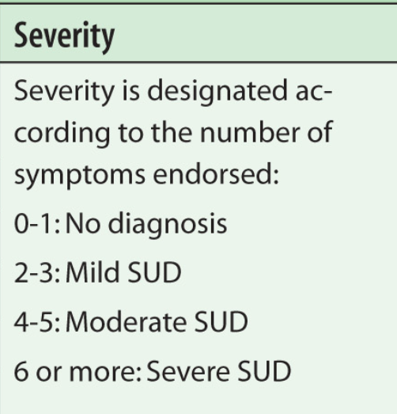
SOURCE: BREZNIG & BISAGA, 2015
Notes:
Patients who have been prescribed long-term opioid medications should be evaluated for opioid use disorder. The follow criteria from the DSM-5 should be considered.

Slide 13
Evidence Based Treatment of Opioid Use Disorder
Medication- Assisted Treatment (MAT)
Buprenorphine (partial opioid agonist)
Methadone (opioid agonist)
Naltrexone (opioid antagonist or blocker)
Inpatient Treatment:
Residential
Long-term or extended treatment
Therapeutic communities (sober living, recovery housing)
Source: National Institute on Drug Addiction (NIDA)
Notes:
recommended treatment for opiate use disorder includes but is not limited to medication-assisted treatment, residential treatment, long-term or extended treatment, and therapeutic communities. Click on the link below to get a full list of recommendations for treatment as outlined by the National Institute on Drug Addiction

Slide 14
TREATMENT FOR OPIATE USE DISORDER
Substance Abuse and Mental Health Services Administration
Notes:
If your client shows interest in getting treatment, SAMHSA has a treatment locator that allows you to search for treatment facilities in local settings. You can access this by clicking on the link below the image.

Slide 15
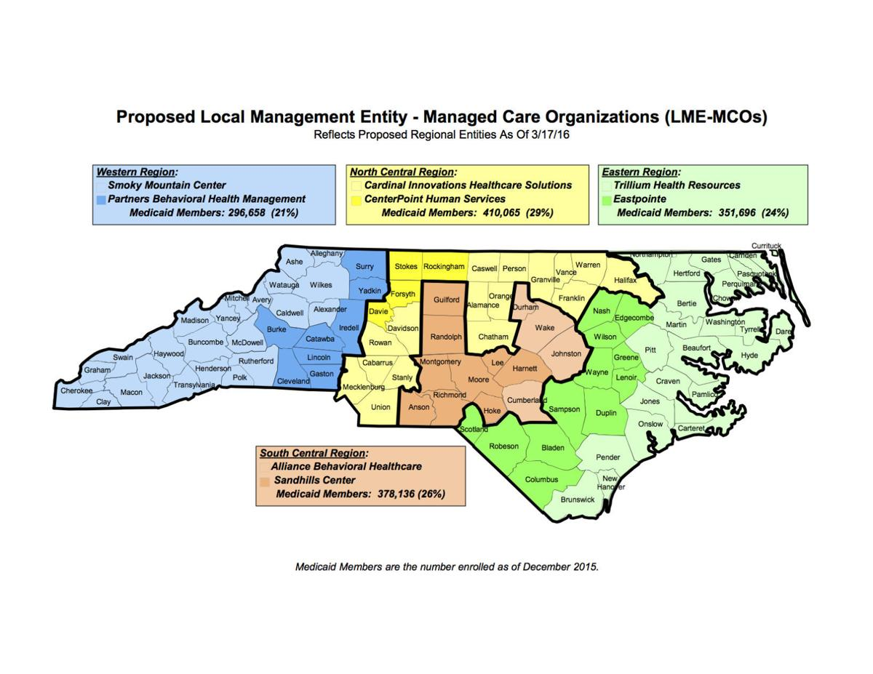
Managed Care in North Carolina
https://www.ncdhhs.gov/providers/lme-mco-directory
Notes:
If your patient does not have insurance, check with your state and local Managed Care organization. This map outlines the providers in four regions of North Carolina. You can access updated information by clicking on the link.

Slide 16
This project was supported by the Health Resources and Services Administration (HRSA) of the U.S. Department of Health and Human Services (HHS) under M01HP31370, UNC-PrimeCare, $1,920,000.00, 100% financed with governmental sources. This information or content and conclusions are those of the author and should not be construed as the official position or policy of, nor should any endorsements be inferred by HRSA, HHS or the U.S. Government.

Slide 17
References
Breznig, C. & Bisaga, A. (2015) “Opioid Use Disorder: Update on Diagnosis and Treatment” Psychiatric Times.Volume 32: Issue 4.
Centers for Disease Control and Prevention. 2018 Annual Surveillance Report of Drug-Related Risks and Outcomes Centers for Disease Control and Prevention, U.S. Department of Health and Human Services. Published August 31, 2018.
Centers for Disease Control and Prevention (2018). “Drug overdose deaths.” Retrieved from: https://www.cdc.gov/drugoverdose/data/statedeaths.html
Centers for Disease Control and Prevention (2018). “Understanding the epidemic” Retrieved from:
https://www.cdc.gov/drugoverdose/epidemic/index.html
Krebs, E.E., Lorenz, K.A., Blair, M.J., et al. (2009). Development and initial validation of the PEG, a three-item scale assessing pain intensity and interference. Journal of General Internal Medicine, 24: 733-738

Slide 18
References
North Carolina Department of Health and Human Services (2017). “Opioid overdose factsheet.” https://files.nc.gov/ncdhhs/Opioid_Overdose_Factsheet_FINAL_06_27_17.pdf
North Carolina Department of Health and Human Services (2019).”Proposed local management entity-managed care organization (LME-MCO) map” Retrieved from:
https://www.ncdhhs.gov/providers/lme-mco-directory
National Institute on Drug Addiction (2019). Treatment approaches for drug addiction.” Retrieved from:
https://www.drugabuse.gov/publications/drugfacts/treatment-approaches-drug-addiction
Substance Abuse and Mental Health Services Administration (2019). “Behavioral health treatment services locator.” Retrieved from:https://findtreatment.samhsa.gov/locator

