Slide 1
The gap between behavioral health assessment and intervention with children and adolescents
Gabi Johnson & Colleen Culley

Slide 2
Disparities
Children/adolescents face significant gaps in accessing behavioral health services. The general prevalence of mental health conditions among young people is known, however, the rates at which they are identified do not match such. Furthermore, many of those who are identified do not get adequate treatment (Perrin, 2018).
We have seen a major gap between assessing for underlying behavioral health concerns in places of primary care/specialty care and the follow through of providing or referring to treatment. This leaves countless youth without adequate care and at risk for increased physical complaints and clinic visits.

Slide 3
Why should you care?
“North Carolina has been ‘reinventing’ its mental health system for the better part of the past 20 years. In an effort to get better result for less money, we’ve managed to achieve neither”
From 2012-2015, NC decreased behavioral health spending each year, one of only 3 states to do so. In 2017, NC had half the national average number of beds, leaving a great deal of mental health patients waiting for care.
“These kids belong to us all. They have names. They are ill and they need access to our health system if they hope to ever live any kind of meaningful life. They are the lonely, lost, last, least and left out. But they are beautiful. And they deserve better.”
(Maddalon, 2017).
Notes:
In an editorial from the Charlotte Observer. Billy Maddalon, therapeutic foster parent, 2017

Slide 4
Why else?
It adds up
Children/adolescents with mental health disorder are more likely to rely on costly services, including juvenile detention, residential treatment, and emergency rooms
It affects academic success
Up to 44% of youth with mental health disorders dropout of high school
Children with mental health concerns miss as many as 18-22 days of school in one school year
Children with mental health problems are suspended and/or expelled at a rate 3x higher than peers
(Stagman & Cooper, 2010)

Slide 5
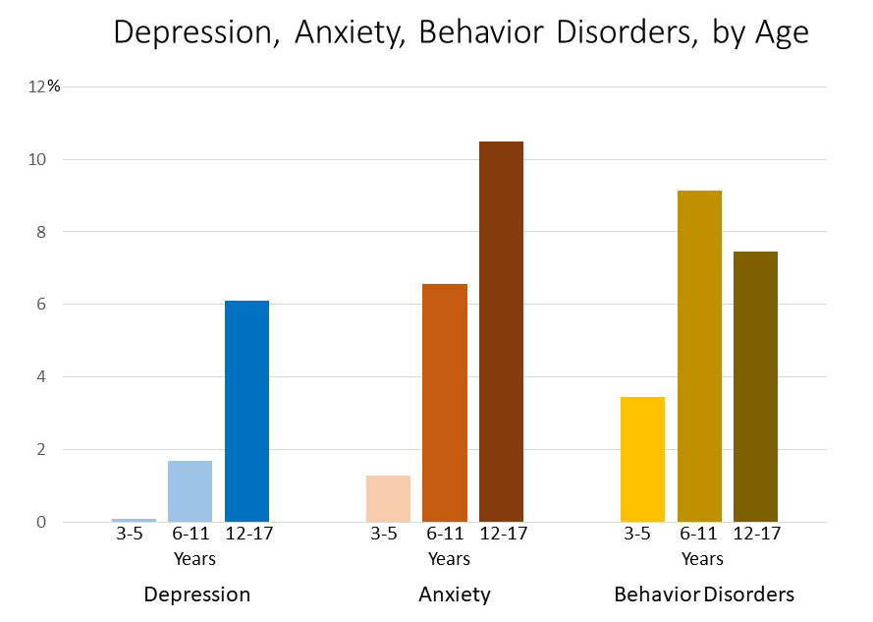
The facts
1 in 5 children have a diagnosable mental health disorder
1 in 10 have a mental health problem severe enough to impair their functioning at home, in school, or in the community
About half of all lifetime mental health disorders start by age 14
(Stagman & Cooper, 2010)
Image taken from: CDC

Slide 6
Risk Factors
Low socioeconomic households
21% percent of low-income children and youth ages 6 to 17 have mental health problems
57% percent of those children and youth with mental health problems come from households living at or below the federal poverty level
Involvement in the child welfare system
57% of children and youth in the child welfare system have mental health problems.
Involvement in the juvenile justice system
67-70% of children/adolescents in the juvenile justice system have a diagnosable mental health disorder.
Risk factors like these should be identified and addressed in early years.
(Stagman & Cooper, 2010)

Slide 7
Current Evidence-Based Practice Recommendations
Onsite Behavioral Health Care for Pediatrics/Family Medicine
Reduces the time between assessment & intervention
Exam room brief behavioral health intervention (BHI)
Increased access to therapy (reducing financial & transportation barriers)
Integrated teams: Social Workers, Primary Care Physicians, Psychiatrists, Nurses, & Staff
Increased communication between PCPs & Social Work for BHI
Warm hand-offs
Regular follow-up appointments
Regular integrated team rounds for case discussions
Electronic Medical Records (EMR)
Image from: Children and Youth Service Network

Slide 8
Evidence-Based Treatment Options
Evidence-Based Treatment Options for Children
Applied Behavior Analysis
Behavior Therapy
Cognitive Behavioral Therapy (CBT)
Cognitive Therapy
Family Therapy
Interpersonal Psychotherapy
Organization Training
Brief Therapy Options
Solution-Focused Brief Therapy (SFBT) ~3-5 sessions Image from: Catalyst Counseling
Brief CBT ~4-8 sessions
(Society of Clinical Child & Adolescent Psychology) (Mignogna, 2014)

Slide 9
Integrated Care Settings’ Role
Reduce barriers to behavioral health care
Financial: lower copays
Transportation: free/cheaper options for transportation as well as onsite BHC
Stigma: Increased normalization of mental health at site (posters, pamphlets, screening, etc)
Aided with warm hand-off
Appointment reminders to reduce high no-show rates
Lower patient to staff ratio to reduce employee burnout and patient wait times

Slide 10
Gaps Between Recommendations & Reality
High patient to BHC provider ratio
Low funding for onsite BHC
High no-show rates
Barriers
Financial, transportation, or stigma
Patients with severe depression may have difficulty with motivation
Language barrier

Slide 11
Actual Practice Example
Lincoln Community Health Center
Integrated Care Teams
Social worker/case manager for each department
Behavioral Health Care Unit (outpatient therapy)
Brief therapy available ~3-6 sessions
Refer out for long-term therapy
Warm-Handoffs for BHI in exam rooms
Free transportation
Sliding scale co-pays
Onsite and telephone Interpreters

Slide 12
Recommendations: Screening
Screening is an important component of uncovering a variety of concerns. We recommend using evidence-based screening tools, approved for youth, such as:
Revised Child Anxiety and Depression Screen (RCADS)
Child Behavior Checklist
Screen for Childhood Anxiety Related Emotional Disorders (SCARED)
NICHQ Vanderbilt Assessment Scales
Children’s Yale-Brown Obsessive Compulsive Scale (CY-BOCS)
Patient Health Questionnaire - 9 modified for adolescents (PHQ - A)
At the UNC Diagnostic clinic these screenings have been largely effective at identifying underlying behavioral health concerns. It is important to have a conversation with the family after reviewing the results, providing psychoeducation on what the child/adolescent’s score indicates.
Notes:
In presentation, note the ages/grades approved for and what it assesses

Slide 13
Recommendations: Improving access
By incorporating behavioral health professionals into the primary care and speciality care workforce, access to treatment could be greatly improved. This is already seen at Lincoln Community Health Center. Simply screening is not enough. We recommend on site behavioral health care in these pediatric settings.
We also recommend advocating for Medicaid Expansion in NC as such would improve access to behavioral health services for many uninsured youth (Gruessner, 2016). Additionally, we encourage further advocacy for the state to apply for Section 115 waivers.

Slide 14
Improving access continued
Why Medicaid Expansion?
This would allow those with incomes at or below 138% of the federal poverty level to be eligible for Medicaid. Many of those who fall within this current gap may struggle with mental illness, leaving them without access to affordable treatment.
In 2015, the Department of Health and Human Services reported that 1.9 million people without health insurance and suffering from a behavioral health condition lived in a state that did not expand Medicaid (such as NC). All of these people would become eligible for Medicaid if expansion occurred (Gruessner, n.d.)
115 Waiver
States, such as NC, that have not expanded Medicaid, can apply for this waiver. If NC does expand, the waiver can still be applied for.
This may allow coverage for services such as Assertive Community Treatment (ACT) and psychiatric rehabilitation
This waiver allows for what the National Alliance on Mental Illness terms “adequate mental health services and supports” which is vital to recovery (NAMI, n.d.)
(NAMI, n.d.)

Slide 15
Recommendations: Culturally-sensitive care
It is important to keep in mind the different world view any client may have. This is particularly notable in minority youth. This can include varied norms, beliefs, and values that contribute to the structure and meaning of one’s life. Great diversity exists both among and within any minority group, these may include: spirituality, interdependence, collectivism, gender roles that differ from the dominant norm, and nonlinear understandings of time.
Interventions are most commonly researched among White Americans. We recommend seeking and even publishing, when possible, research that can contribute to the development of EBPs for minority youth
(Hodge, Jackson, & Vaughn, 2010)
Notes:
”

Slide 16
Culturally-sensitive care continued
Engage with the community to gain their support of the interventions being used, so that they can see them as valuing their culture.
Notice and utilize the strengths within that culture in your interventions.
Hodge, Jackson, and Vaughn’s (2010) meta-analysis of culturally sensitive interventions for youth found little evidence to support the viewpoint that adapting existing interventions can be detrimental. With this in mind, we suggest that interventions be appropriately adapted to incorporate the values of the culture one’s client is from when no existing intervention specifically tested among that group exists.

Slide 17
References
Centers for Disease Control and Prevention (n.d.). “Data and Statistics on Children's Mental Health.” Retrieved from www.cdc.gov/childrensmentalhealth/data.html
Effective Child Therapies-Society of Clinical Child & Adolescent Psychology. (n.d.). Retrieved from https://effectivechildtherapy.org/therapies/
Gruessner, V. (2016, March 29). How Medicaid Expansion Improves Behavioral Health Access. Retrieved from https://healthpayerintelligence.com/news/how-medicaid-expansion-improves-behavioral-healthcare-access
Hodge, D. R., Jackson, K. F & Vaughn, M. G. (2010). Culturally sensitive interventions and health and behavioral health youth outcomes: A meta-analytic review. Social Work in Health Care, 49, 401–423. doi: 10.1080/00981381003648398
Maddalon, B. (2017, Oct 1).What’s happening to my children is a North Carolina tragedy. The Charlotte Observer. Retrieved from https://www.charlotteobserver.com/opinion/editorials/article176221961.html

Slide 18
References continued
Mignogna, J., Hundt, N. E., Kauth, M. R., Kunik, M. E., Sorocco, K. H., Naik, A. D., . . . Cully, J. A. (2014). Implementing brief cognitive behavioral therapy in primary care: A pilot study. Translational Behavioral Medicine,4(2), 175-183. doi:10.1007/s13142-013-0248-6
National Alliance on Mental Illness. (n.d.). Medicaid Expansion. Retrieved from https://www.nami.org/Learn-More/Mental-Health-Public-Policy/Medicaid-Expansion
Perrin, J. M. (2018). Can mental health parity help address the mental/behavioral gap in child health? Pediatrics, 142 (2). doi: 10.1542/peds.2018-1572
Stagman, S. & Cooper, J. L. (2010). Children’s Mental Health: What Every Policymaker Should Know. New York, NY: National Center for Children in Poverty. Retrieved from http://www.nccp.org/publications/pdf/text_929.pdf

Slide 19
This project was supported by the Health Resources and Services Administration (HRSA) of the U.S. Department of Health and Human Services (HHS) under M01HP31370, UNC-PrimeCare, $1,920,000.00, 100% financed with governmental sources. This information or content and conclusions are those of the author and should not be construed as the official position or policy of, nor should any endorsements be inferred by HRSA, HHS or the U.S. Government.

